Slide 1
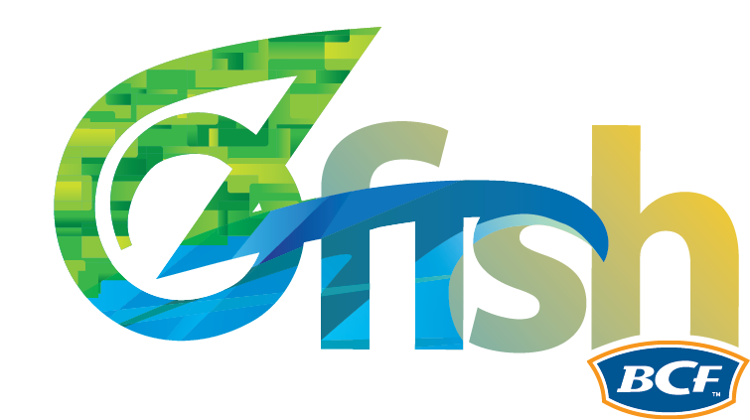
OzFishers + Carp
Carp Action Summit
Cassie Price, CEO

Slide 2
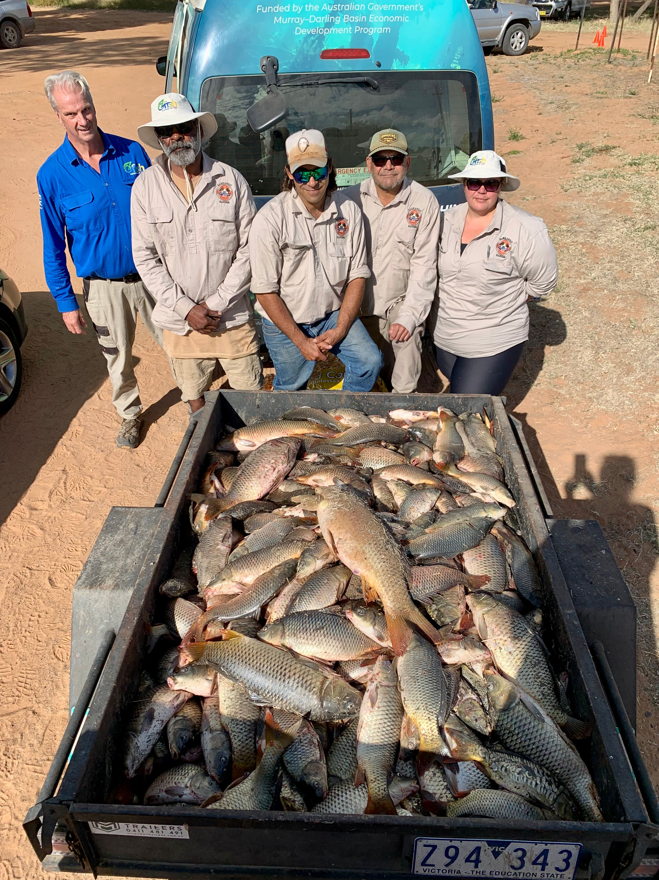
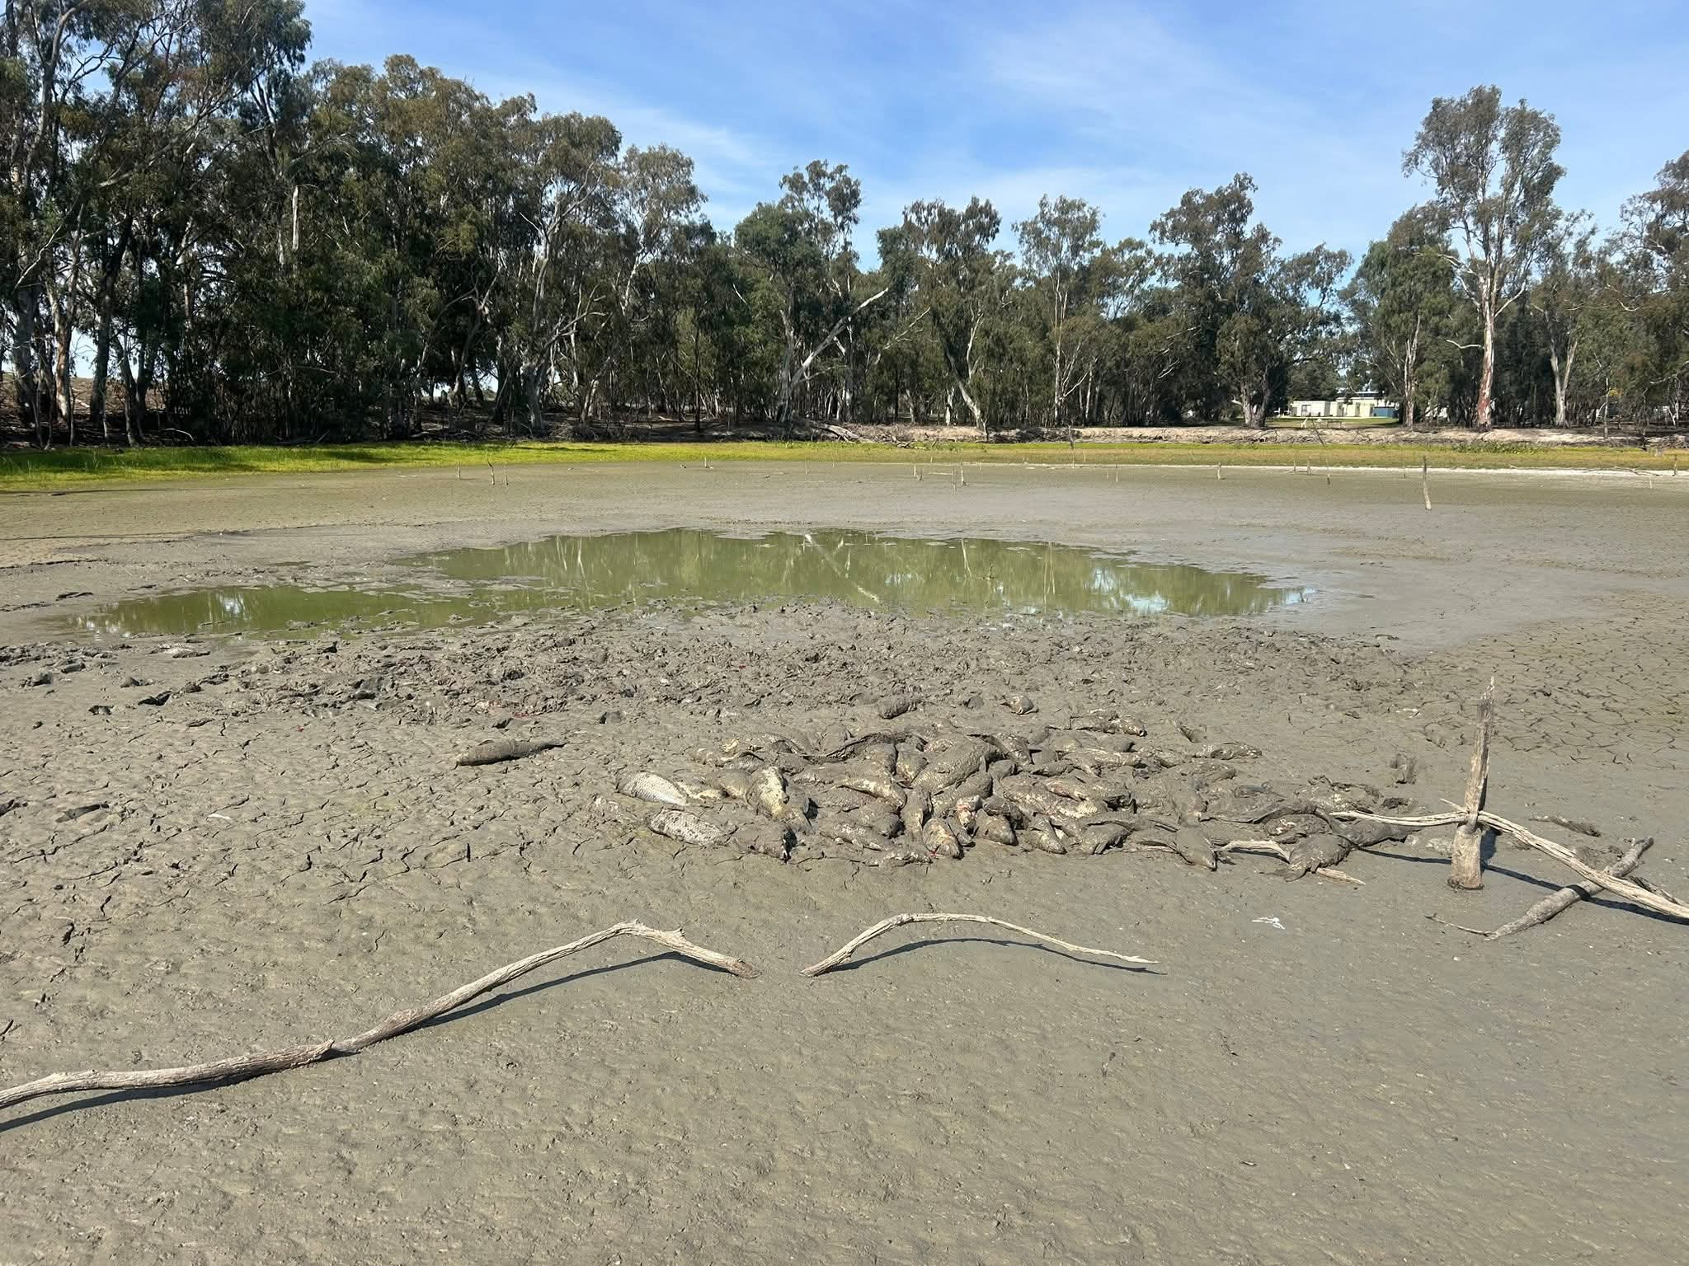
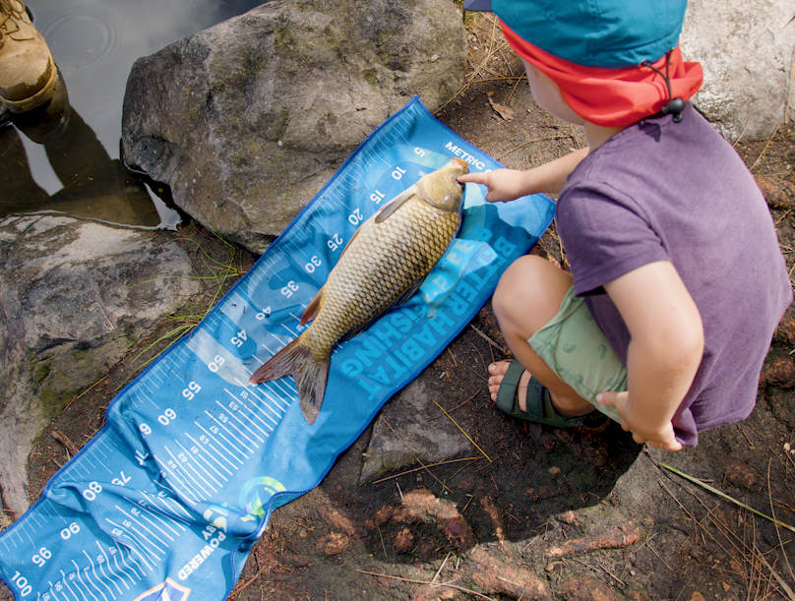
What OzFishers are seeing
Increased Non-native Fish
Non-native species like carp dominate waterways, reducing the presence of iconic native fish in many waterways.
Increased interest in carp-muster events in some areas, simply because of numbers.
Decline of Native Species
Native fish populations largely still in decline, despite over a decade of waterway improvements.
Environmental Changes Observed
Fishers report muddier water, fewer aquatic plants, and changing/damaged banks across multiple waterways.
Value of Fishers' Observations
Fishers’ lived experiences provide top quality data, all anecdotal so far, but we’re starting to collect the information more formally – more on that later.
Notes:
Firstly, OzFish is a national non-profit who brings opportunities to fishers to restore their local waterways, addressing impacts just like carp with good science and fish habitat restoration.
For many recreational fishers, the story of non-native fish is not theoretical; it is personal and practical. People who have fished the same rivers and dams for decades often describe clear changes over time.
Let's be clear, carp are a symptom of unhealthy rivers, rivers that have favorable conditions for carp, and not for our natives. And that’s entirely evident in the continual decline in native species, even after a decade or more of restoration efforts – the carp are still coming out on top.
We’ve seen a sharp uptick in requests for carp muster style events, born out of the increase in carp numbers, and the sheer desperation of fishers to ‘do something’ to be part of the solution for their local rivers.
Fishers also notice changes beyond fish themselves, including muddier water, fewer aquatic plants, and altered bank conditions. These lived experiences are valuable data and we’re now collecting that in a more formal way (more on that later). When combined with scientific monitoring, they help build a clearer picture of what is happening at scale.

Slide 3
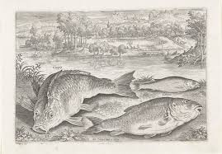
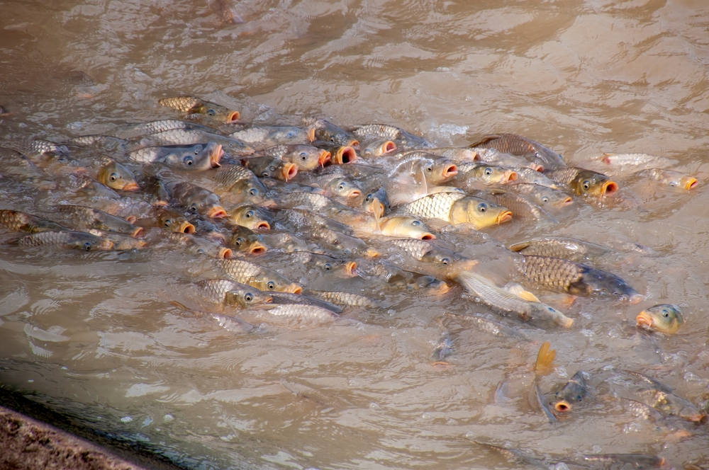
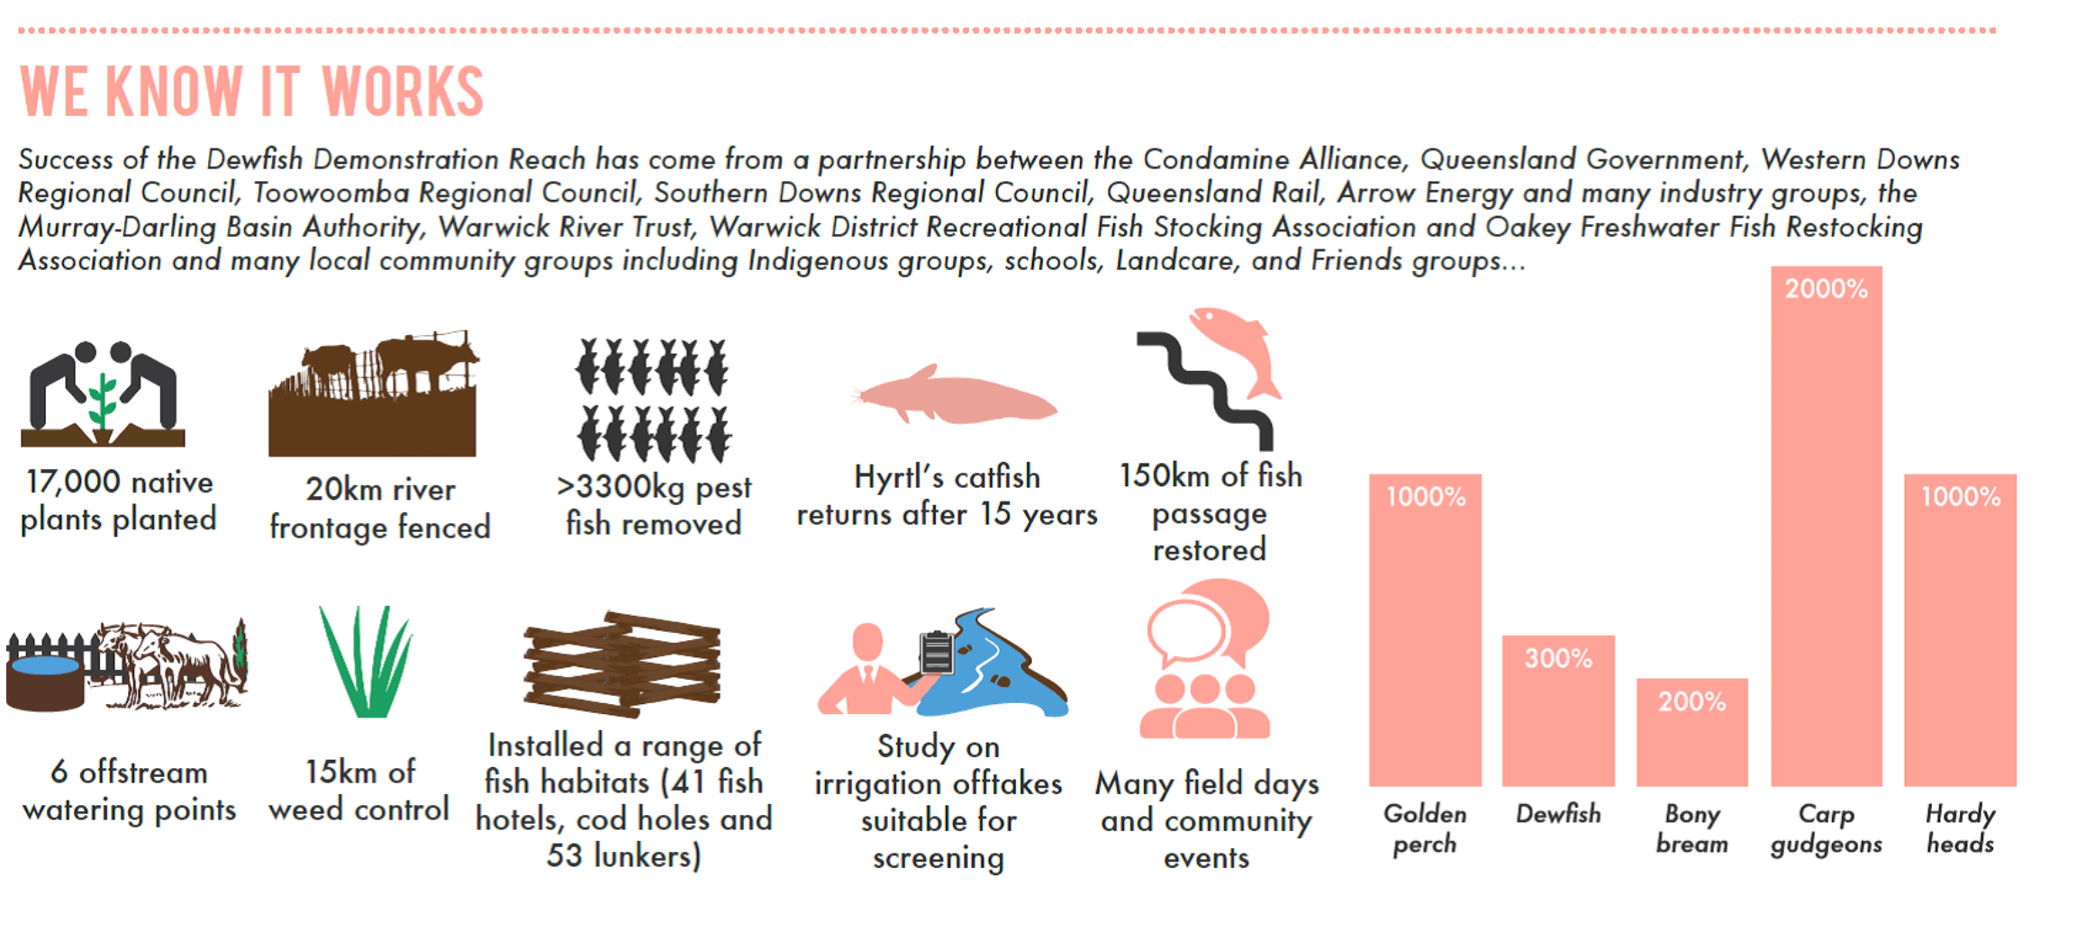

3-phases of Carp
THEN: Initial Carp Introduction
Carp introduced in the 1800s initially had limited distribution and largely failed to compete and establish.
NOW: Carp Boom + River Degradation
River regulation and pollution shifted conditions, enabling carp to dominate native species. Floods exacerbate issue.
NEXT: Restoration and Hope
Greatly reducing carp numbers, and restoring river health can reduce carp dominance and support native fish recovery and competition.
Notes:
For fishers, I think it boils down to 3-phases for Carp in Australia,
One of the most powerful stories in discussions about non-native fish is the historical failure of carp to immediately dominate Australian waterways. Carp were introduced in the 1800s, yet for many decades they remained relatively limited in distribution and abundance. This often surprises people, given how widespread carp are today. The key reason lies in the condition of rivers at the time. Many waterways were healthier, with more natural flows, intact habitats, and better water quality. These conditions limited carp success and allowed native species to hold their ground. As rivers became increasingly modified through regulation, land clearing, and pollution, the balance shifted. Carp did not suddenly become more aggressive or intelligent; the environment simply became more suitable for them. This lesson is important because it counters the idea that carp dominance is inevitable or irreversible. It shows that when rivers function well, non-native fish struggle to gain a foothold. For a public audience, this historical context provides hope and reinforces the value of restoration. If degradation helped carp succeed, then recovery can help native fish return.

Slide 4
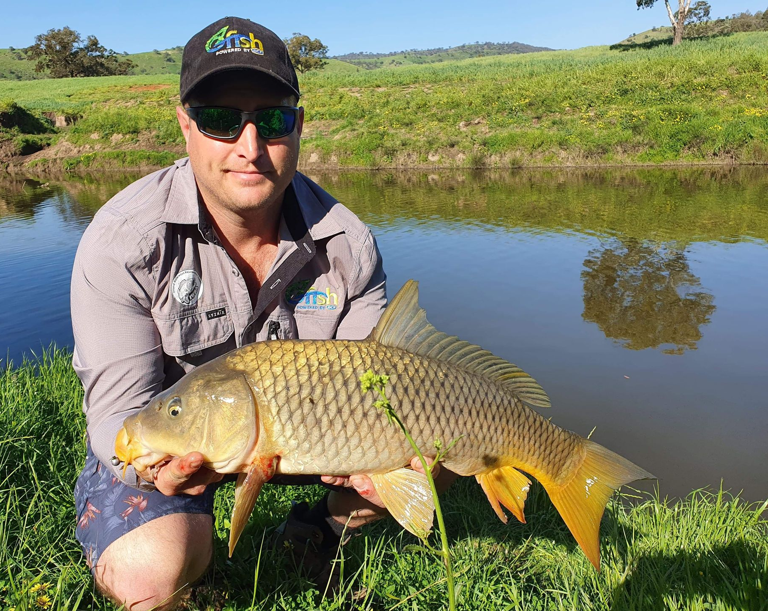

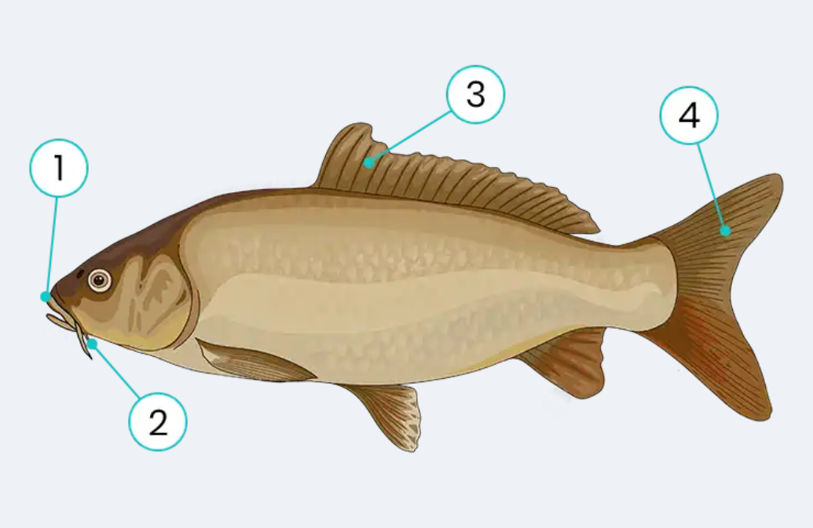
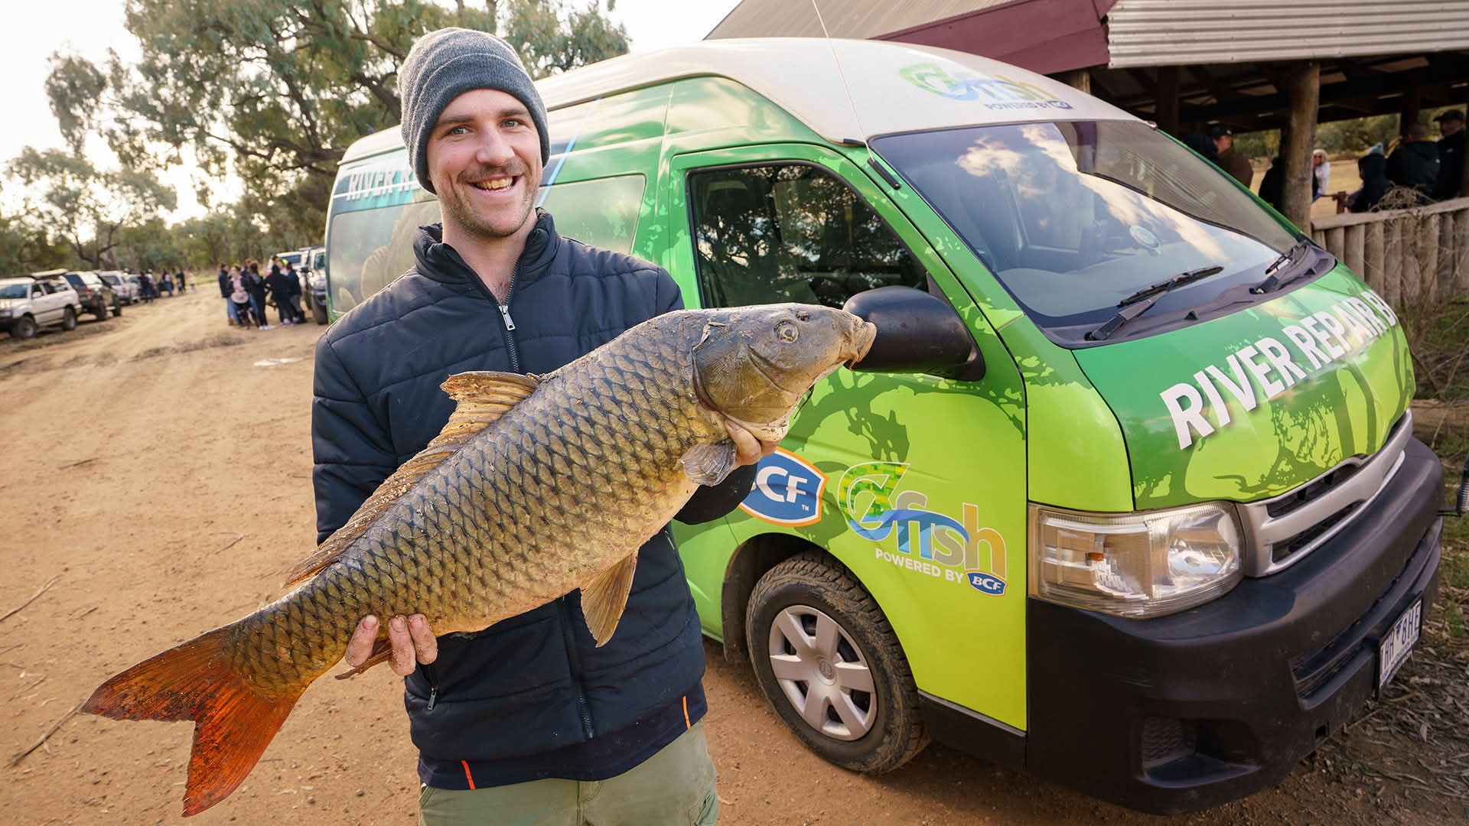
Rec Fishers Matter
Insightful Water Stewardship
Fishers gain unique knowledge about fish populations and habitat through their time spent on the water.
Citizen Science Contributions
Fishers contribute valuable data to scientific programs that support fishery research and management efforts.
Preventing Species Spread
Knowledge and best practice helps fishers prevent the spread of non-native species.
Habitat Restoration Involvement
Many fishers actively restore habitats by planting vegetation and installing instream structures.
Notes:
Number 1, they want to and need to be part of the conversation.
Recreational fishers play a critical role in addressing non-native fish issues. Their time on the water gives them unique insight into changes in fish populations and habitat condition. Through citizen science programs, fishers contribute valuable data that supports research and management. They also help prevent the spread of non-native species by following best practices around bait use, equipment cleaning, and fish handling. Many fishers are actively involved in habitat restoration, from planting riparian vegetation to installing instream structures. Emphasising this role counters narratives that blame fishing communities for environmental problems. Instead, it highlights fishers as stewards and partners in recovery. For public talks, this message helps build pride, ownership, and motivation to get involved.

Slide 5
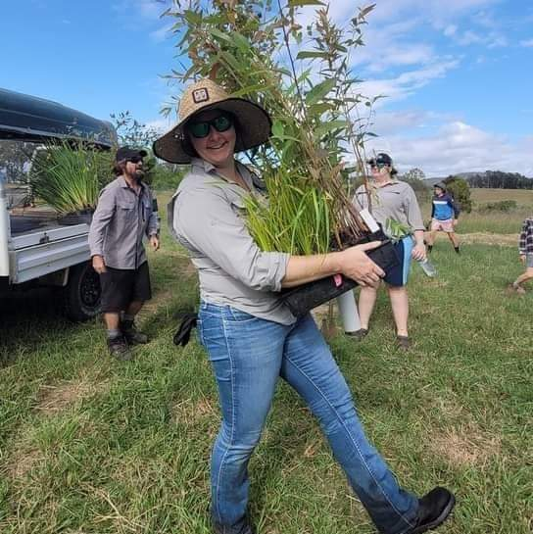
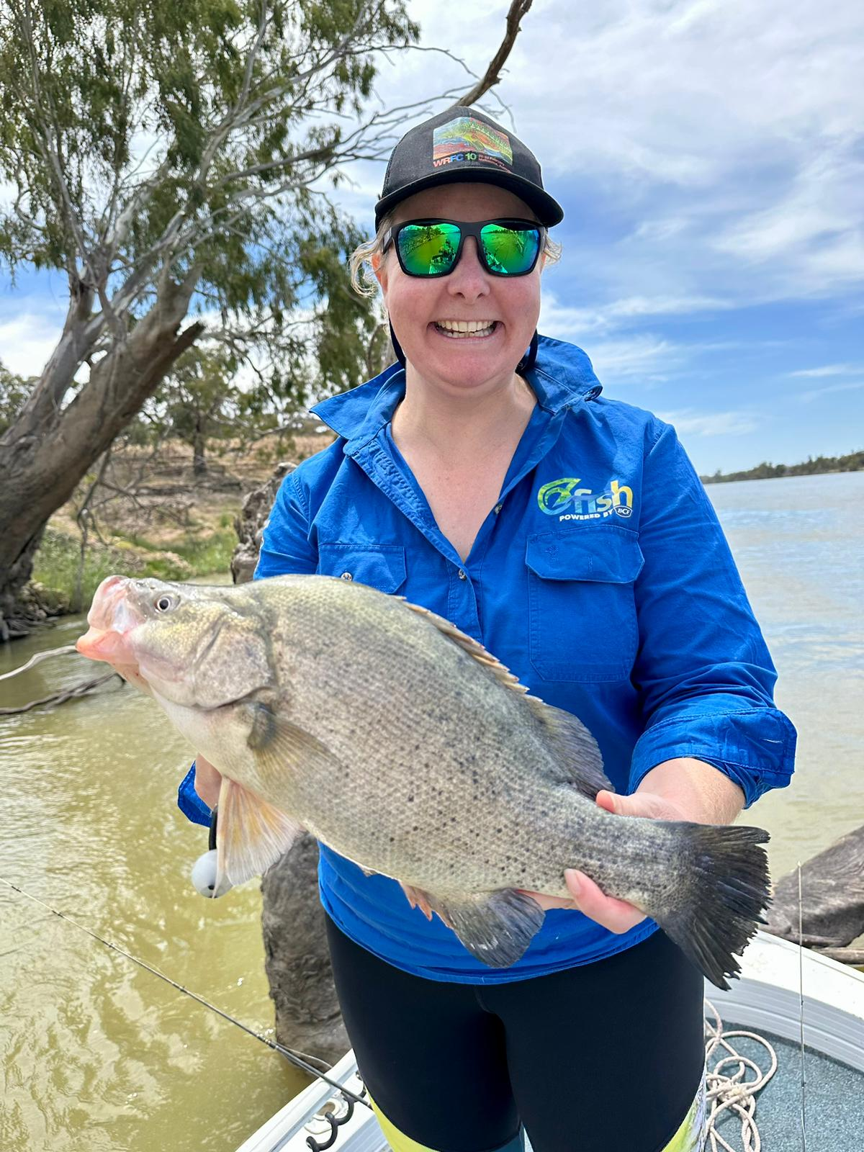
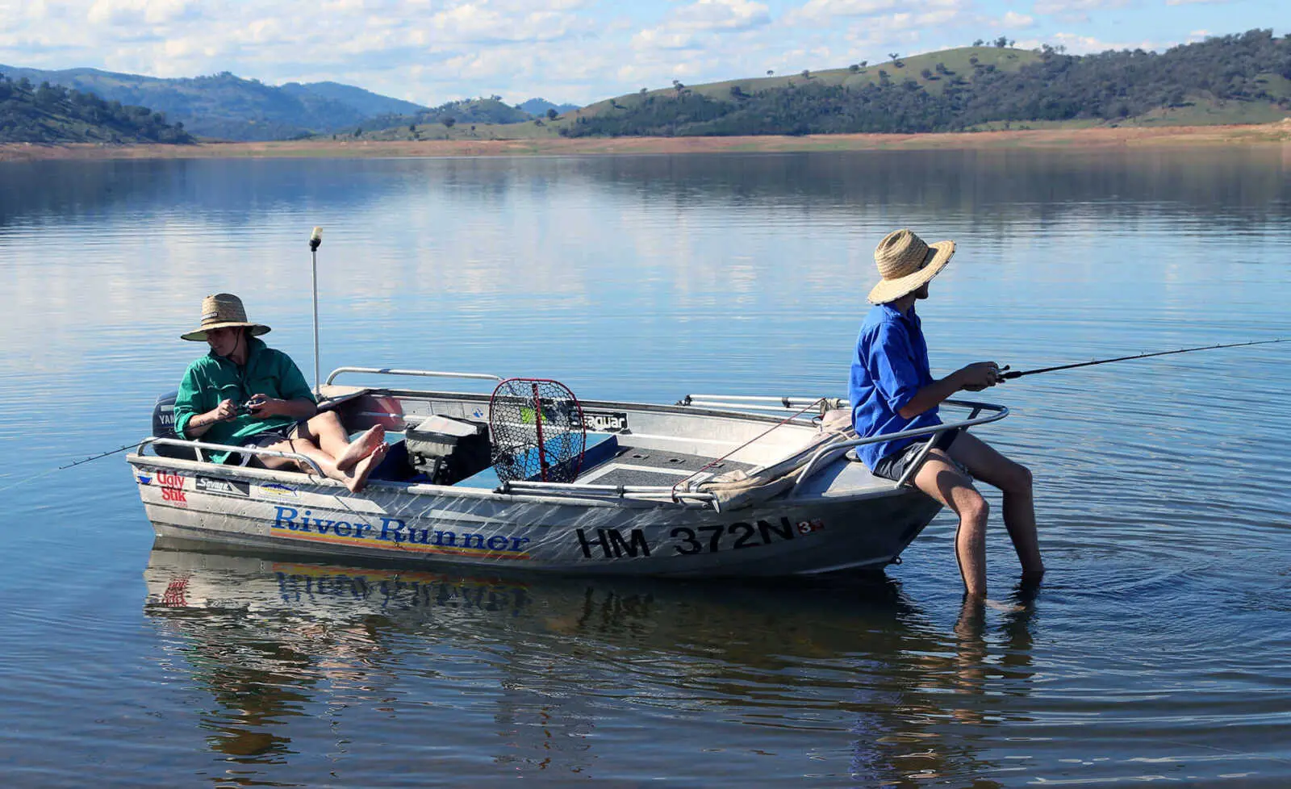
Restoration maintains the balance
Habitat Improvement
Restoration enhances habitat complexity and natural flows, creating favorable conditions for native fish species.
Native Fish Recovery
Native fish populations rebuild through increased shelter, spawning sites, and habitat connectivity after restoration.
Decline of Non-native Fish
Non-native fish decline as restoration reduces conditions they rely on, rebalancing the ecosystem.
Broader Restoration Benefits
Restoration supports fishing, water quality, and community wellbeing beyond conservation goals.
Notes:
Virus will be the thing that gives us back the advantage over carp, it will be river restoration that keeps it.
Restoration offers a way to break the downward spiral and shift the balance back toward native fish. By improving habitat complexity, reinstating more natural flows, and enhancing water quality, we create conditions that favour native species adapted to local environments. Projects such as large-scale habitat restoration demonstrate that when rivers are given the chance to recover, native fish often respond positively. Increased shelter, spawning sites, and connectivity allow populations to rebuild. At the same time, non-native fish frequently decline in relative abundance because the conditions they rely on are reduced. Importantly, successful restoration is rarely about a single action. It involves coordinated efforts across catchments, sustained over time. Sharing real-world examples helps audiences see that change is possible and practical. It also highlights that restoration is not just about conservation; it delivers benefits for fishing, water quality, and community wellbeing. This slide reinforces the idea that healthy rivers are the best long-term defence against non-native fish dominance.

Slide 6
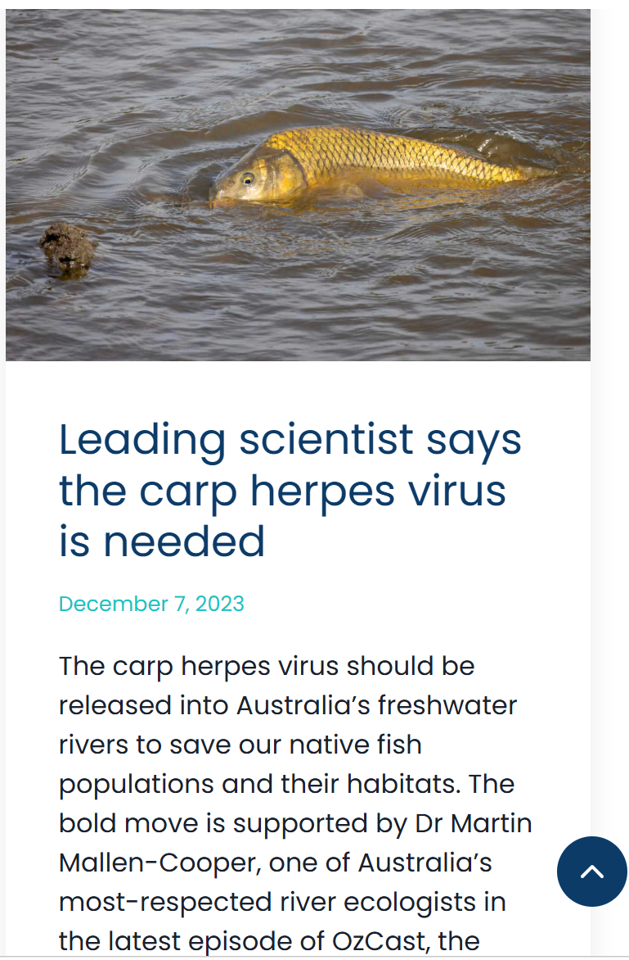
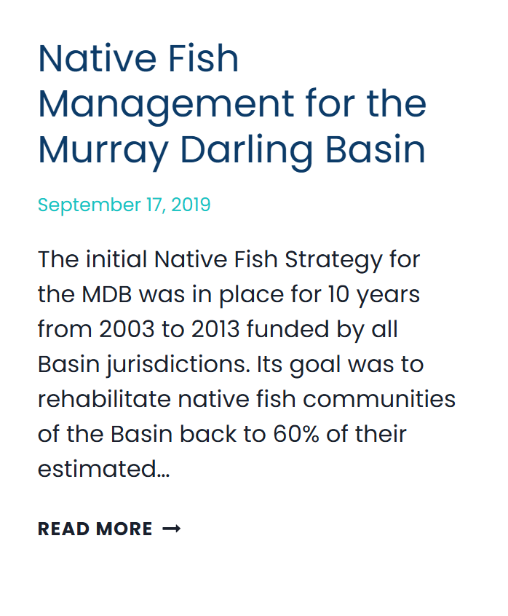

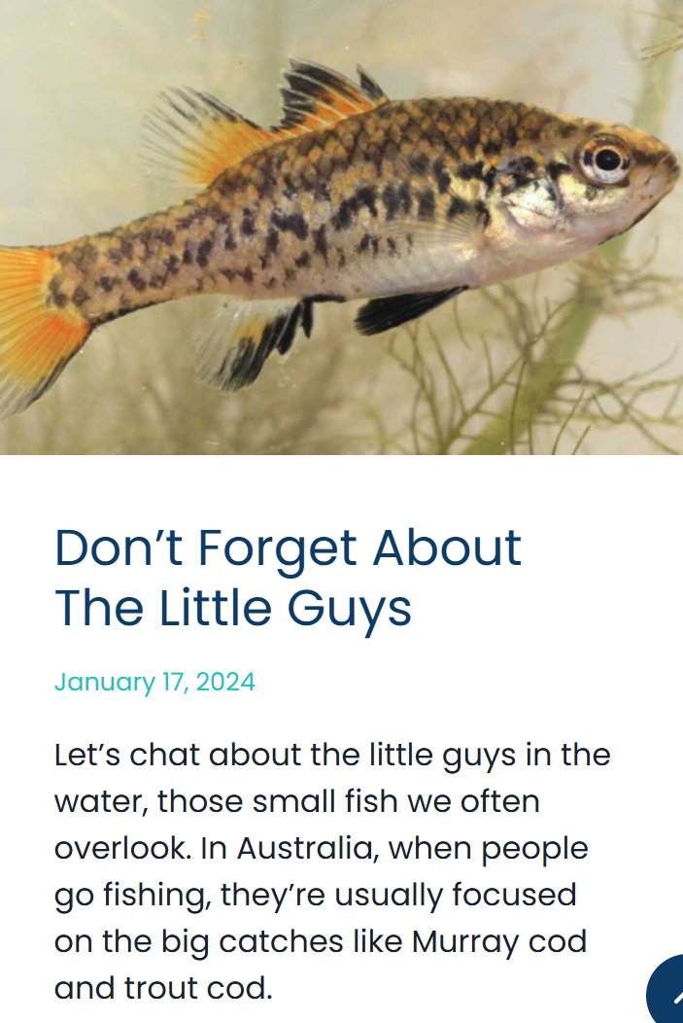
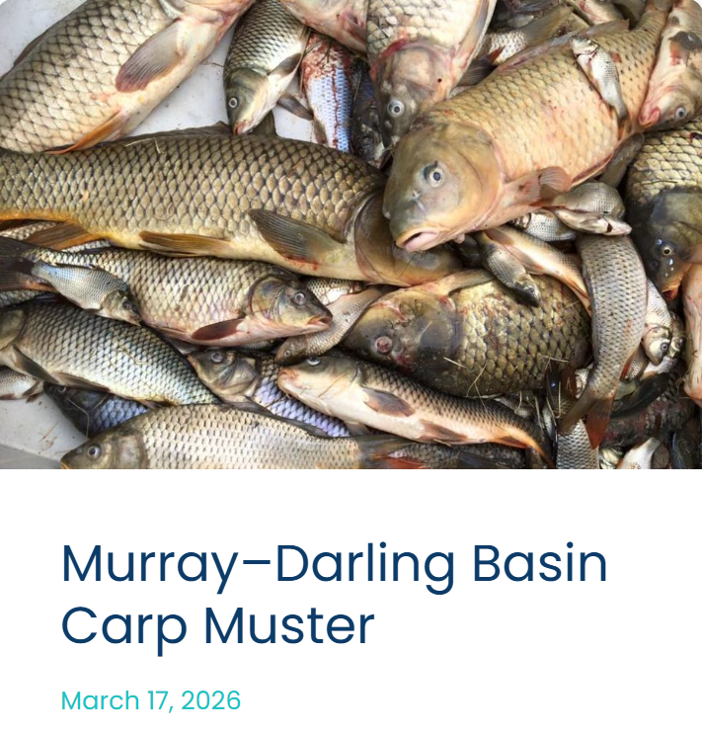
OzFish’s Role
Science-Driven Management
OzFish bases its fish management strategies on scientific research to achieve ethical and effective outcomes.
Community Engagement
Involving local fishers, landholders, and communities is essential for the success of OzFish’s restoration efforts.
Long-Term River Health
Focus on restoring habitat and improving river connectivity supports sustainable and measurable ecosystem benefits.
Integrated Solutions
OzFish coordinates efforts across sectors to address complex environmental challenges with practical solutions.
Notes:
OzFish has recently released our position paper on our approach to non-native species in our work, including but not specific to carp – you can link to that and our blog piece on all of our non-native work on our website: https://ozfish.org.au/news/
OzFish’s approach to non-native fish management is grounded in science and shaped by community involvement. Rather than focusing on short-term fixes, the organisation prioritises long-term improvements to river health. This includes restoring habitat, improving connectivity, and supporting research that informs ethical and effective management. Community engagement is central, recognising that local knowledge and participation are essential for success. By working with fishers, landholders, scientists, and managers, OzFish helps align efforts across sectors. This approach acknowledges that complex problems require integrated solutions. For a public audience, it is important to emphasise that this work is practical and outcomes-focused. Projects are designed to deliver measurable benefits, not just reports. Highlighting this builds credibility and encourages broader support for restoration-based strategies.

Slide 7
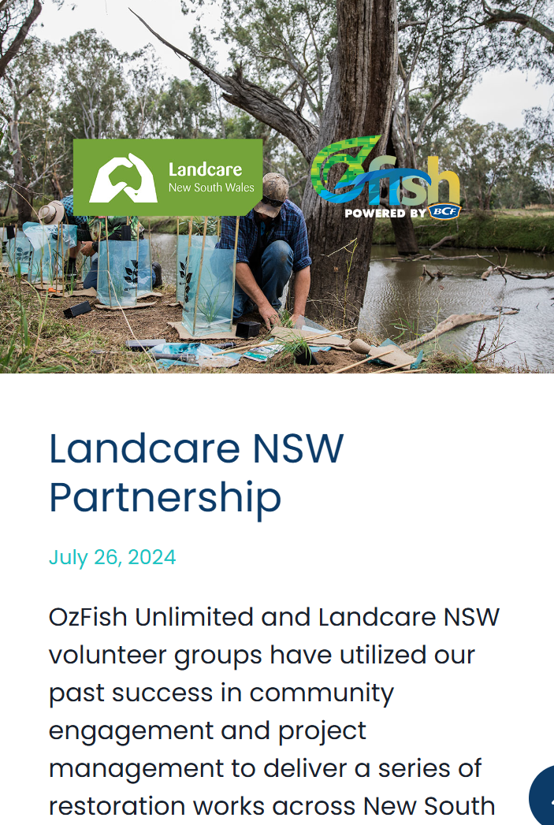
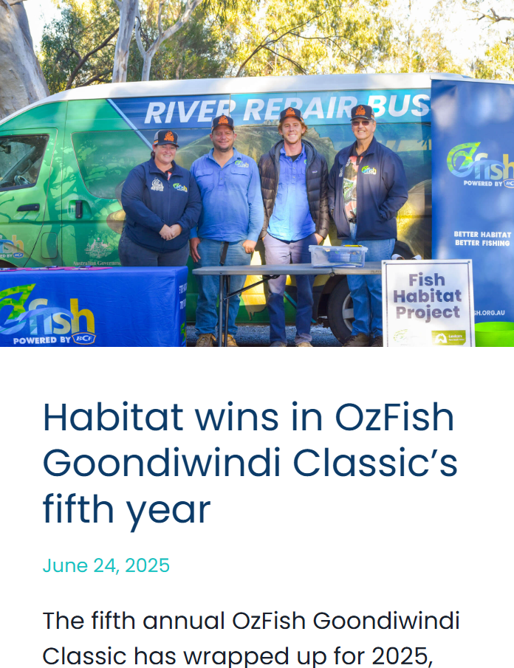
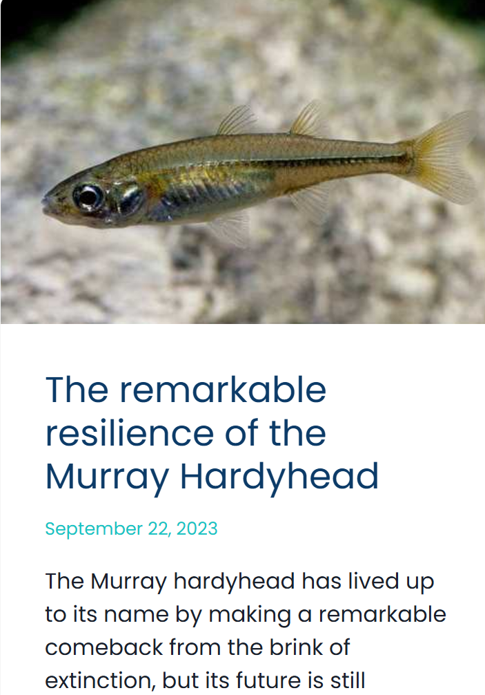
Restoring our Rivers together
Shared Responsibility
Restoring waterways requires collective effort from individuals, communities, and organizations working together.
Individual Involvement
Citizens can participate through science projects, restoration activities, and responsible fishing to support river health.
Positive Outcomes
Informed and sustained collective action leads to native fish recovery and healthier, resilient waterways.
Notes:
Express urgency, too long on the wrong side of good health
The final message of this public talk is one of shared responsibility and optimism. Restoring balance to our waterways is possible, but it requires collective effort. Individuals can get involved through citizen science, local restoration projects, and responsible fishing practices. Communities can support initiatives that improve river health and advocate for sustainable water management. Organisations like OzFish provide pathways for people to turn concern into action. By working together, we can create conditions where native fish recover and waterways become healthier and more resilient. Ending on this note reinforces that while non-native fish signal a problem, they also point toward solutions. With informed action and long-term commitment, the balance can shift back in favour of native species and thriving rivers.

Slide 8

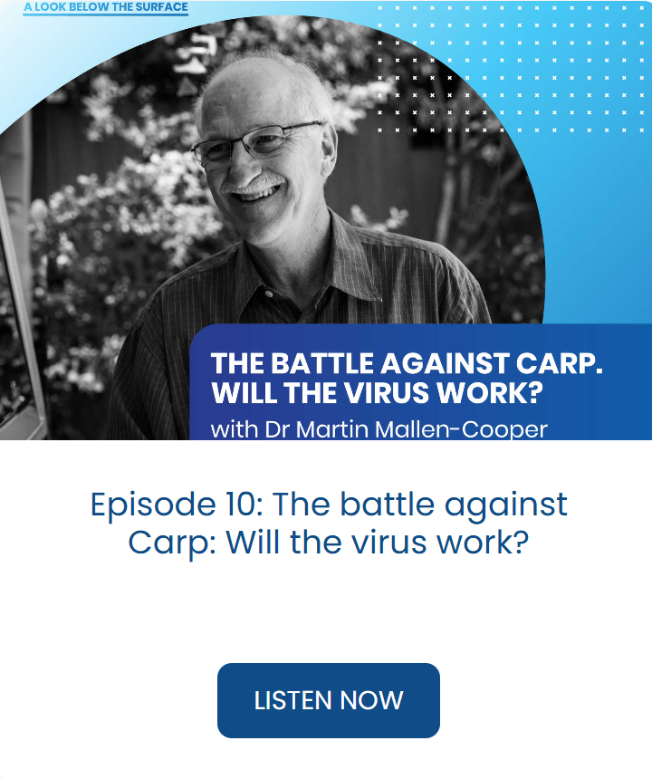
Thoughts, Questions? & More Info
Carp Monitoring – NSW MDB-wide Carp Muster
OzFish Basin Fish Program:
https://ozfish.org.au/programs/murray-darling-basin/

