Slide 1
Integrated Catchment Management
What is it?
Coordinated management of land, water and biodiversity to achieve sustainable, balanced use.
Approach
Combines environmental, social and economic goals.
Engages stakeholders to protect water resources and ecosystem health.
Prevents fragmented management, favoring collaborative planning, restoration and stewardship.

Slide 2
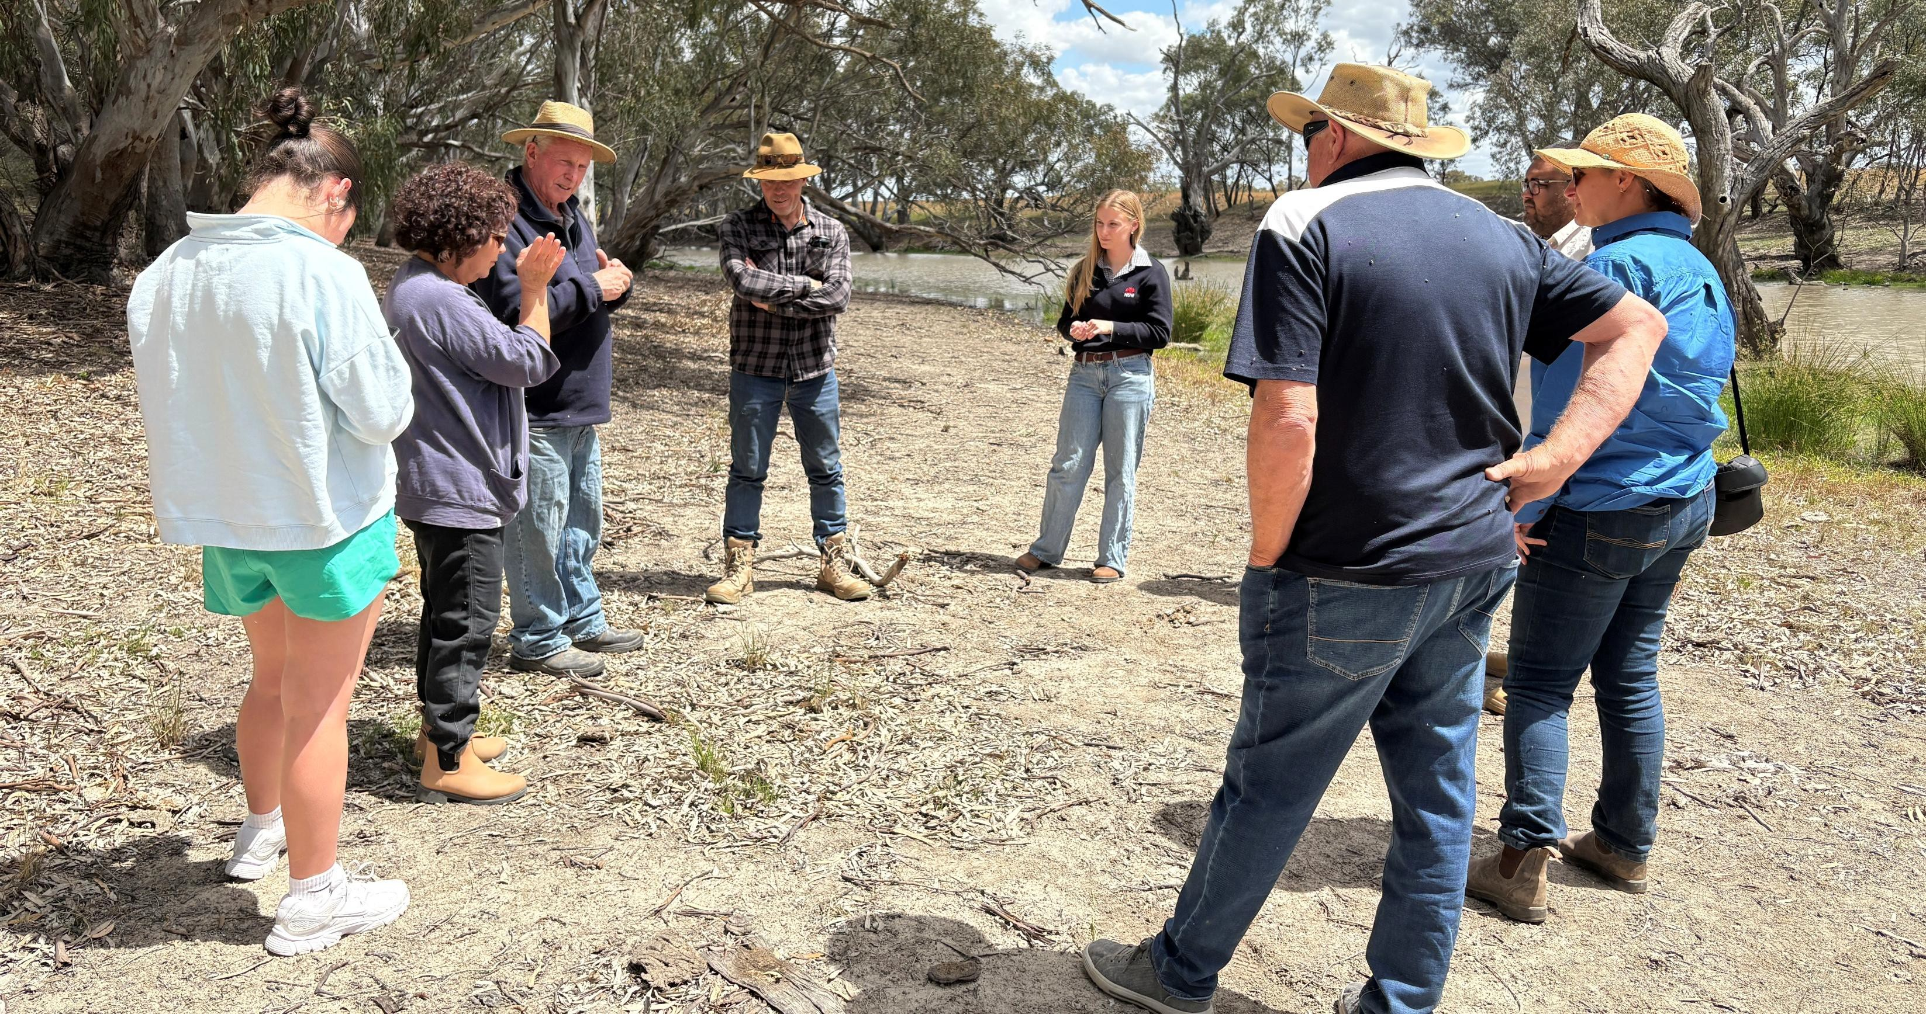
Stakeholder meeting discussing carp control – YACTAC, Murray LLS, Dr John Conallin and Dan Hutton (Ecologists), Jeithi Aboriginal Group, Jerilderie Fishing Club

Slide 3
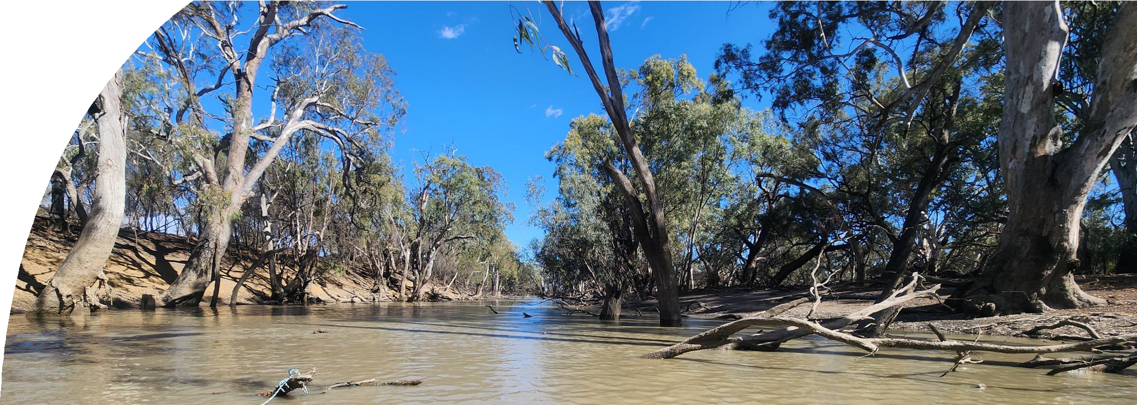
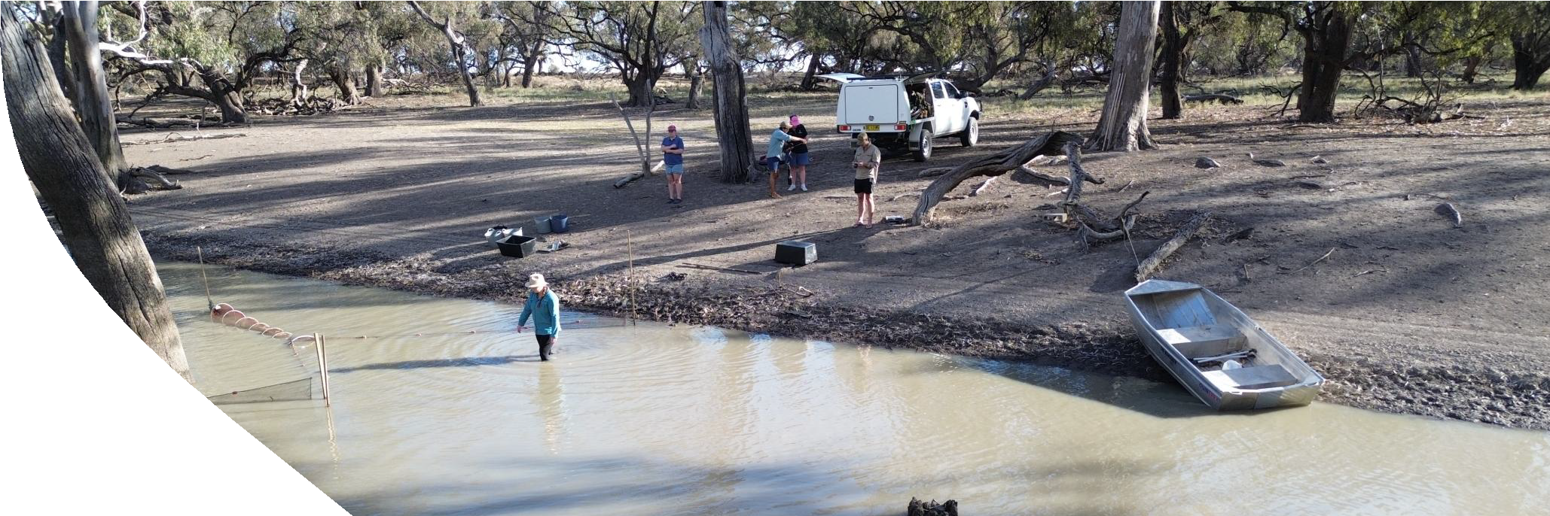
Carp Impacts on Waterways:
Increased turbidity
Uprooting of aquatic vegetation
Reduced light penetration = limited photosynthesis
Competition with native species
Predation on native eggs and juveniles
Increased nutrient levels = algal blooms
Reduced dissolved oxygen levels
Photo credit: Gordon O’Brien, CSU

Slide 4
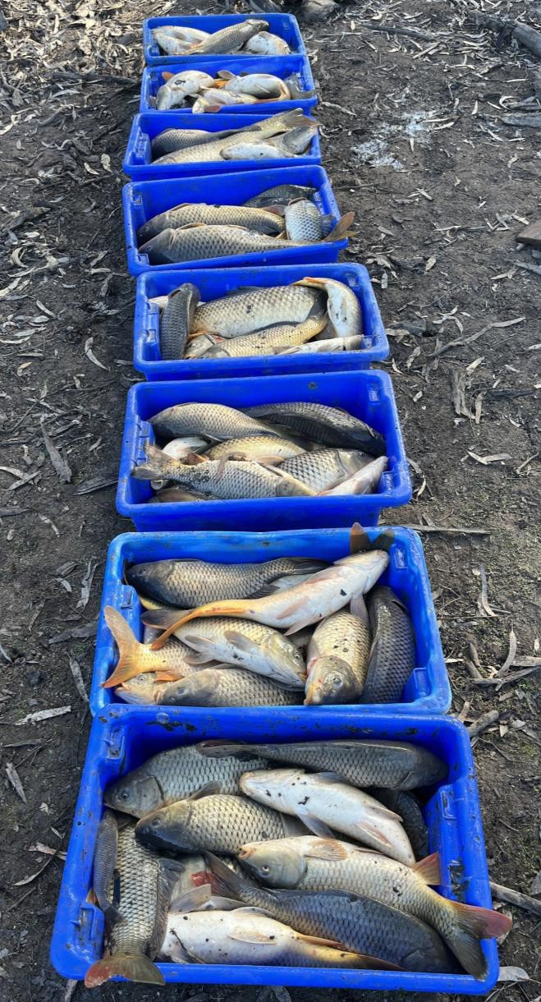
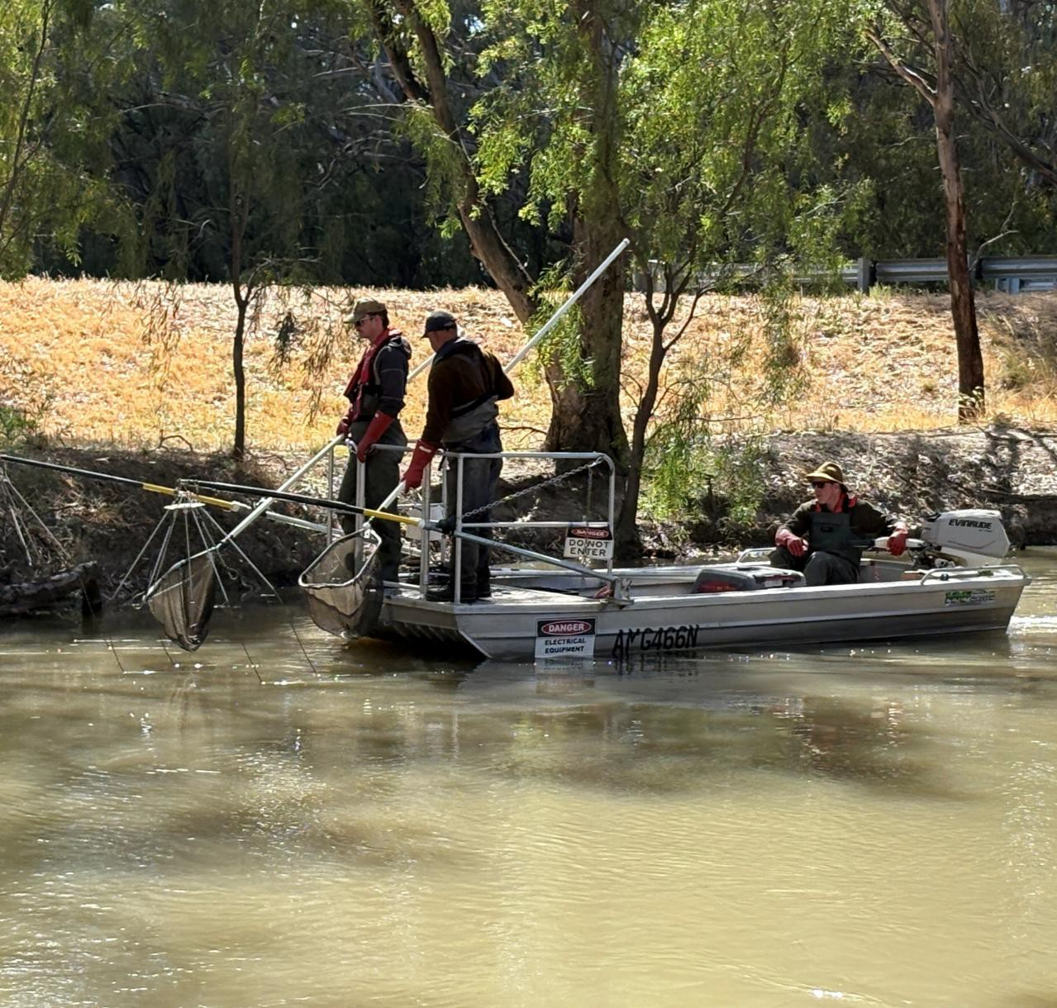
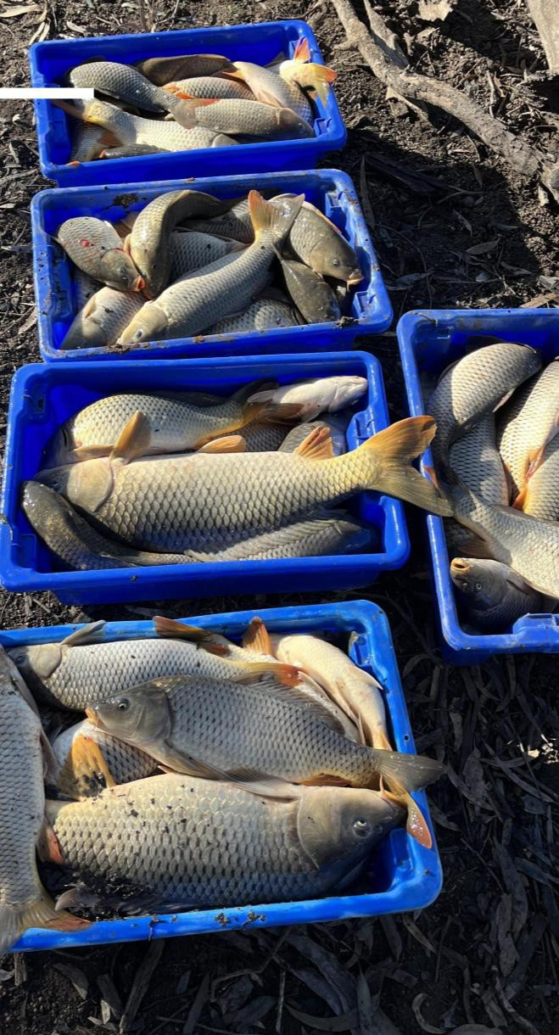
Electrofishing the Yanco Creek System – Dr. John Conallin, Dan Hutton, Angus Bolton

Slide 5
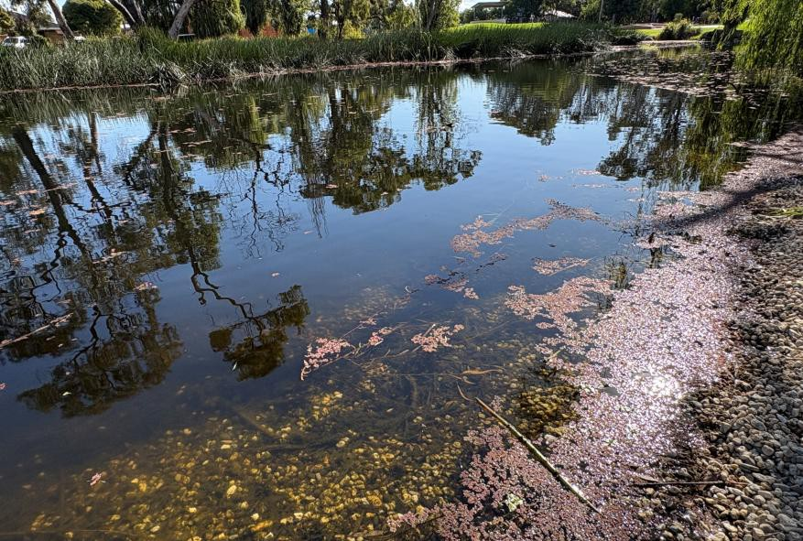
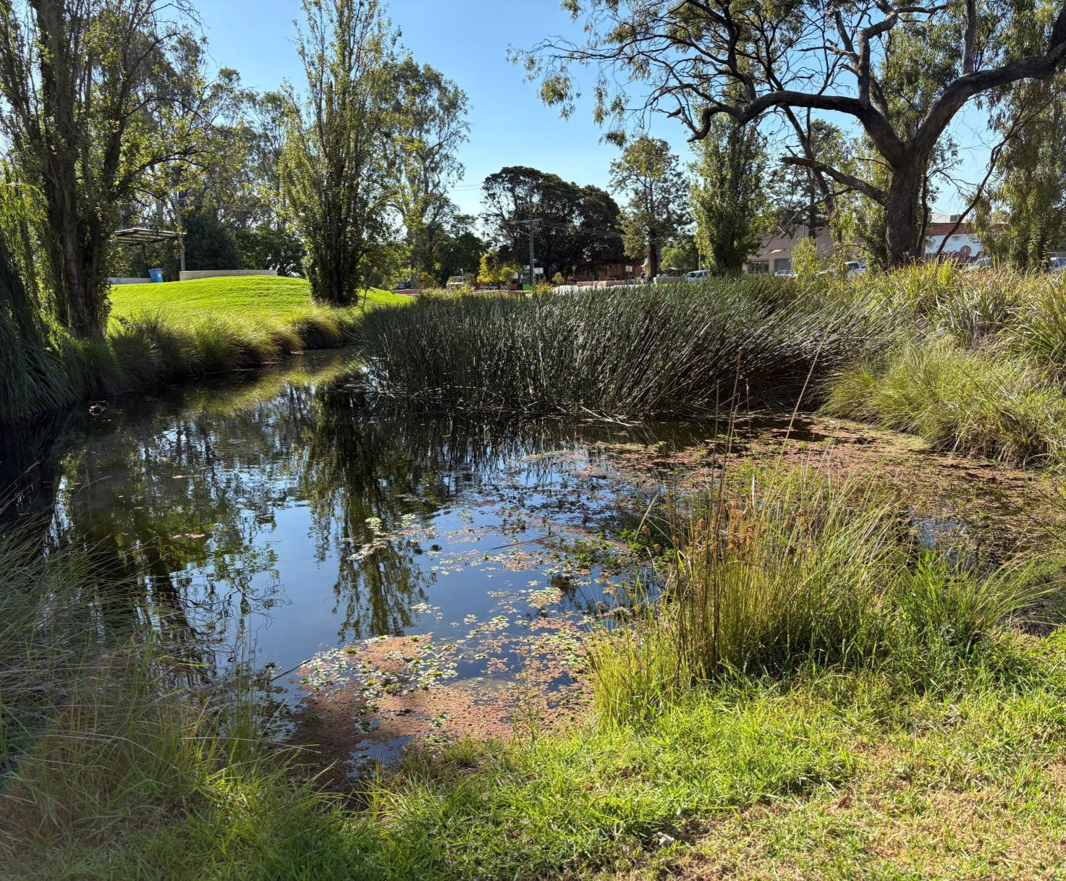
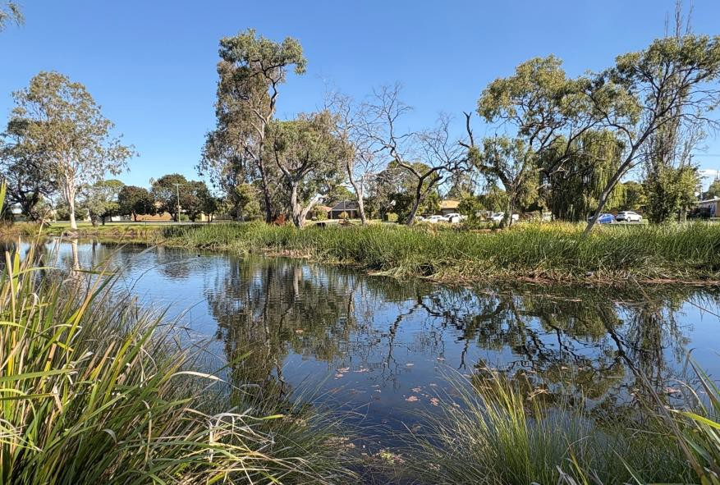
Deniliquin Lagoon System – carp removed, clear water, eel-tailed catfish successfully nesting and reproducing

Slide 6
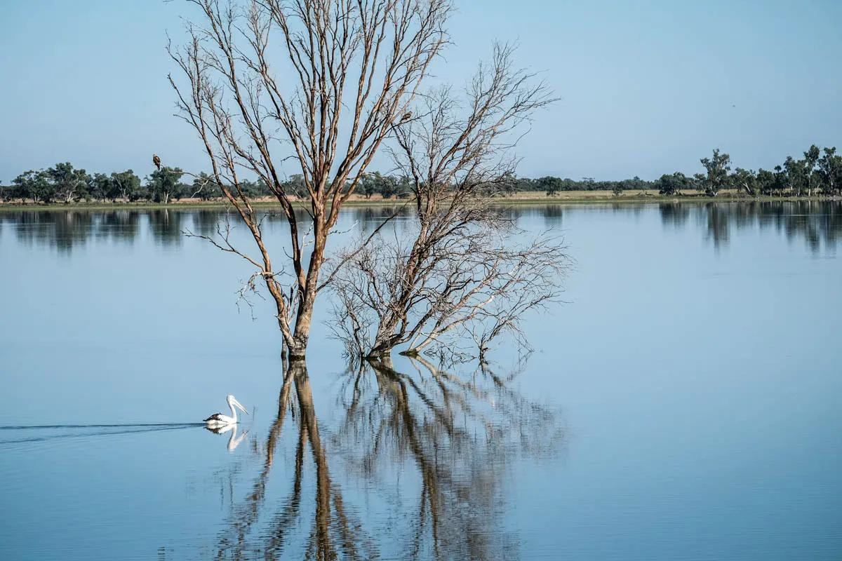
Lake Paika
Refilled in 2011 after 100 years dry
Carp excluded using carp
screens
Clear water
Supports
  Native fish
  Waterbirds
  Extensive aquatic vegetation
Photo credit: Lake Paika Outback Beds

Slide 7
Carp eating out the riverbank in the Murray River
Video credit: Zac Cahill

