Slide 1



The National Carp Control Plan: science overview
Murray-Darling Carp Action Summit, 30 April 2026
Dr Toby Piddocke

Slide 2
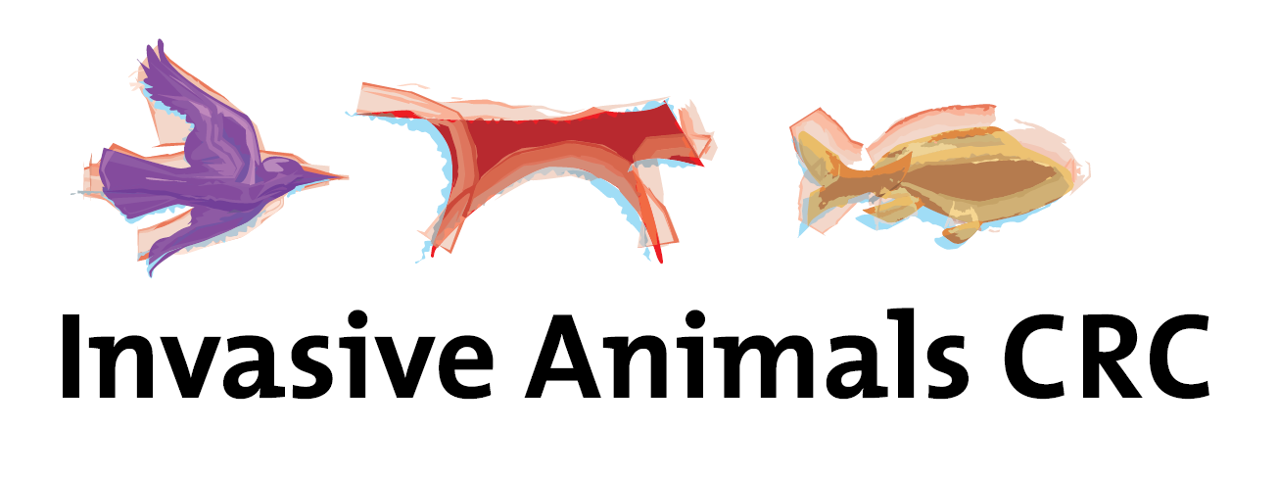
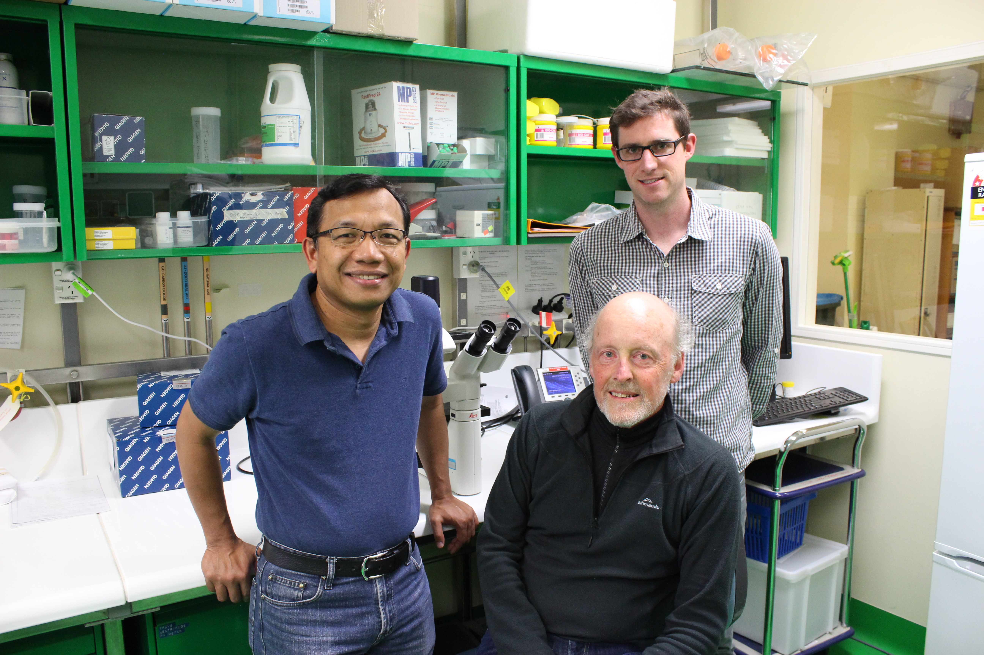


Notes:
I’d like to begin by acknowledging far-sighted investment by the then Invasive Animals CRC (now the Centre for Invasive Species Solutions) that enabled early work by Ken McColl and colleagues Agus Sunarto and Matt Neave at CSIRO, who identified the initial potential of CyHV-3 as a biocontrol agent.

Slide 3
What was the NCCP?
A research and planning (policy + operations) program assessing the feasibility of using Cyvirus cyprinidallo3 (formerly Cyprinid herpesvirus 3 (CyHV-3) as a carp biocontrol agent.
Feasibility = 3 broad questions
  Will biocontrol using the virus be effective?
  What are the risks and how could they be managed?
  How could carp biocontrol be implemented?
Explicit focus on biocontrol using CyHV-3

Slide 4
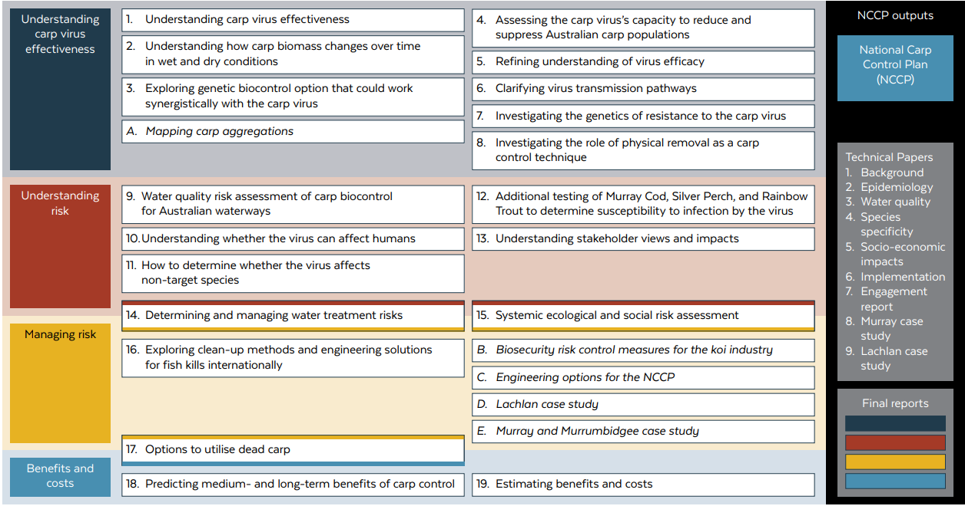
NCCP research

Slide 5
Headline messages
40–80% reductions possible (depending on carp demography)
Initial major outbreaks followed by ongoing seasonal kills of mainly small carp
Suppression through “boom” cycles
“Carpageddon” unlikely, rather;
A concerted effort required to introduce the virus and initiate outbreaks in targeted carp populations:
WQ risks less than if virus were self-propagating, BUT
Considerable effort likely needed for broadscale rollout, and risk management will require similarly broadscale surveillance.
Broadscale WQ impacts unlikely, but could occur in some habitat types

Slide 6
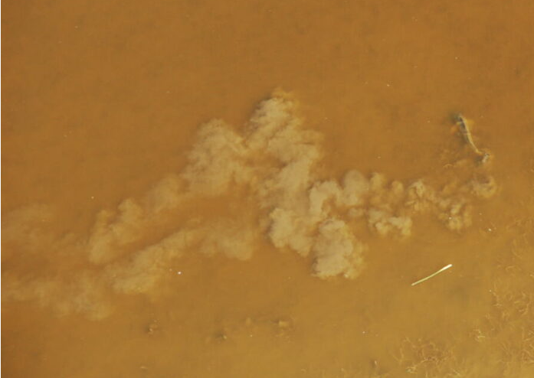
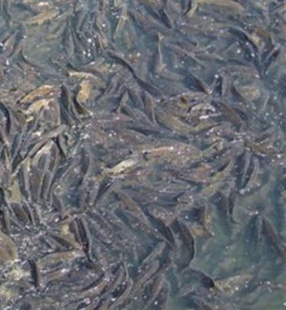
Key science (selected): epidemiology
Primary factors regulating disease outbreaks and carp suppression: water temperature, physical contact, latency and recrudescence.
Notes:
Water temp within which the virus causes disease variously defined as 18-28 deg C and 16-26 deg c.
Within this range, there is a narrower range within which it does so most effectively 22-24 deg C or 22-26 deg C.

Slide 7
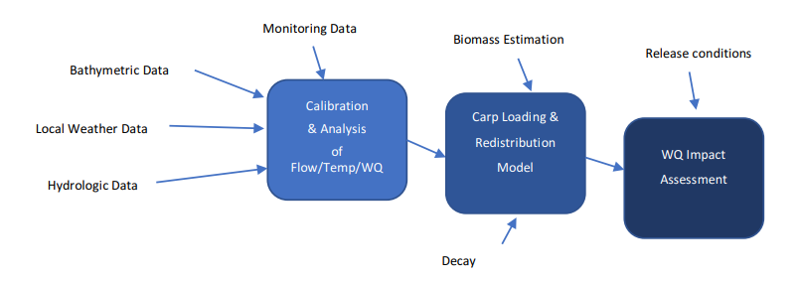
Key science (selected): water quality
Modelling to understand impacts of decaying carp on dissolved oxygen dynamics and risk of cyanobacterial blooms
Assessed impacts across various dead carp loadings
Flow and aeration are the two factors that mitigate risk—off-channel habitats present highest risk
Notes:
300 kg/ha is the figure for WQ impacts
Different loading rates account for uncertainty in biomass estimates and epi modelling.

Slide 8
Non-target species (NTS) susceptibility
OIE Manual of Diagnostic Tests for Aquatic Animals lists carp and carp hybrids as the only species fulfilling its criteria as susceptible to CyHV-3 infection, but notes detection of genomic DNA in several other freshwater fishes and invertebrates
An area of public concern
Trial results considered inconclusive by carp SAG and C’wealth regulators—additional research being conducted under the Carp Biological Control Program (CBCP)
Notes:
57% of about 4,680 survey respondents concerned about virus infecting species other than carp.

Slide 9
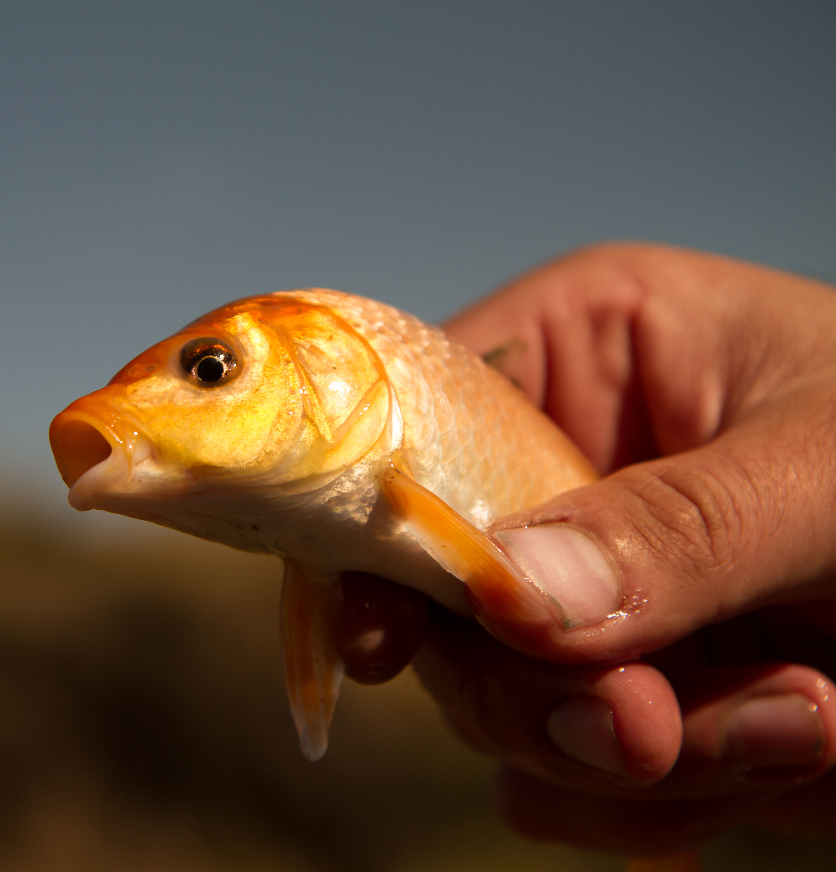
Uncertainties/challenges
Need for additional NTS work (incl Rainbow Trout).
Improved understanding of the emergence of genetic resistance and/or herd immunity desirable.
Improved understanding of key epidemiological mechanisms (latency/recrudescence) and parameters (transmission rates—Beta) desirable.
Managing WQ impacts in off-channel and/or vulnerable habitats (e.g. northern MDB ephemeral systems, Chowilla in SA).

Slide 10

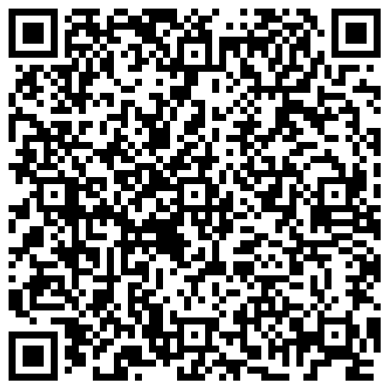
Carp Biological Control Program
The NCCP concluded in 2022. The Department of Agriculture, Fisheries and Forestry is managing new research under the Carp Biological Control Program.
Research
  7 Priority Research Actions to address NCCP knowledge gaps – led by CSIRO, Elizabeth Macarthur Agricultural Institute and Adelaide University
National coordination
  The Carp Virus Implementation Planning Advisory Group will develop a national implementation plan
  The program continues to engage stakeholders nationally through webinars and events
Regulatory assessments
  Regulatory approval of the carp virus by 3 Commonwealth agencies is Mandatory
  Australian Agriculture Ministers to make final decision (expected in 2028)
agriculture.gov.au/carp-control
For more information contact:
carp@aff.gov.au
Notes:
Speaker notes:
When the NCCP ended in 2022, an expert review and regulatory advice recommended further research was required to support regulatory approval and evidence-based decision-making.
In 2023, all Australian Agriculture Ministers agreed that this additional research was necessary before a decision could be made. The Carp Biological Control Program is delivering this research as well as seeking the required regulatory approvals and leading national coordination.
This targeted research phase is addressing the necessary knowledge gaps that were identified in the NCCP and has been broken down into 7 Priority Research Actions.
Additionally, it is important to note that regulatory approval was never sought during the NCCP. This process is an unavoidable legal requirement that must be completed before the virus can be brought into Australia. Subject to this process being completed successfully, which is expected to be in 2028, all Australian Agriculture Ministers will make the final decision on whether to authorise use of the virus in Australia for biological control of carp.
Also note of course that regulatory approval and national coordination will draw on and incorporate work completed under the NCCP
You can find out more about the Carp Biological Control Program via the QR code on the screen, and if you have any additional questions about the research, regulatory approval process or national coordination efforts, or you would like to be kept informed as the program progresses, I encourage you to reach out to the team at carp@aff.gov.au

Slide 11
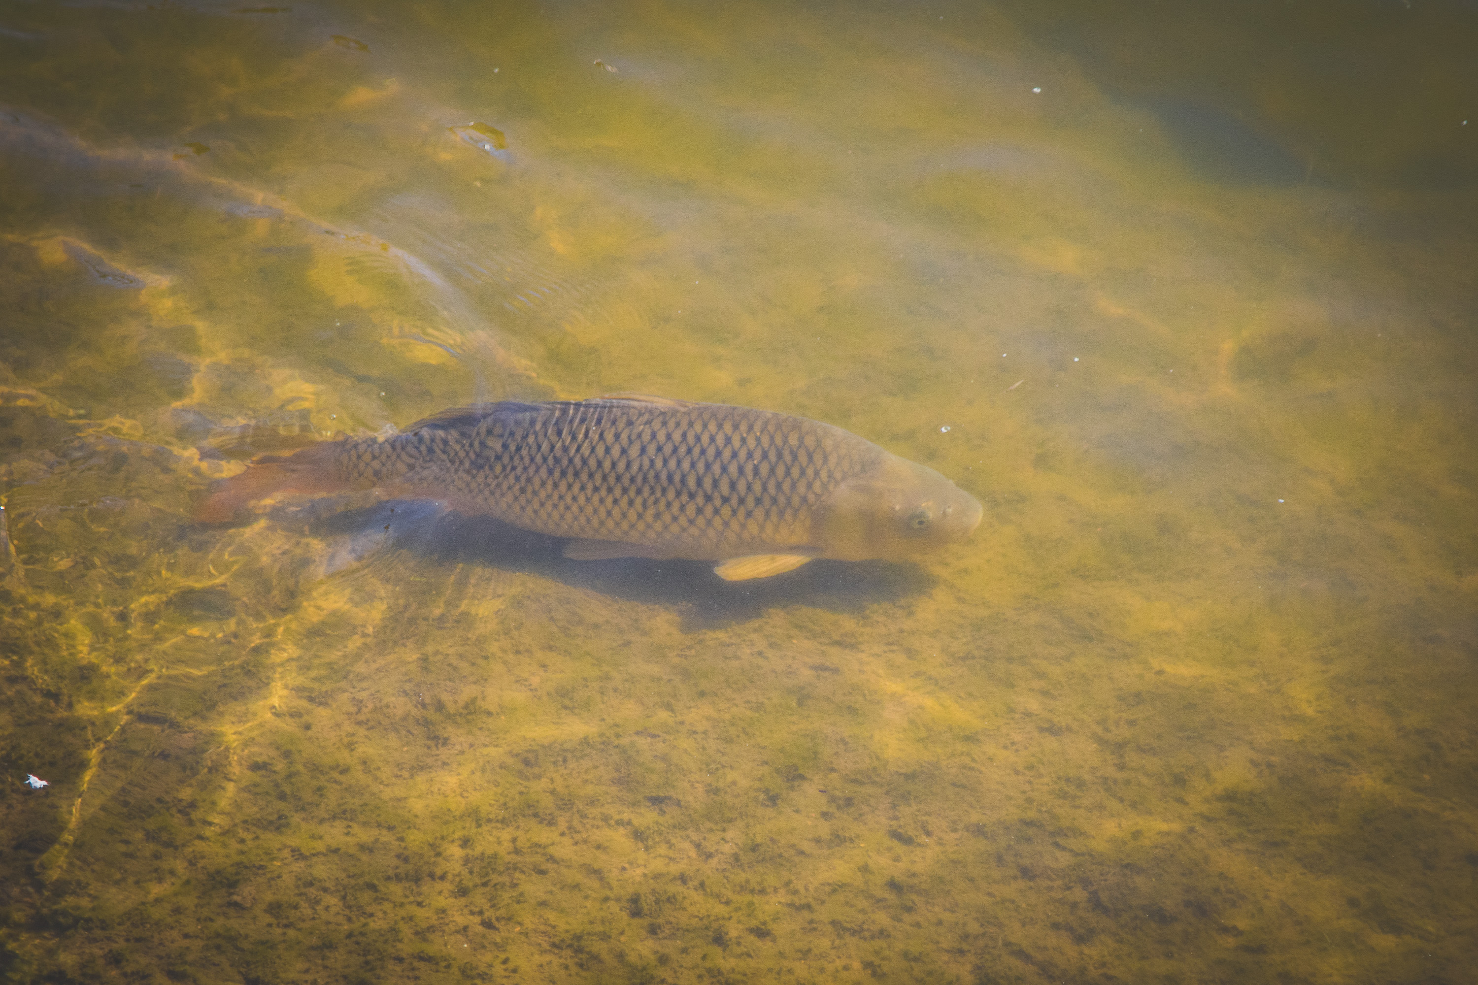

Questions?

