Slide 1
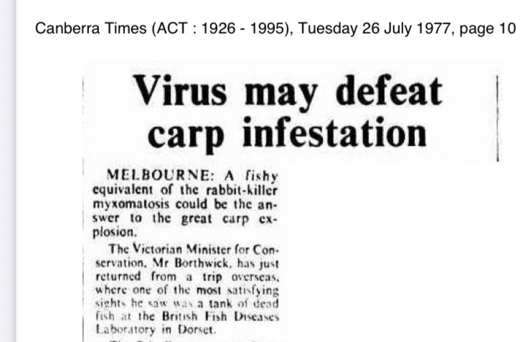
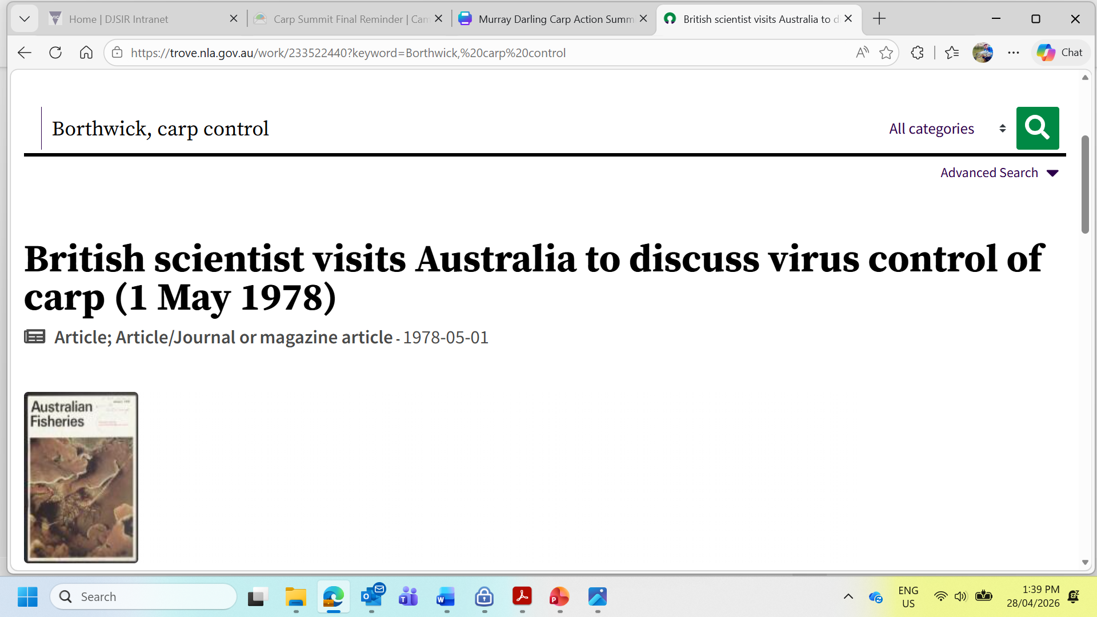
Spring viraemia carp biocontrol investigation in
1977

Slide 2
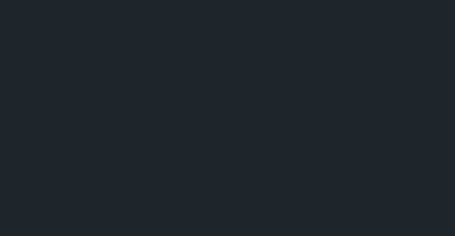
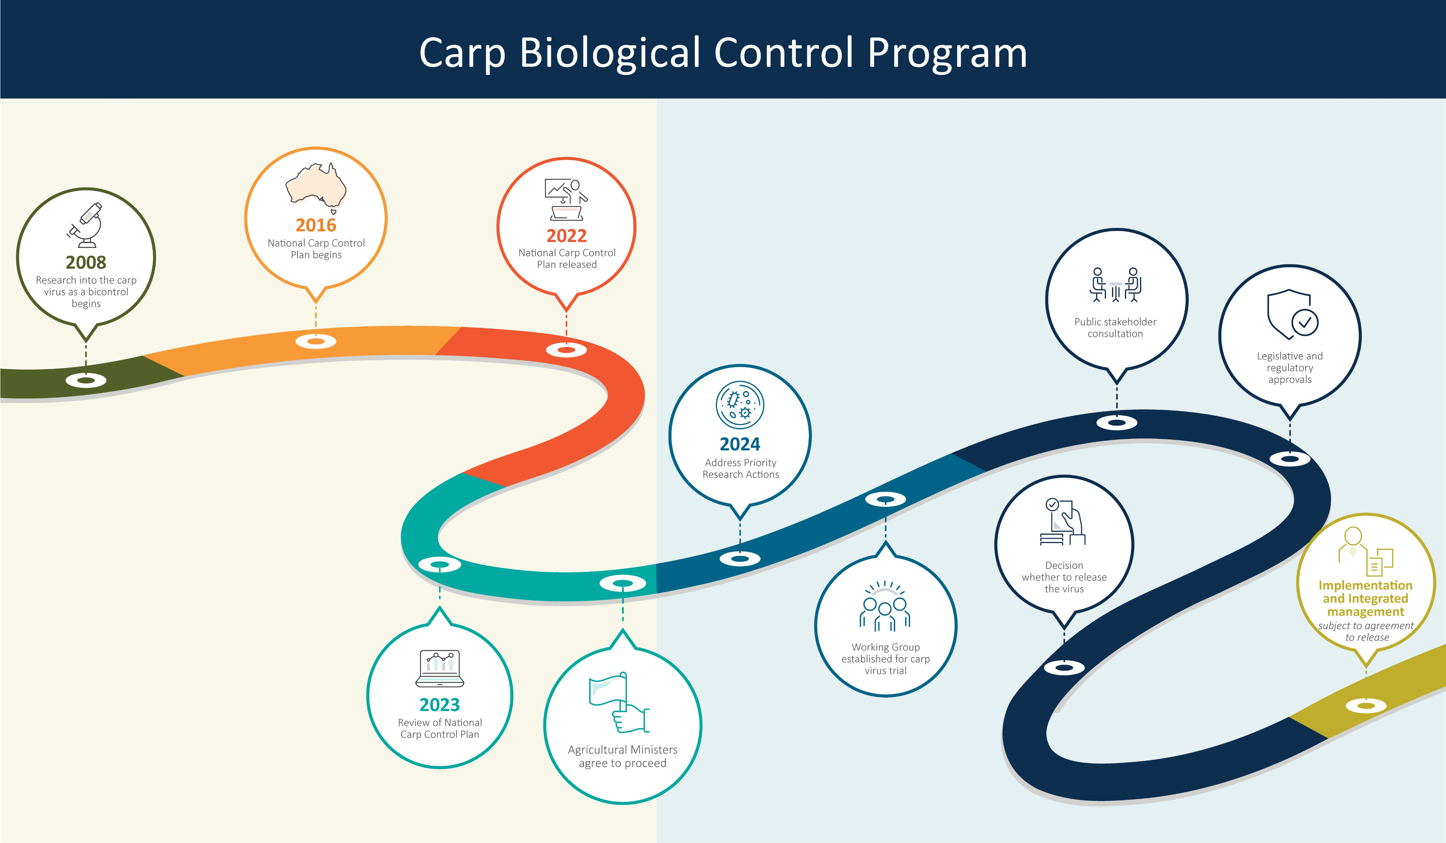
Never-ending approvals pathway
Welcome!

Slide 3








































Working together

