Slide 1
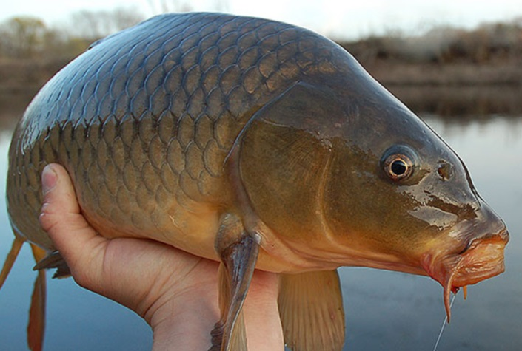

Carp in Australia: impacts, evidence and the case for action
Ivor Stuart
ivstuart@csu.edu.au
April 2026
Notes:
Carp are now the dominant fish biomass across much of the Basin, but we still have no basin-scale strategy for reducing their impacts.
My role here today here isn’t to argue for any single tool. Its to describe what effective population-scale carp management would actually require.

Slide 2
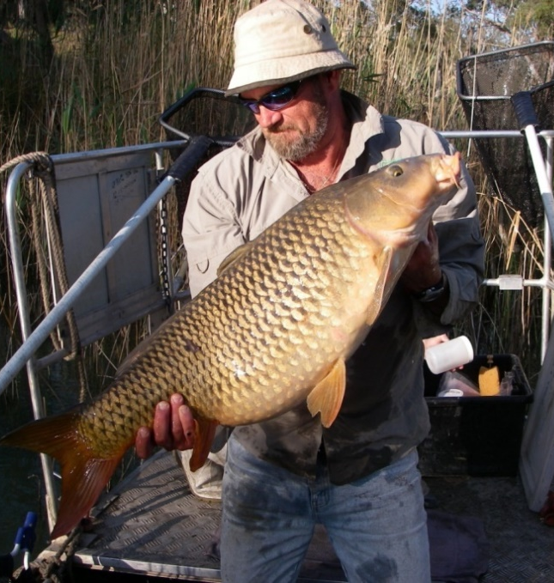
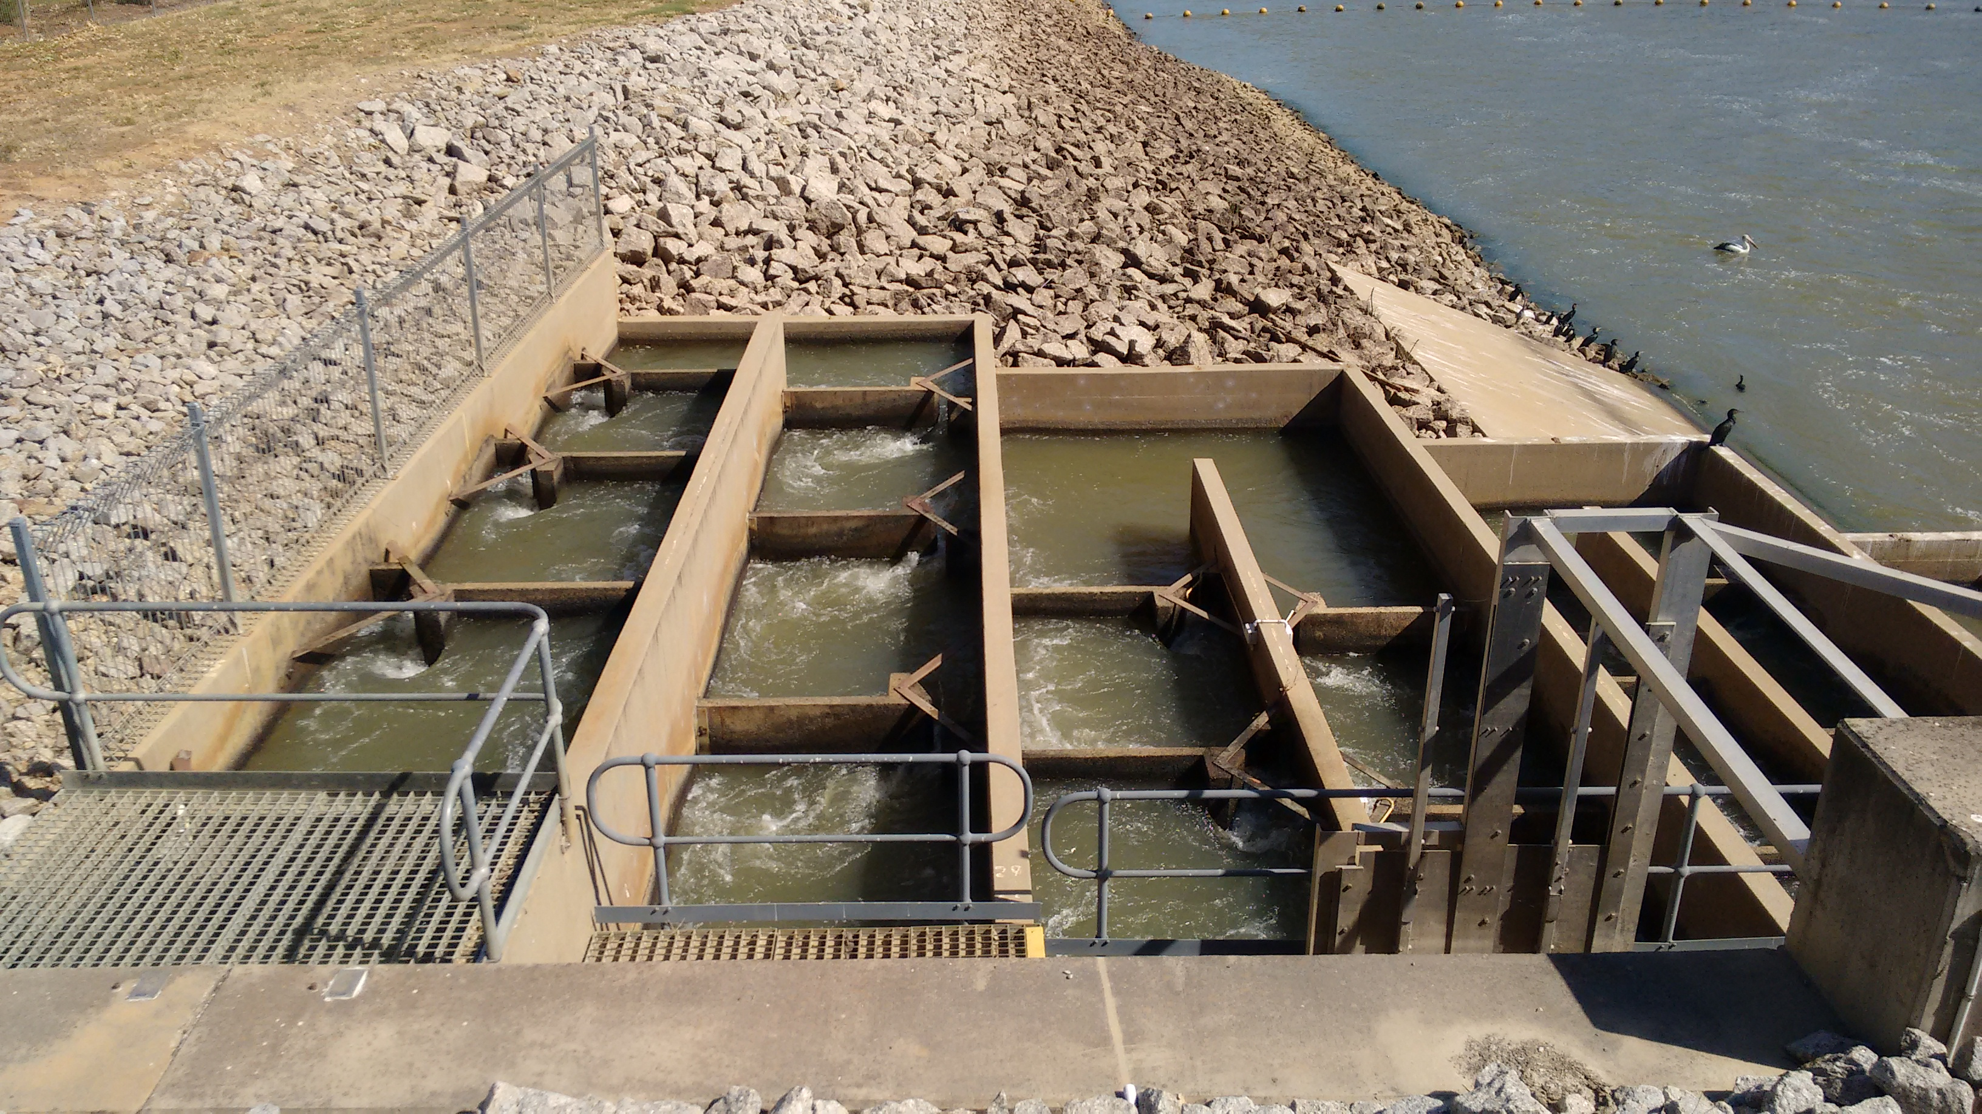
Why carp management matters now
Basin Plan review underway (does not set carp biomass or population trajectory targets [roadmap])
NCCP assesses biocontrol but does not set trajectory targets
No EPBC or FFG listing (policy gaps)
Carp are recognised everywhere but governed nowhere as a ecosystem recovery constraint –
No shared vision of what success looks like.

Slide 3
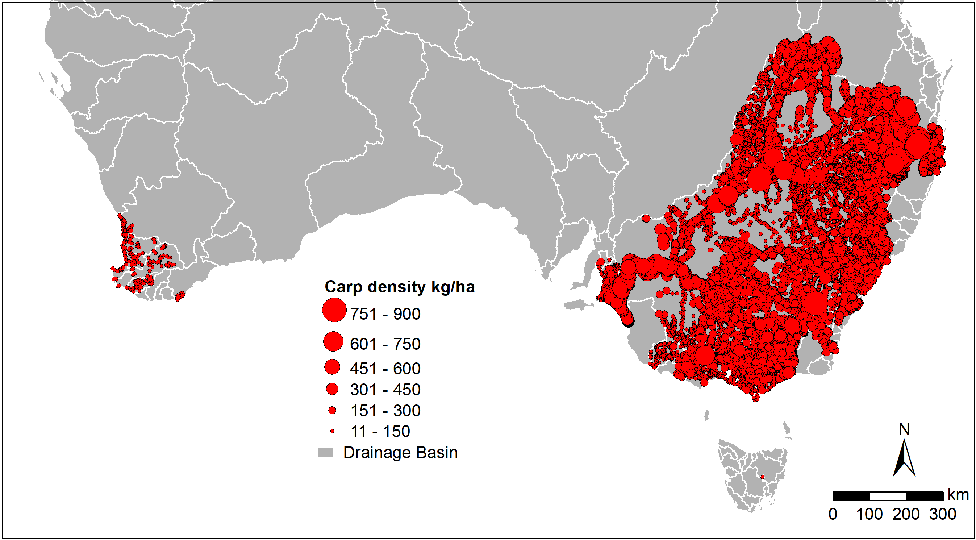
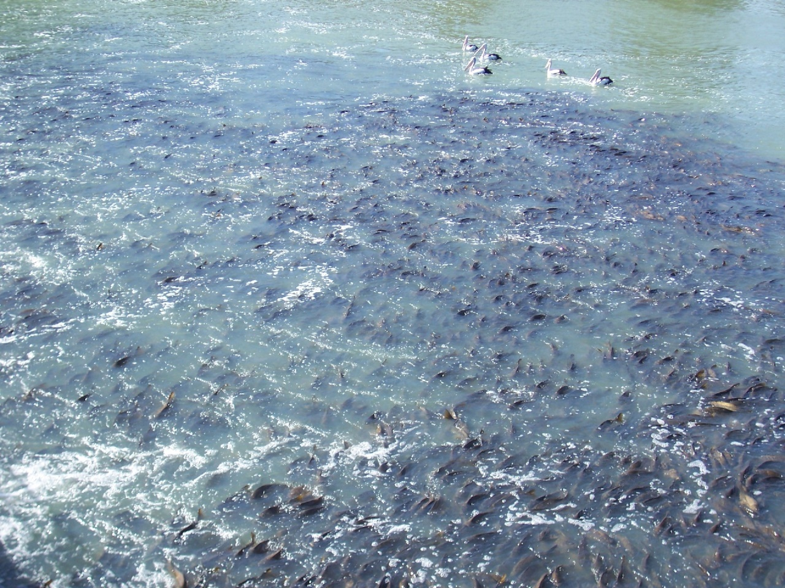
What 55 years of carp biomass actually looks like (NCCP biomass project)
Exceed density-impact thresholds (DIT)
100kg/ha in
97% of large rivers & 54% of wetlands
400,000 tonnes
Notes:
Message:
carp dominance is spatially structured, not uniform
Say:
Carp are not everywhere equally. That matters because it means management can be targeted.
Carp have dominated fish biomass for the past 50 years.
Control efforts remain fragmented, local and not at population scale.
No basin-scale population trajectory has been attempted.

Slide 4
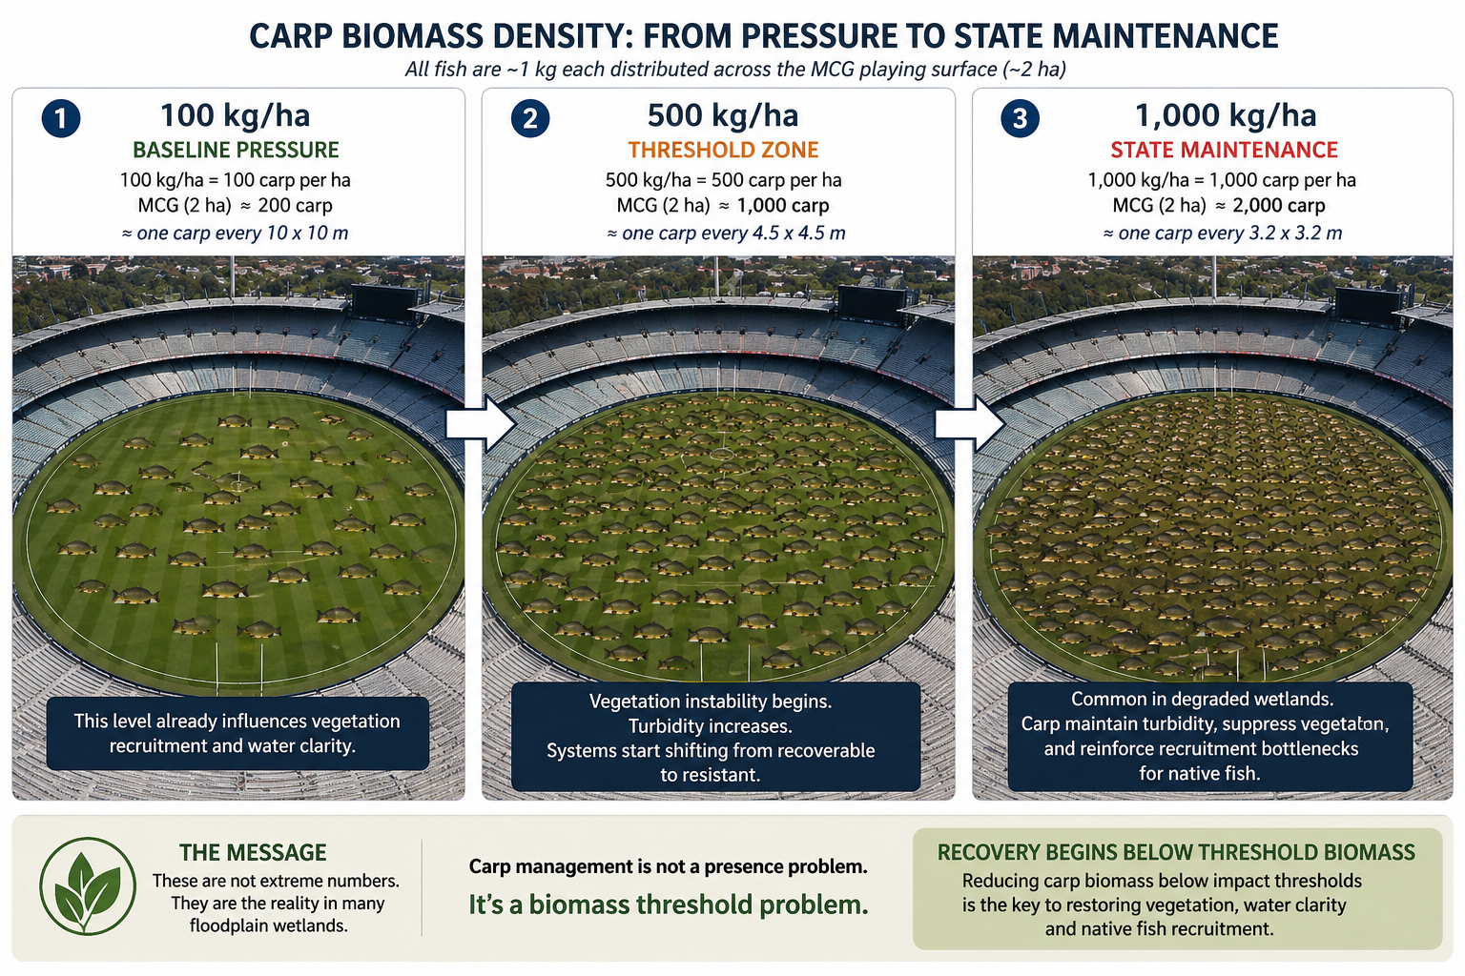

Slide 5

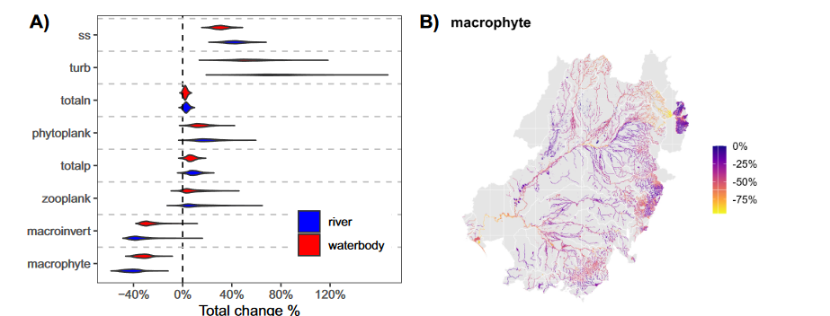
What are carp doing to our waterways?
Not just impacts – maintain degraded states
Notes:
Key idea:
ecological change begins well below 90% dominance
Say:
The ecological problem with carp begins long before they dominate a system.
Introduce:
~200–400 kg/ha = macrophyte collapse risk
800 kg/ha = persistent turbidity regimes likely

Slide 6
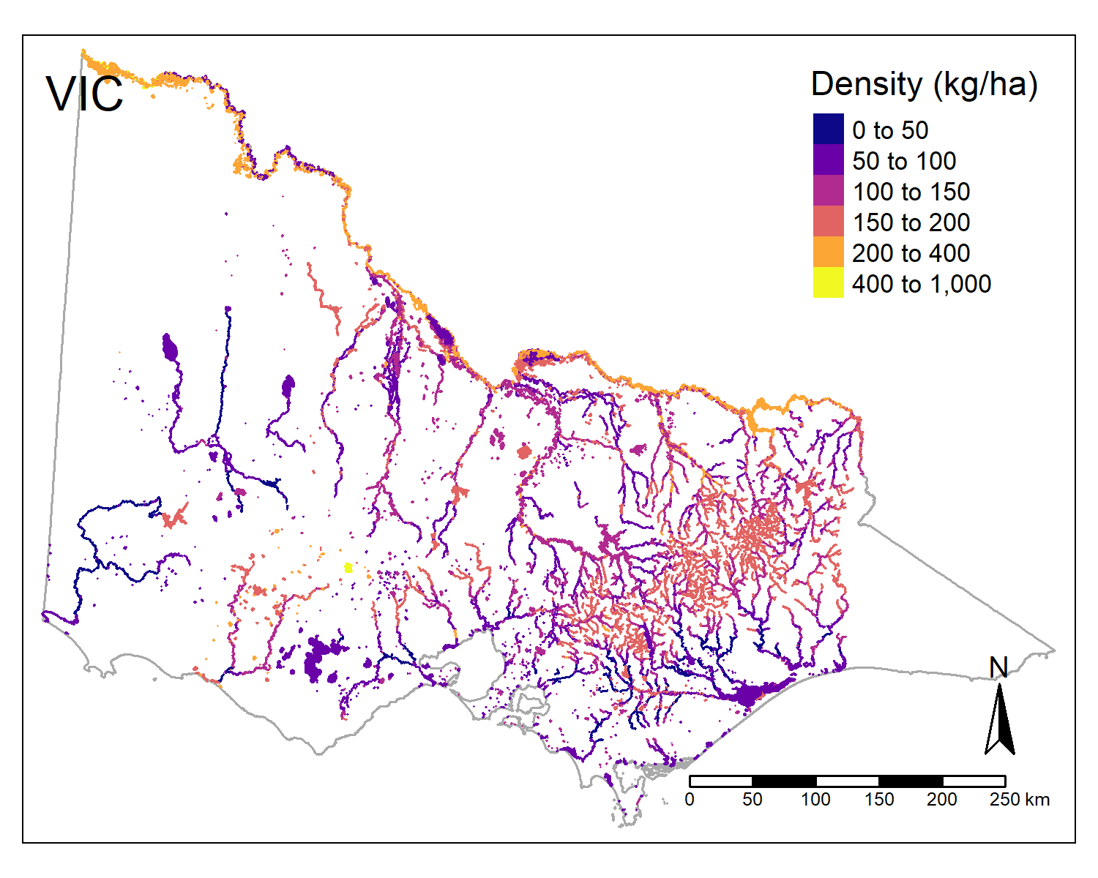
Carp trajectories are already visible
Protection
Suppression
Production
If biomass is organised spatially then carp trajectories become manageable.
Notes:
BUT a spatial trajectory already exists in the data
BUT recruitment geography is manageable
If recruitment geography is manageable, then carp trajectories are manageable.

Slide 7
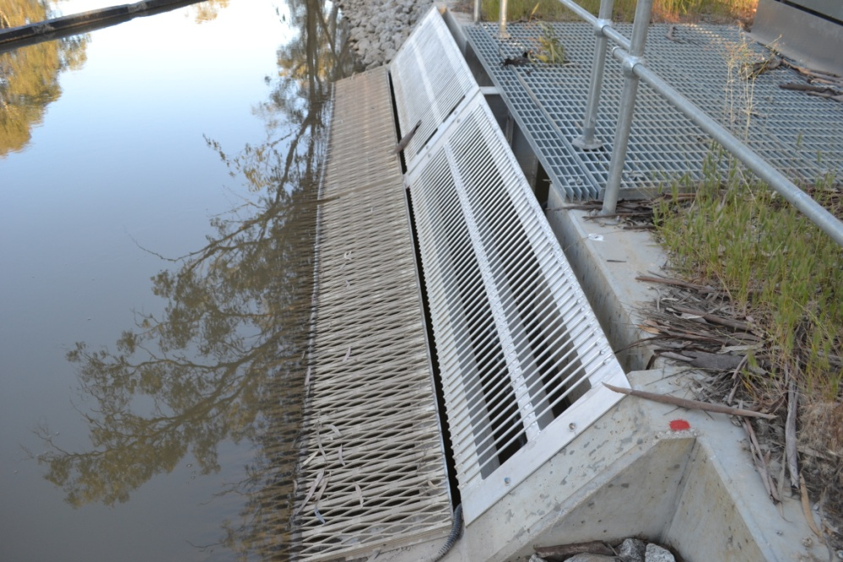
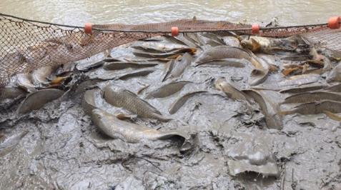
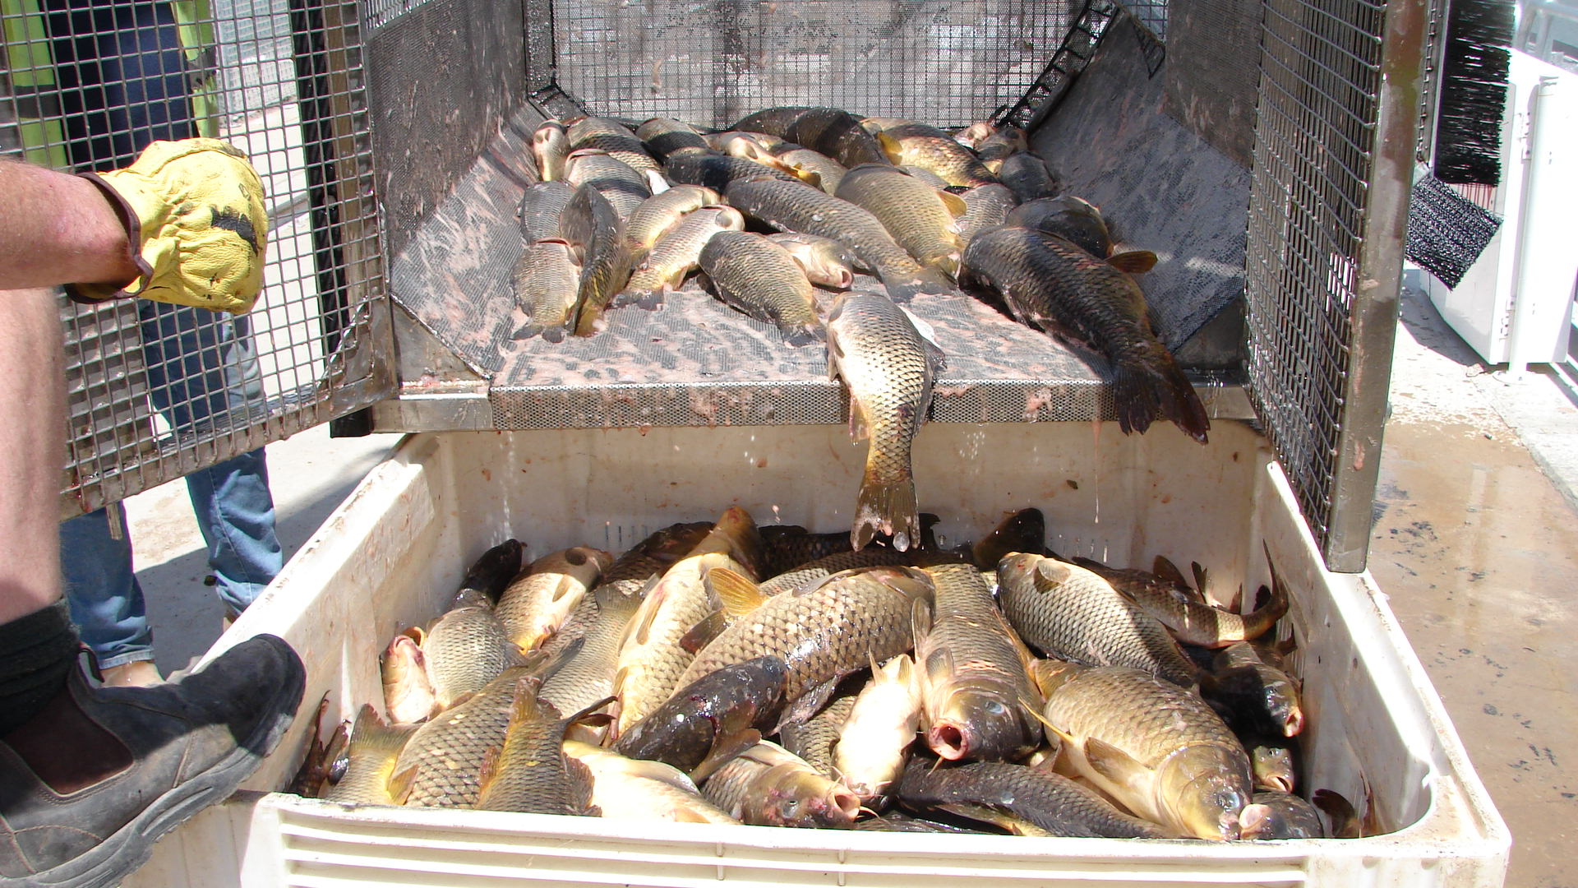
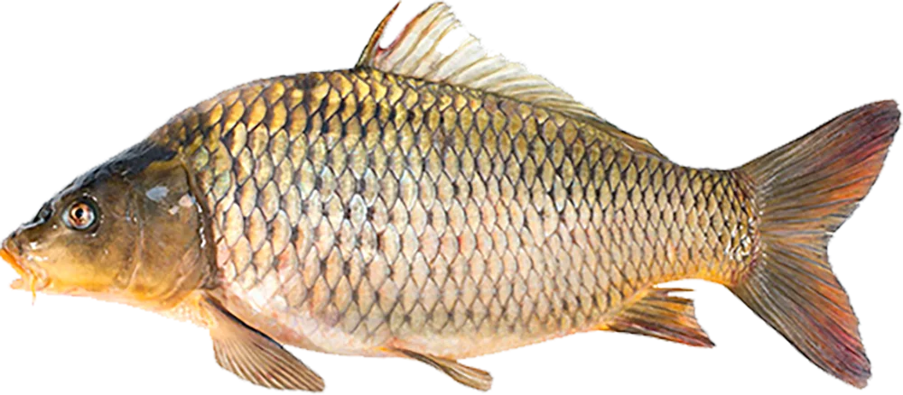
Protection
Zones
(keep carp
out)
Suppression
zones (biomass
reducible)
Production (carp
generated)
Biosecurity
Monitoring
Screens
Policy
(e.g. Tas)
Harvest
Wetland drying
Regional hubs
HIGHEST ECOLOGICAL RETURN (e.g. Ovens River)
Ecosystem condition
Bulk commercial removal from recruitment hot spots
Transform degraded carp production habitats
HIGHEST COMMERCIAL RETURN (e.g. lower Murray)
0
200
400
600+
Carp biomass (kg/ha)
Notes:
the national strategy has understandably focused on genetic biocontrol as a potential basin-scale solution, but recovery will still depend on removal systems capable of extracting biomass from recruitment hotspots.
Harvest is the missing middle layer
A credible carp strategy is not just about reducing numbers. It is about building the infrastructure to remove biomass at the scale the Basin produces it. That means regional processing hubs, smarter capture technology, and partnerships with industry alongside biocontrol—not instead of it.

Slide 8
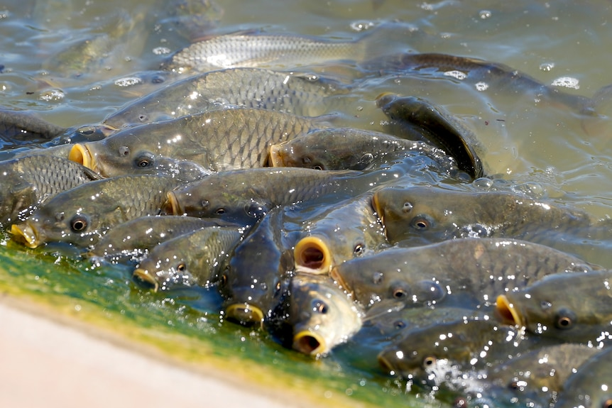
Recovery begins once biomass zones are explicit
Three steps:
Protect uninvaded systems (protection zone)
Shift production zones to suppression zones (biocontrol, harvest, wetland drying – IPM)
Restore stabilising habitat feedbacks (macrophytes, flow variability, screens, wetland isolation)
The question is not whether we can reduce
carp locally but whether we intend to
reduce them at basin-scale over decades.
Notes:
Carp management does not need to be uniform across the Basin. It needs to be strategic across three zones: protect where carp are rare, suppress where impacts are reversible, and transform where systems are already dominated.

Slide 9
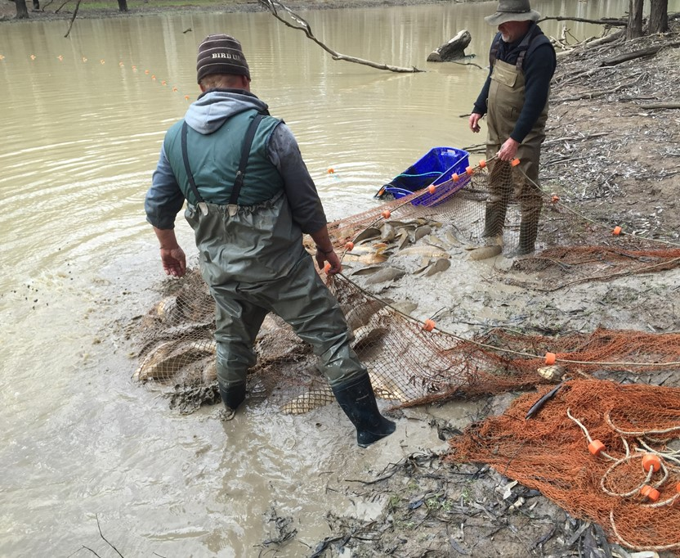
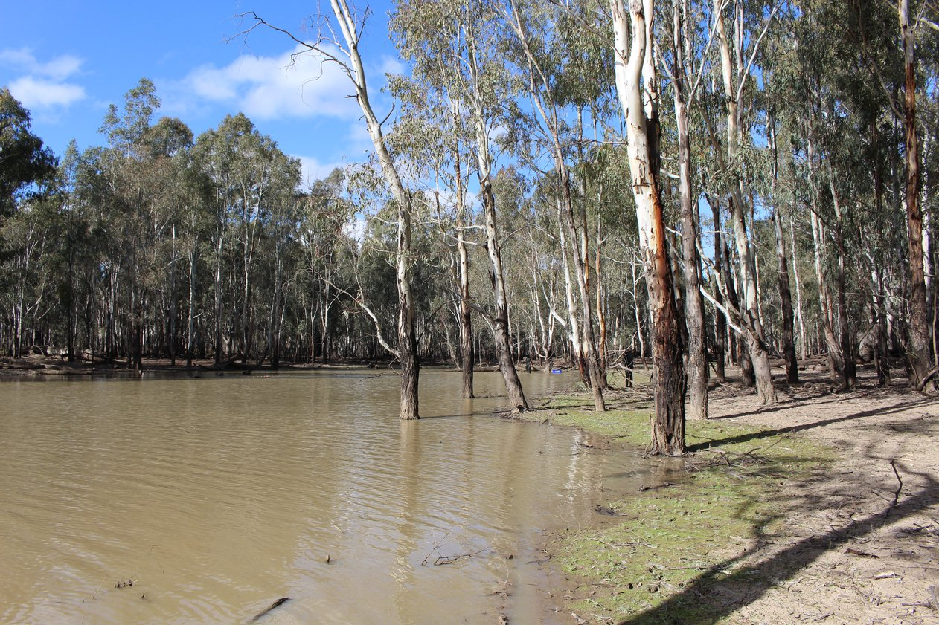
Local action already works: wetlands respond when carp pressure is reduced
wetlands reset through drying and carp removal
screening prevents reinvasion
regional harvest removes tonnes annually (Tasmania, Lock 1)
community monitoring maintains suppression zones
We already know regional communities are already shifting wetlands out of production states. The next step is connecting those local successes into a basin-scale trajectory.

Slide 10
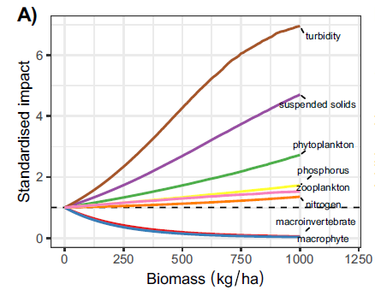
Choosing a carp trajectory: depends on what you value
Production zone
Suppression zone
Biocontrol could be a powerful basin-scale
suppression tool, but it does not replace
the need for a defined carp trajectory.
The required trajectory needs multiple
integrated control techniques
Notes:
200–400 kg/ha → macrophyte collapse risk
800 kg/ha → persistent turbidity regimes
turns carp from “a pest fish” into:
a state-change driver

Slide 11
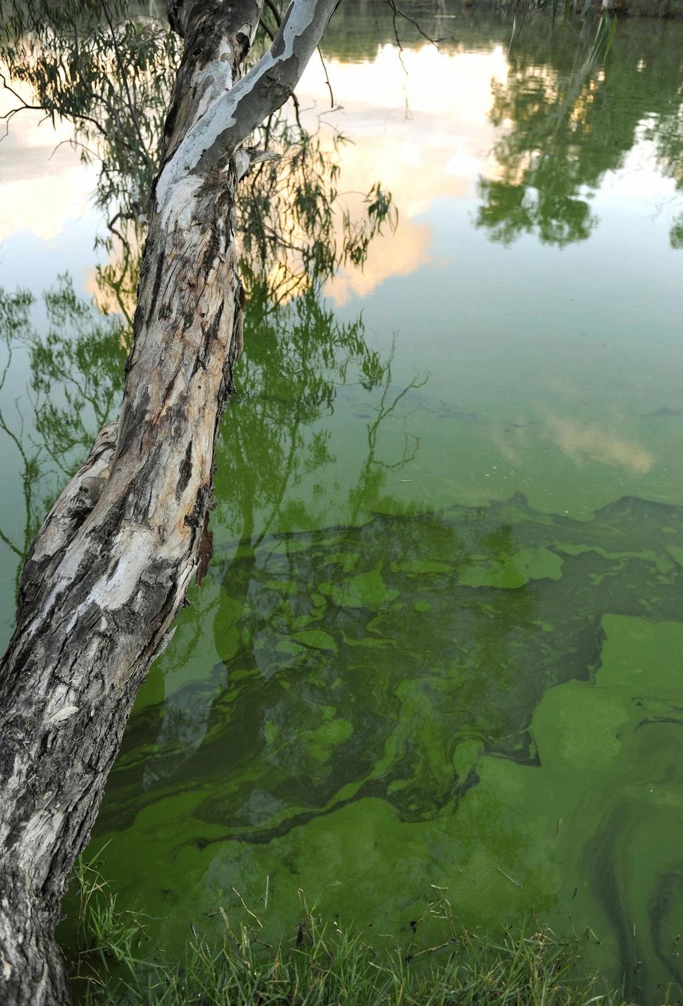
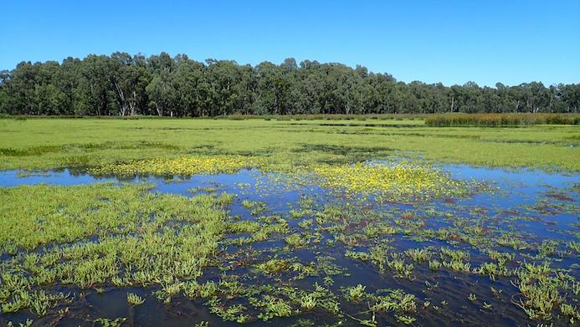
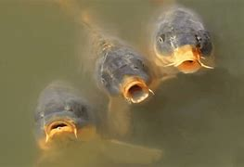
What success looks like
What changes over 20 years
Production footprint is reduced (e.g. lower Murray)
Suppression footprint is increased (e.g. Ovens River)
Protection footprint stable (e.g. Tasmania)
A roadmap for crossing into recovery thresholds in carp-dominated rivers
Success is not eliminating carp. Success is
shrinking the production footprint of the Basin.

Slide 12
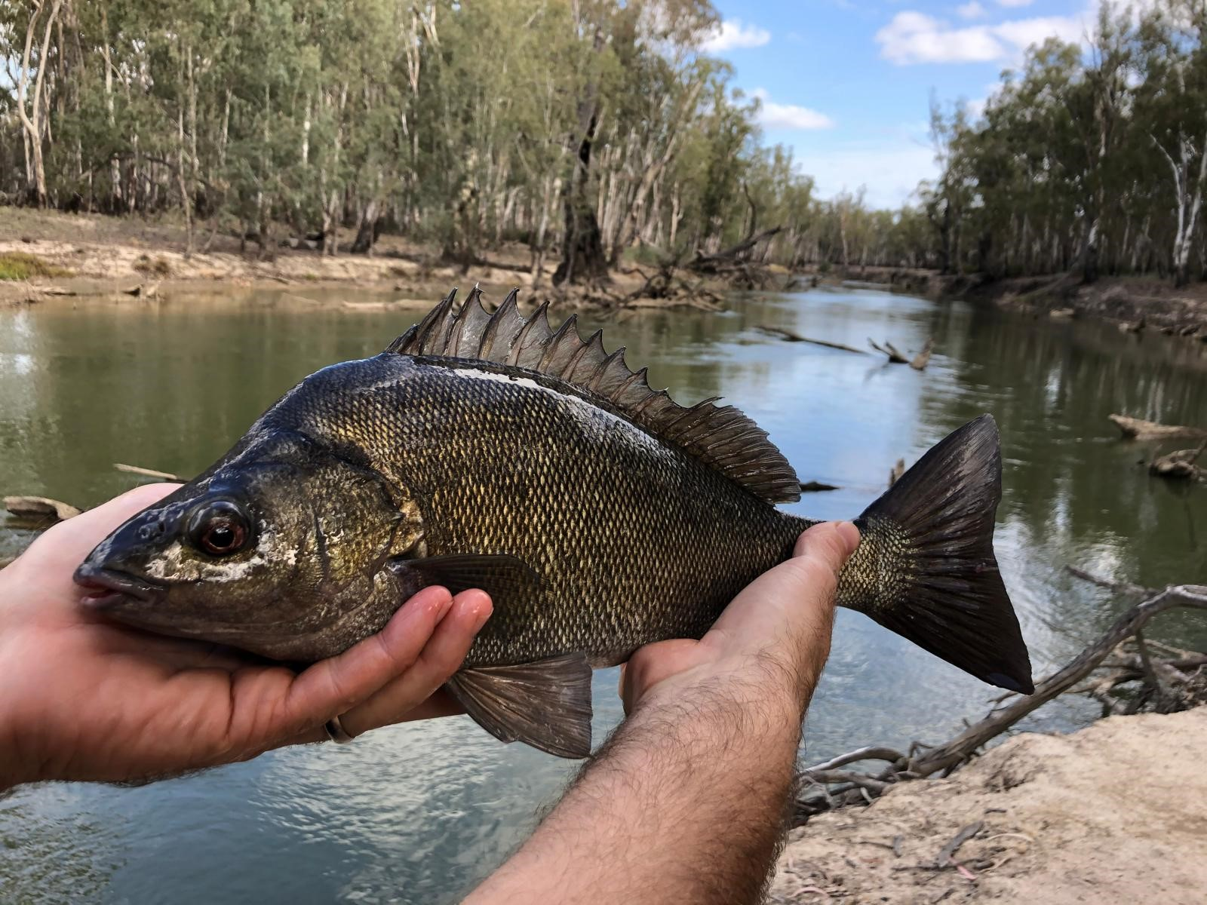
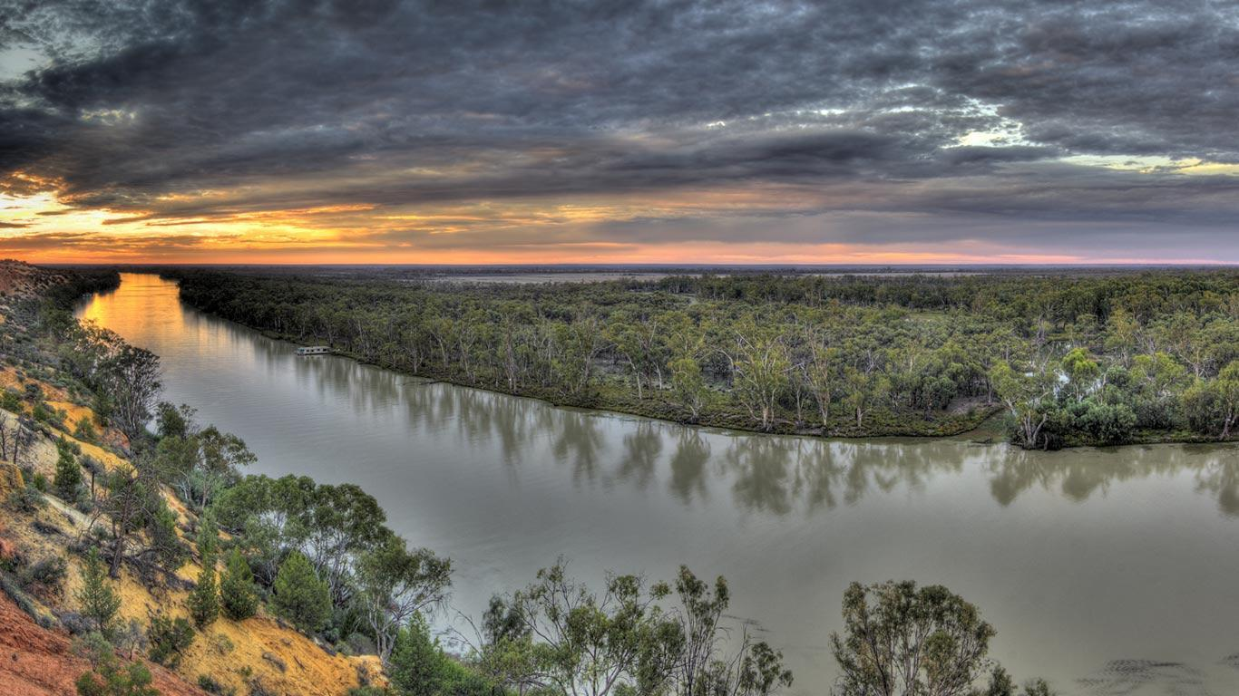

Final message
Without managing carp biomass, native fish recovery will remain limited—regardless of investment in flows, connectivity or habitat.
Carp are recognised everywhere but governed nowhere as a recovery constraint: an agreed & collaborative trajectory can change this.
ivstuart@csu.edu.au
Notes:
Biocontrol has the potential to reduce carp biomass at basin scale and remains an important component of the national response. But even if successful, recovery will still depend on protecting carp-free systems, suppressing biomass below impact thresholds in priority rivers, and disrupting recruitment in production zones.

