Slide 1


Carp Control – A key Recreational Fisher issue
Anthony McGrath
Executive Officer

Slide 2
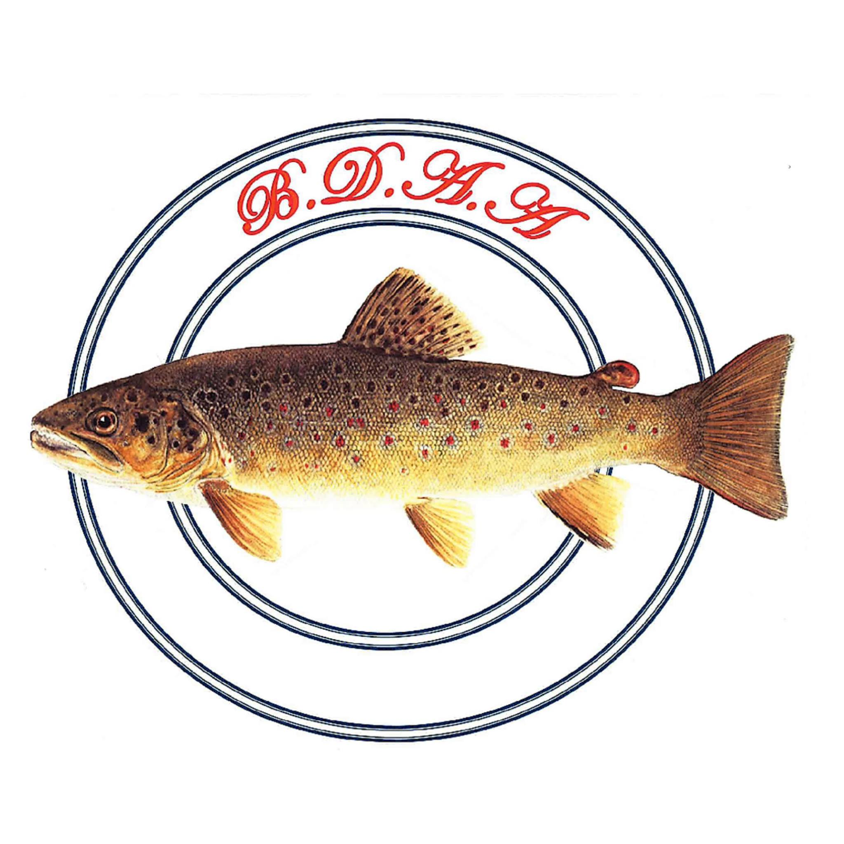











VRFish – The peak body for 31 years
150 fishing clubs and associations
370 individual members
160 financial members
55,000 subscribers

Slide 3
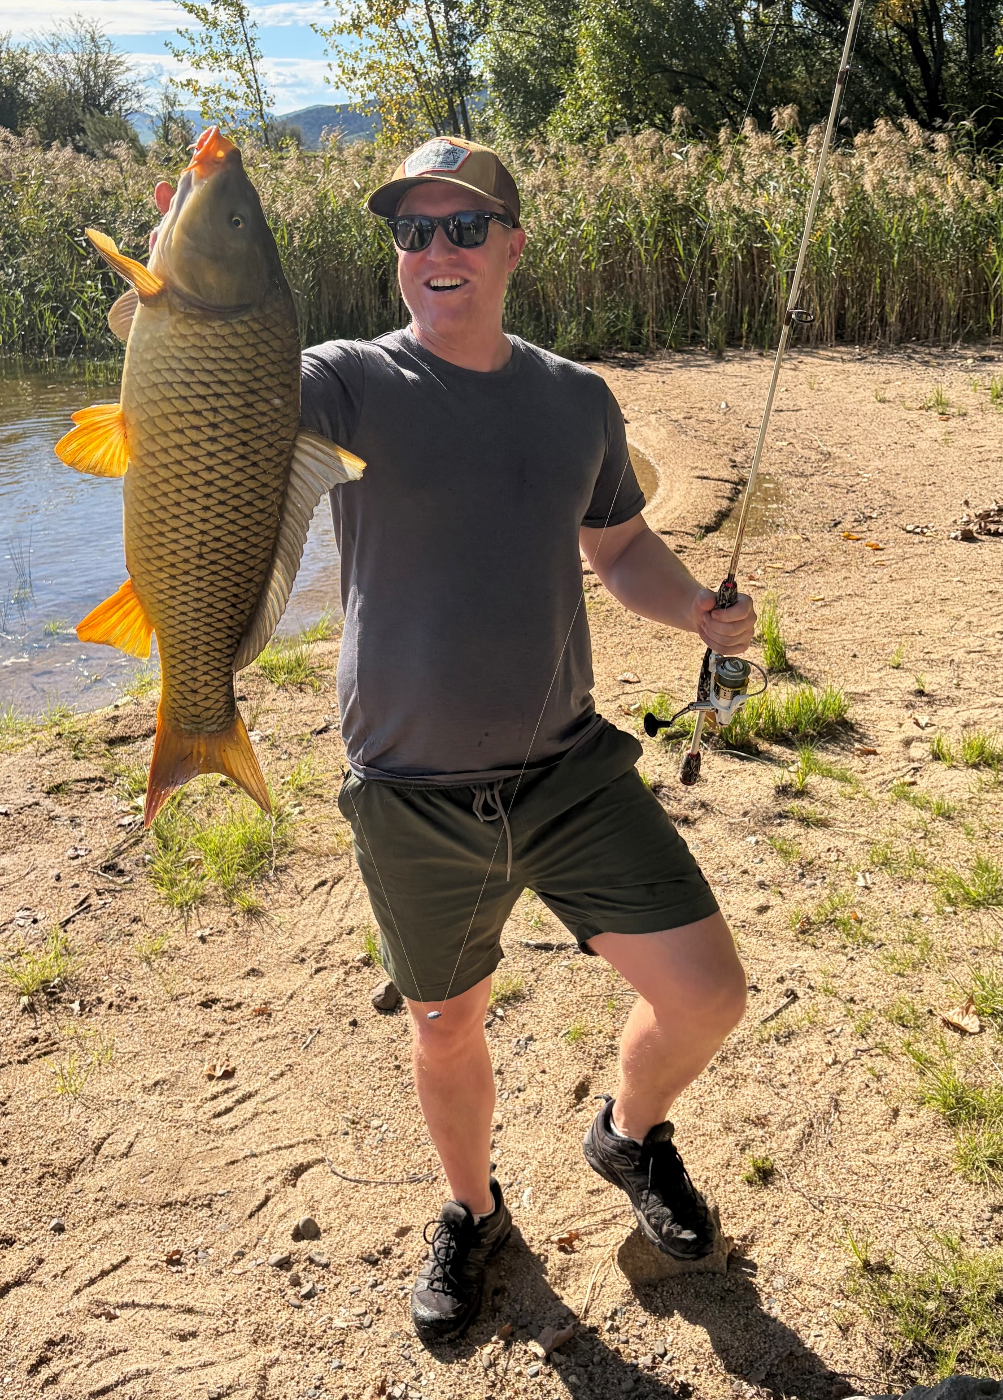
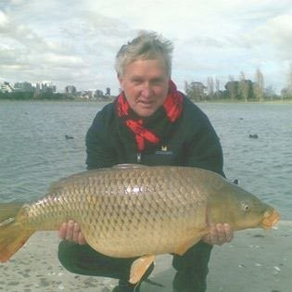
Carp in our waters

Slide 4
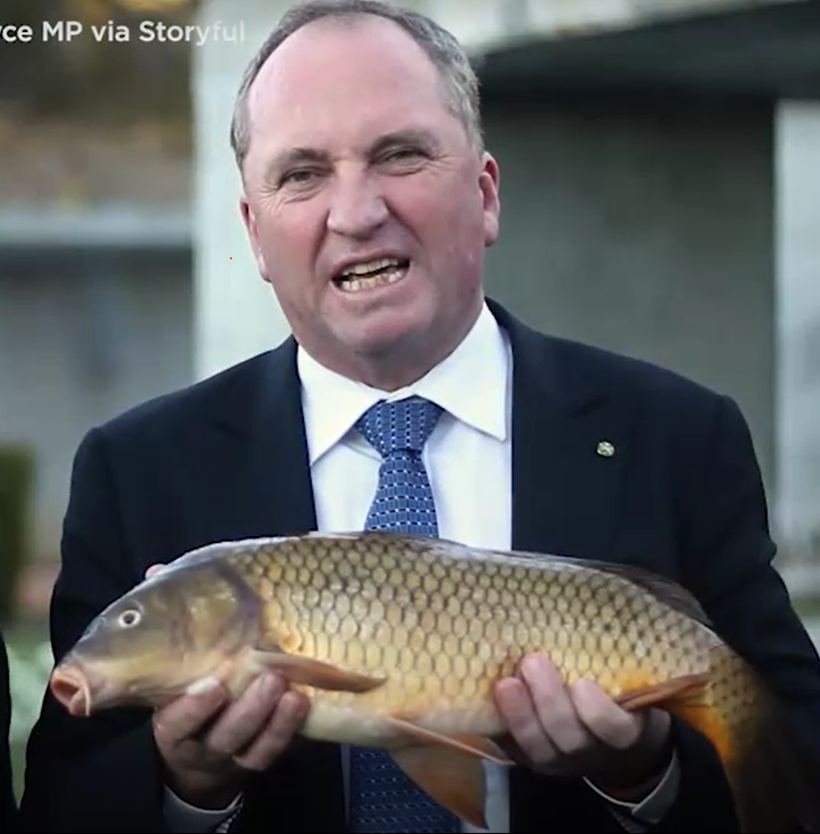
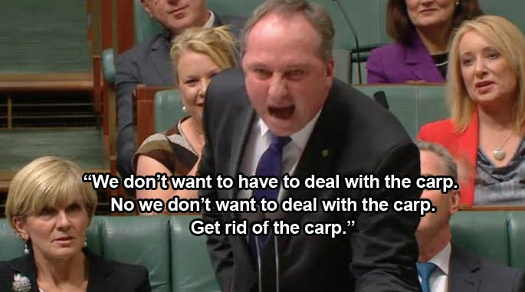

Carp on the national agenda

Slide 5
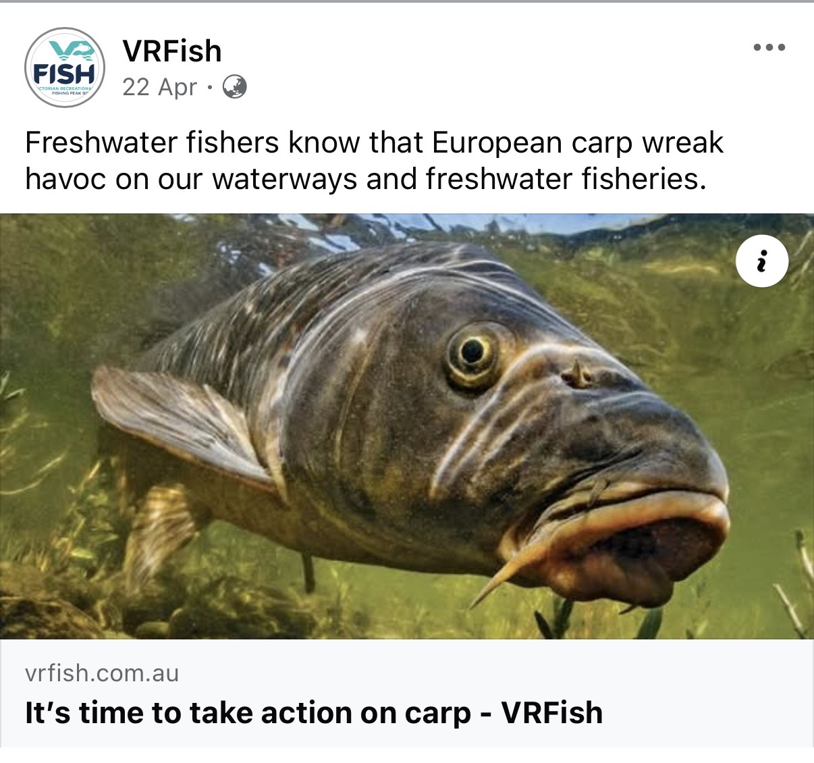
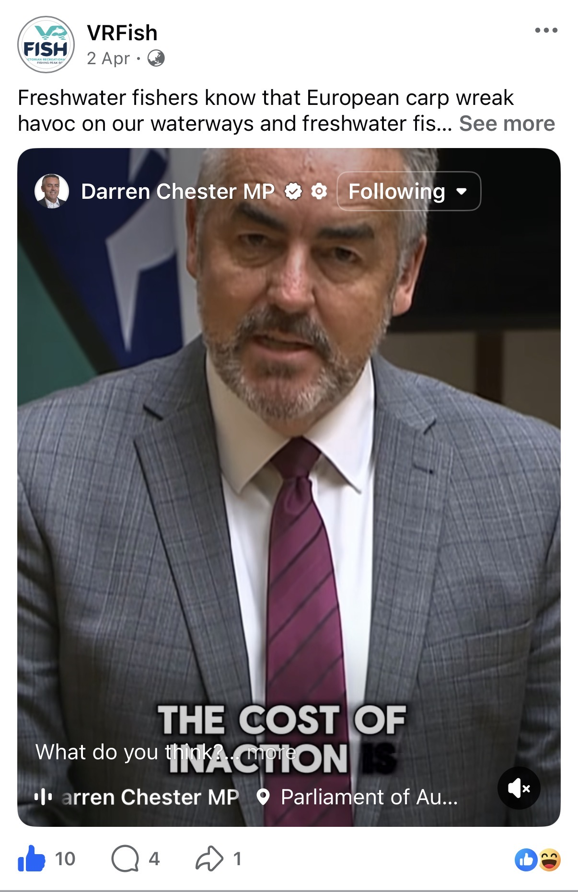


Back on the agenda

Slide 6
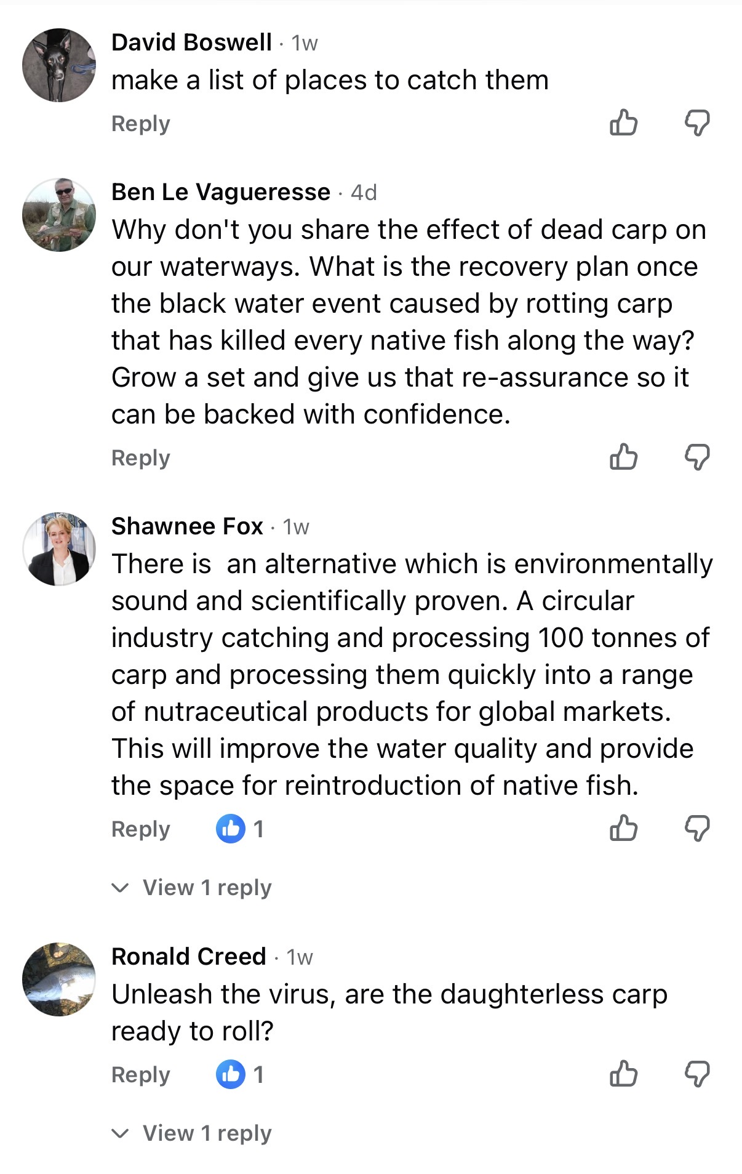
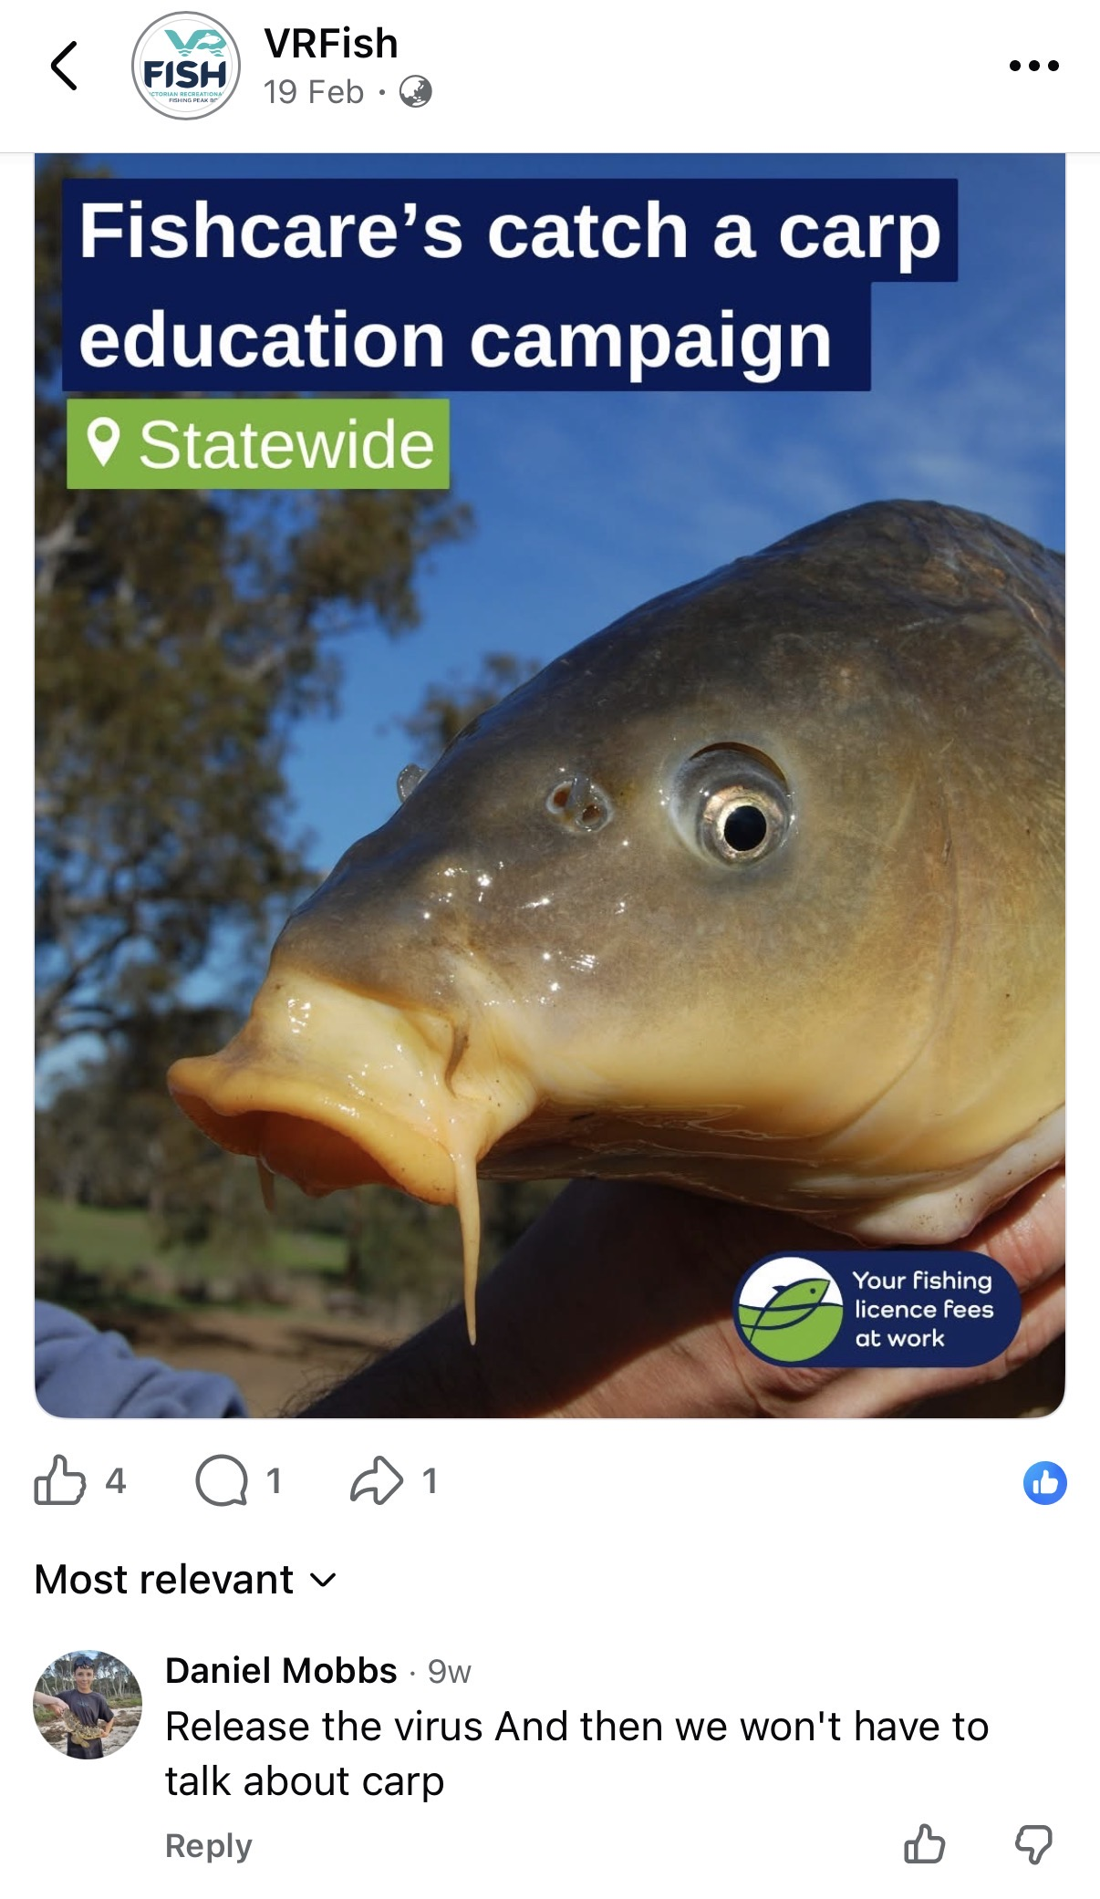
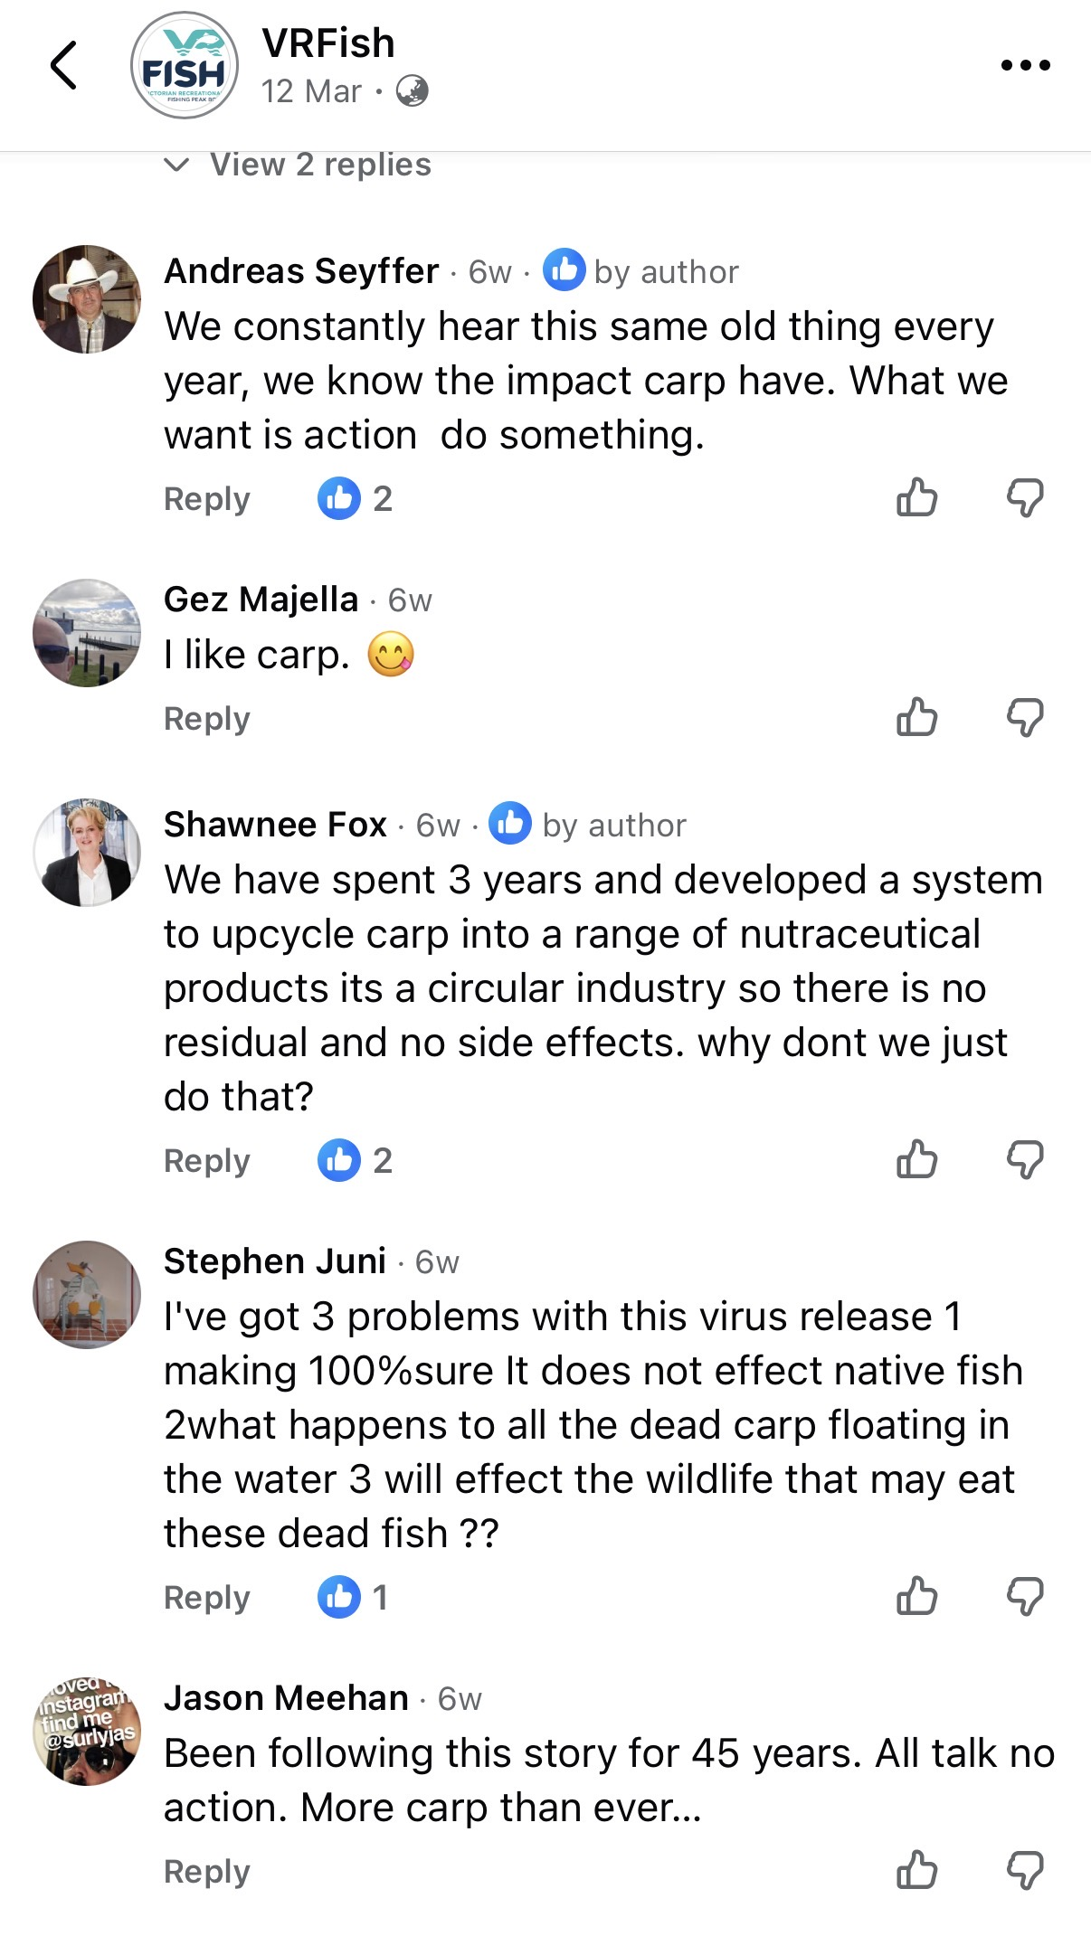
Fishers are demanding action

Slide 7
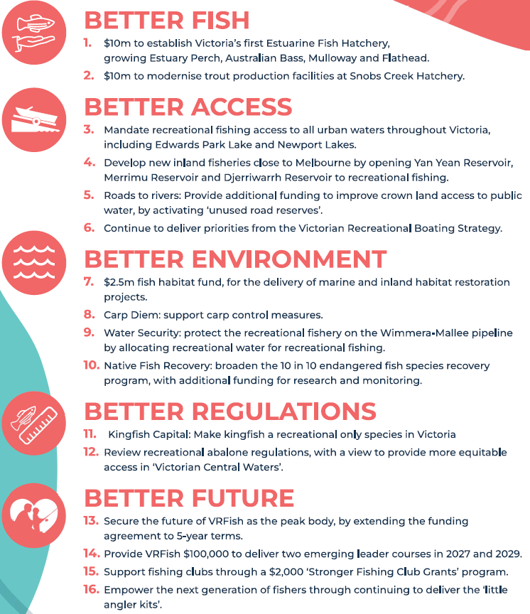

2026 Victorian State election

Slide 8
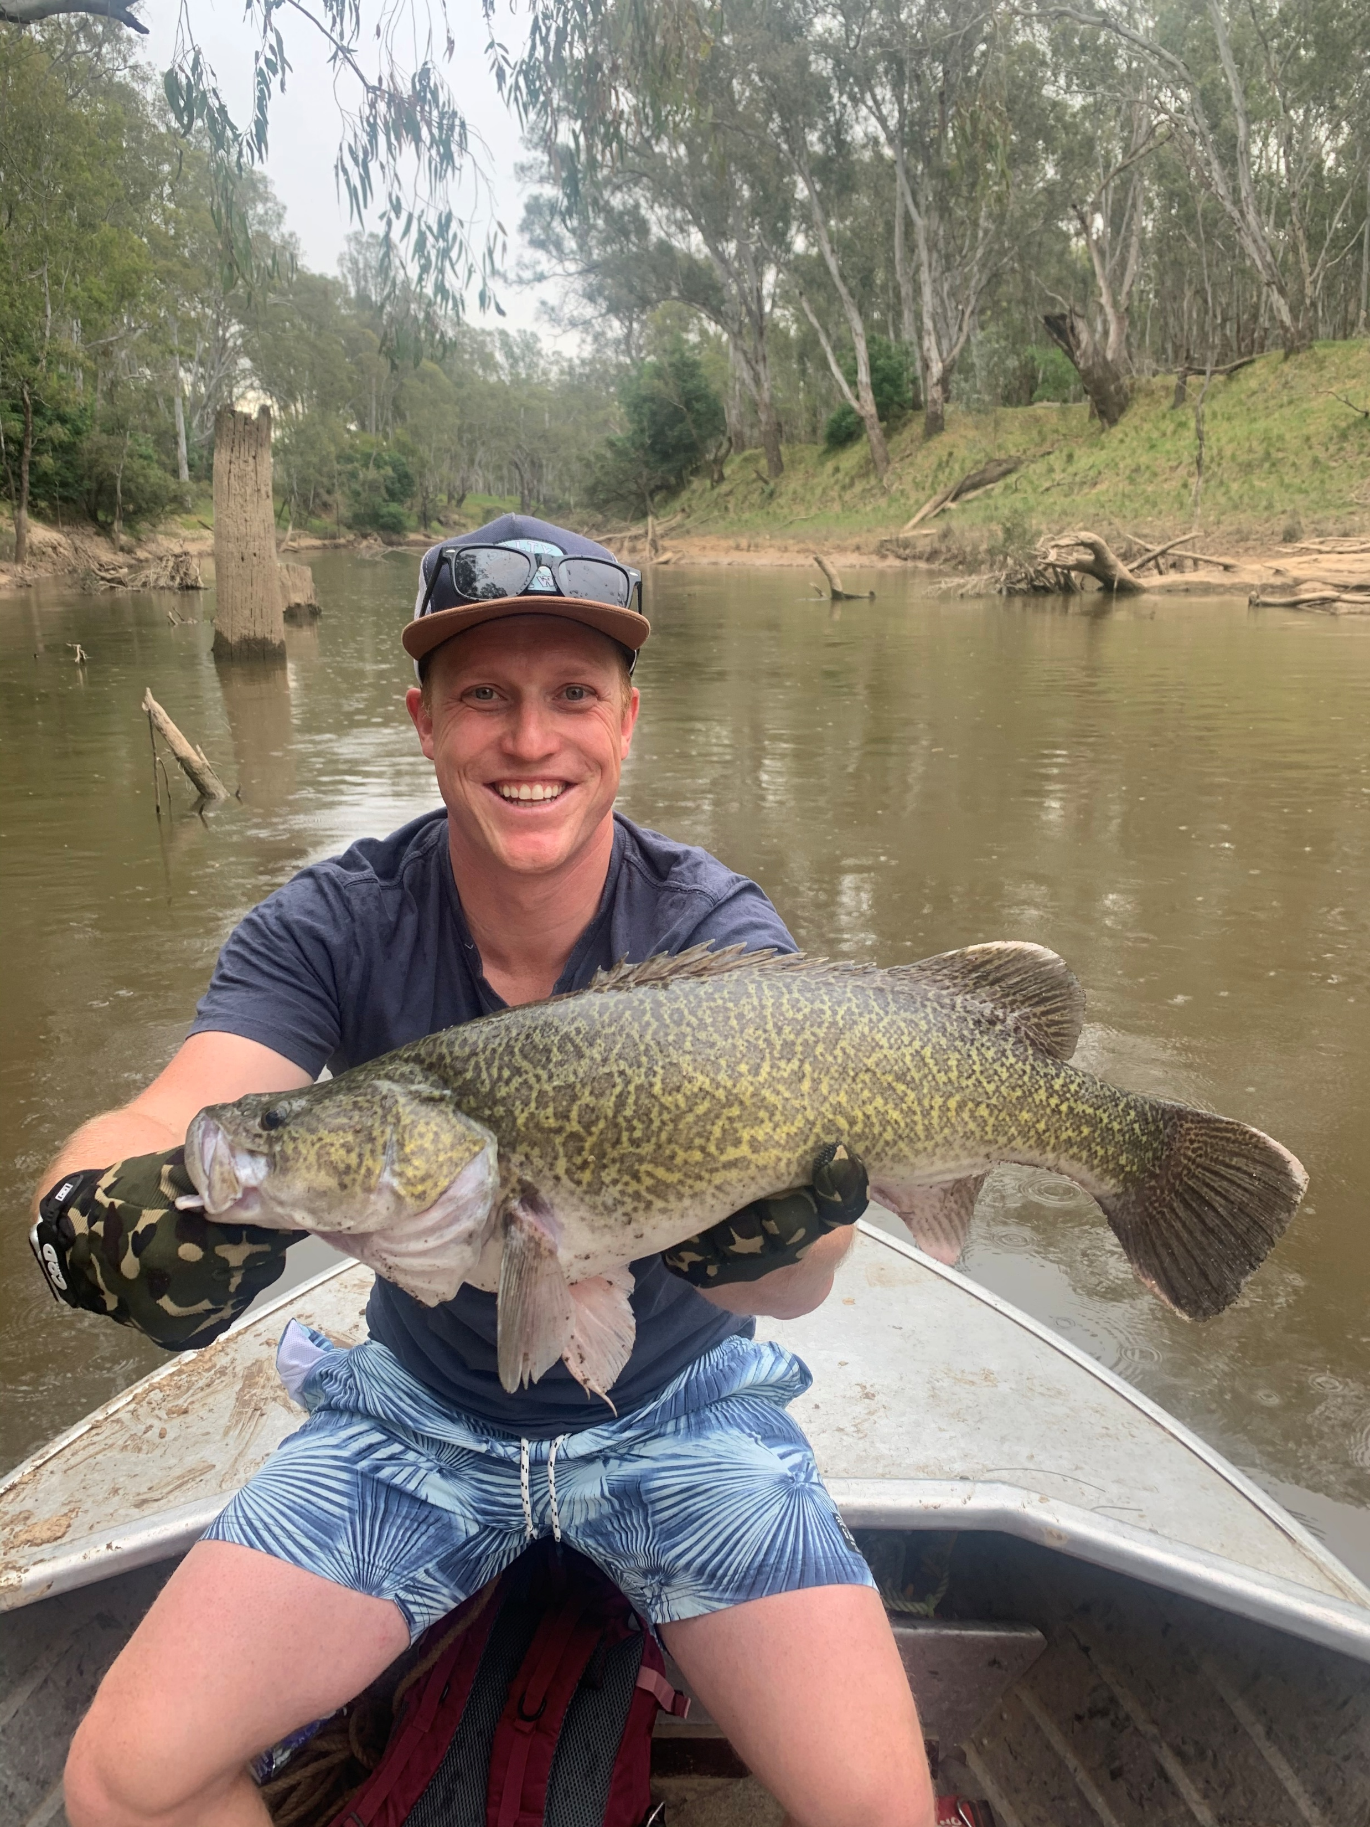
Skin in the game (RFL spend on carp)
Direct Carp expenditure
Around $400,000 in the last 5 years
Indirect habitat and access
$1.9 million in the last 5 years

Slide 9
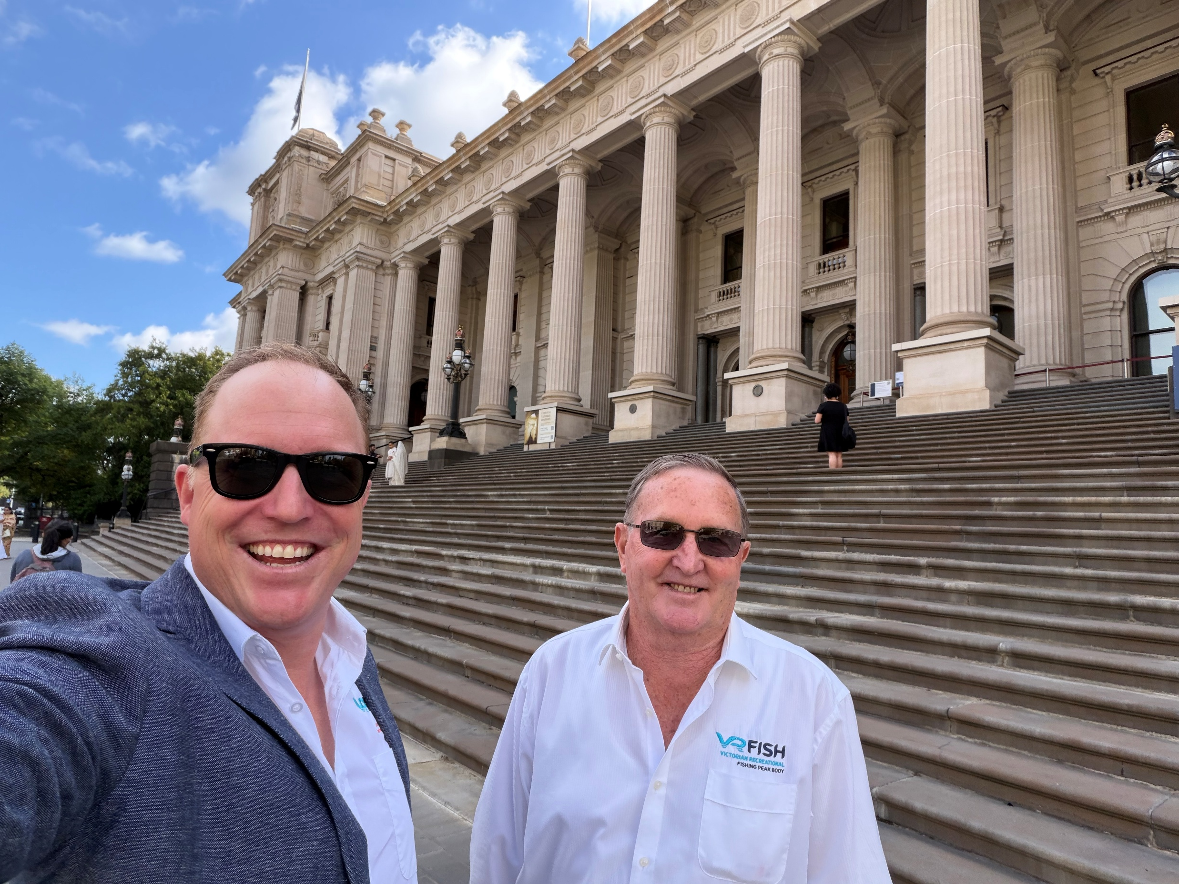
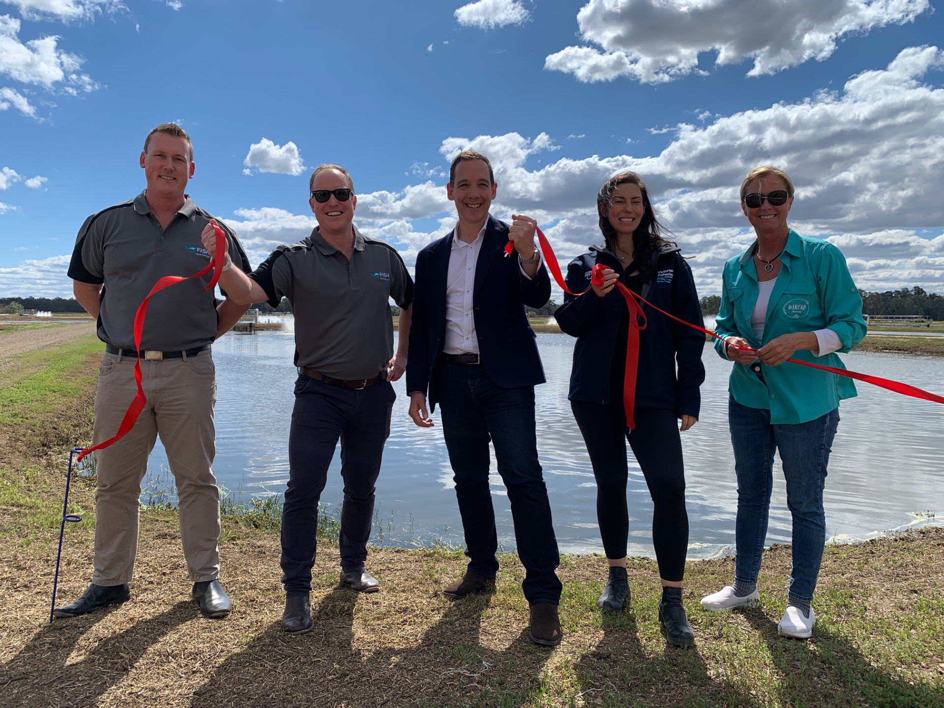
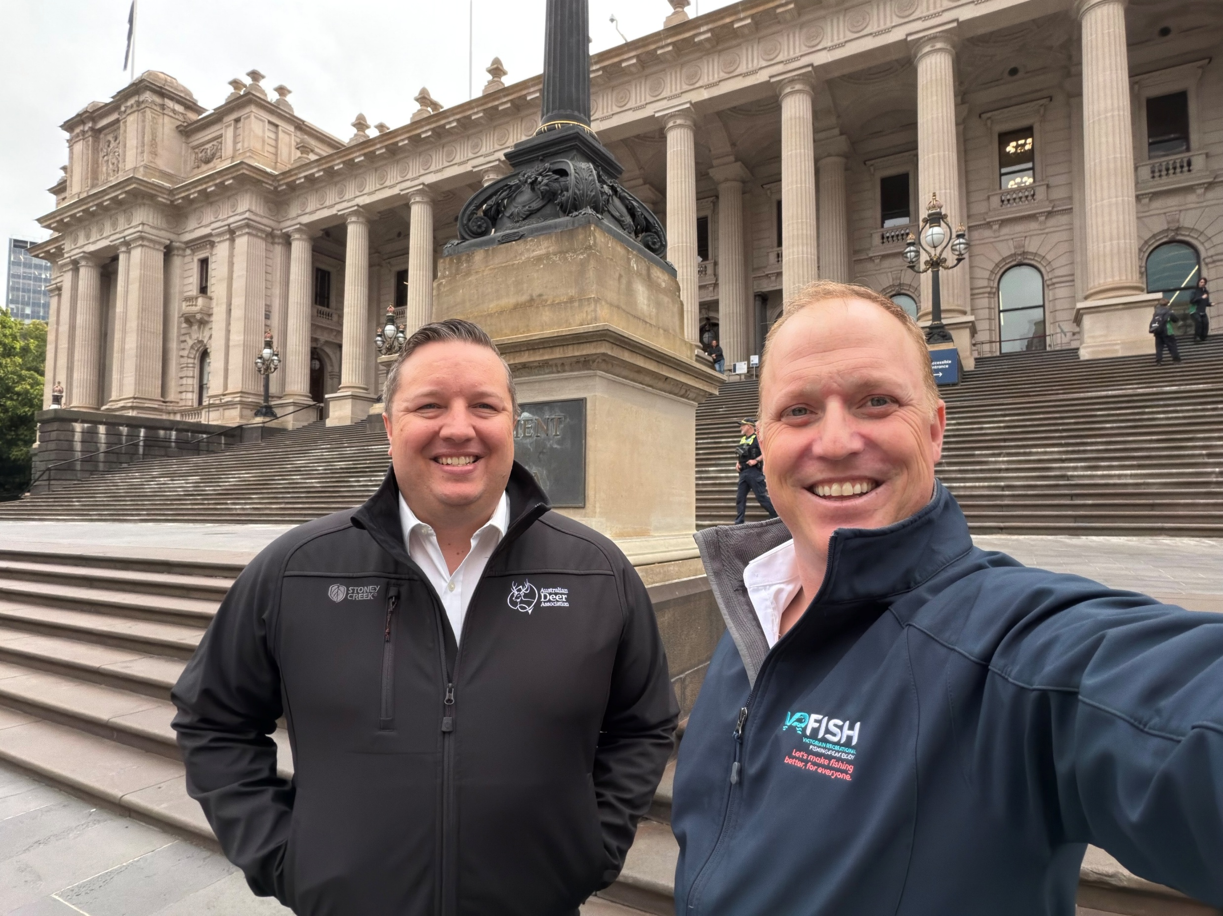
Advocacy

Slide 10
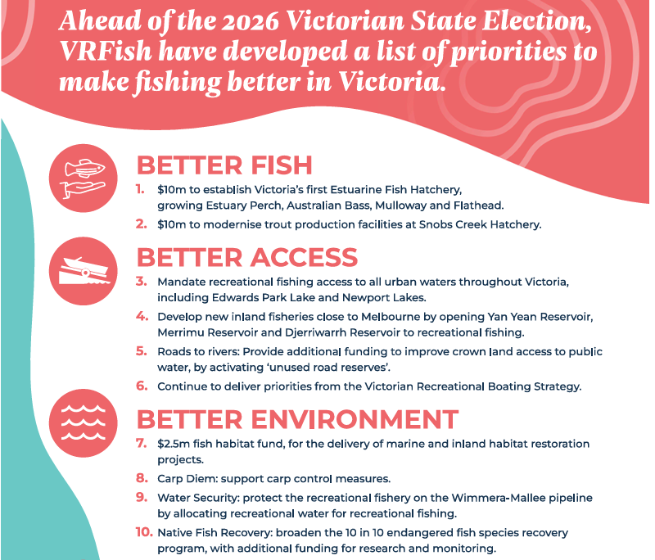
2026 Victorian State election

Slide 11
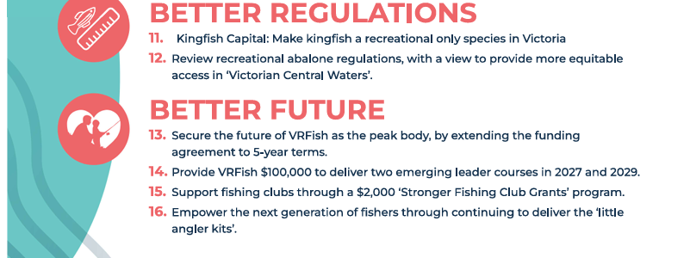
2026 Victorian State election..cont’d

Slide 12


Scan the QR Code or visit www.vrfish.com.au/join
Annual Individual Membership subscription: $25

