Slide 1

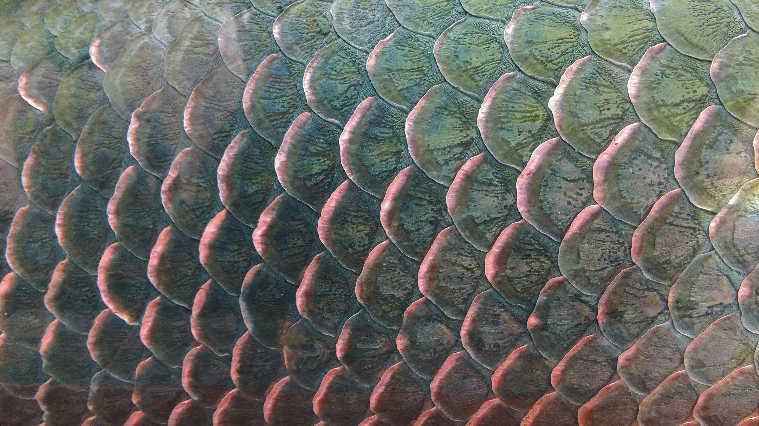


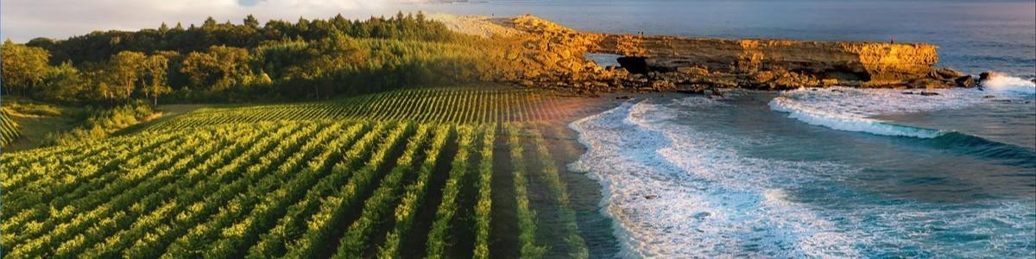
Scaling Australia’s Marine
Biostimulant Industry

Slide 2

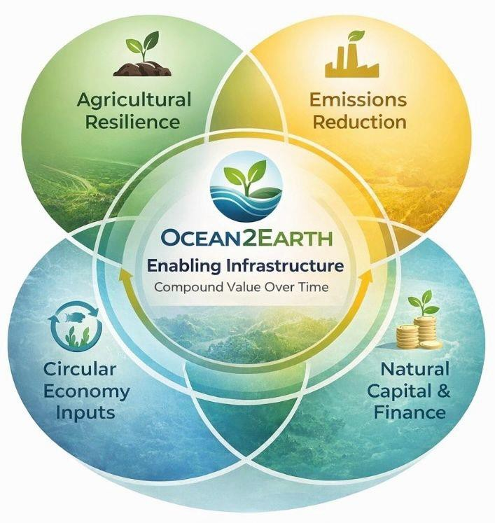
Introduction
Ocean2Earth (O2E) is an Australian circular marine bioproducts company converting underutilised seafood and marine side streams into regenerative agricultural inputs.
Founded in regional NSW to address seafood waste challenges, O2E has progressed from small-scale collection and composting into an integrated marine bio-stimulant manufacturing platform.
We operate active collection, recovery, fermentation and processing systems across regional Australia (NSW, VIC and expanding into TAS).
Through 7+ years of applied R&D, we have developed a growing portfolio of biological products now integrated into commercial on-farm programs, delivering measurable and repeatable outcomes.
O2E is supported by the Pentarch Group, providing capital, industrial capability, governance oversight and semi national-scale infrastructure.

Slide 3
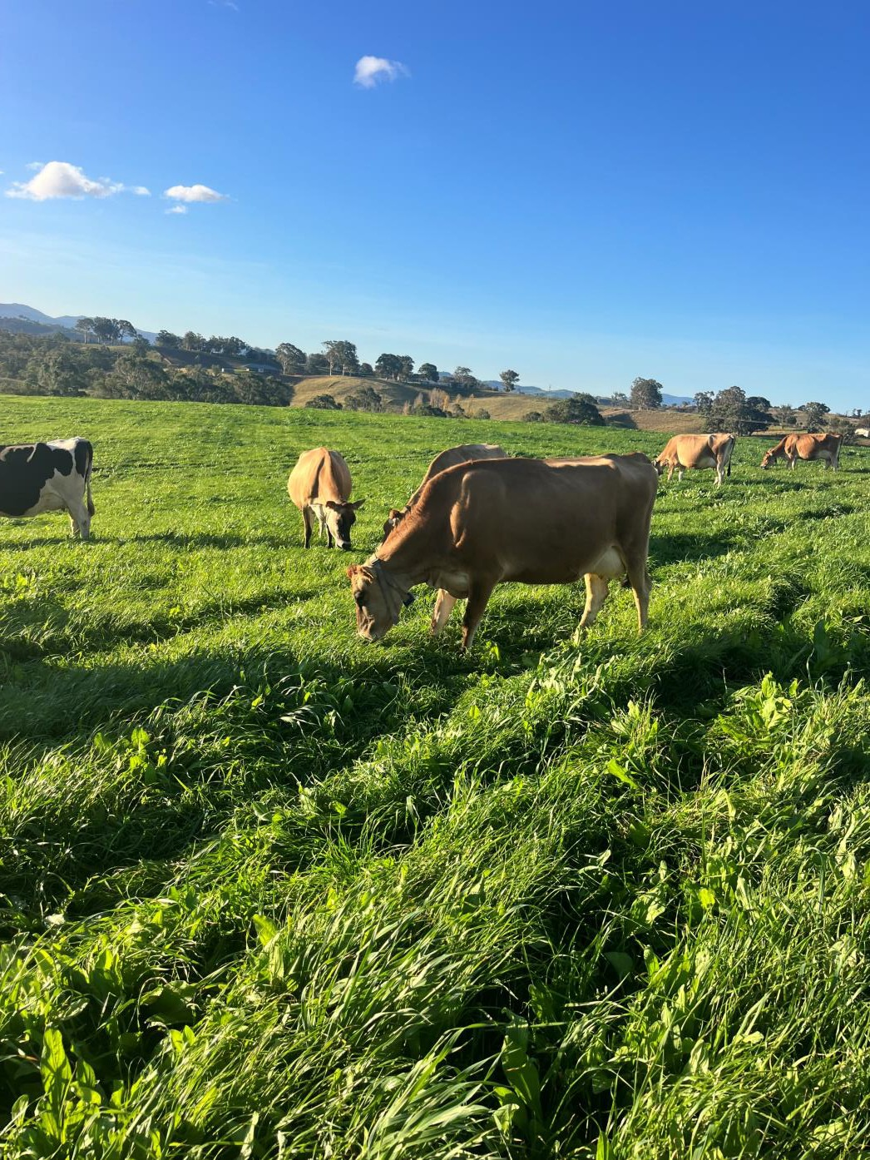

Our Vision - Connecting Ocean 2 Earth
Every year in Australia, thousands of tonnes of nutrient-rich marine
by-products are landfilled or underutilised, while millions of tonnes of fertiliser inputs are imported to sustain agricultural production.
We believe the future of Australian agriculture lies in reconnecting
these systems - recovering marine nutrients and returning them to
productive soils through circular, regenerative systems.
We see a future where:
Marine side streams are recognised as a strategic agricultural asset
Soil health and biology is strengthened across farming systems
Productivity improved with lower emissions intensity
Regional industries strengthened through circular resource recovery
Why it matters
Healthy Soils → Resilient Farms → Healthy Livestock → Healthy Food Systems → Healthier Communities

Slide 4
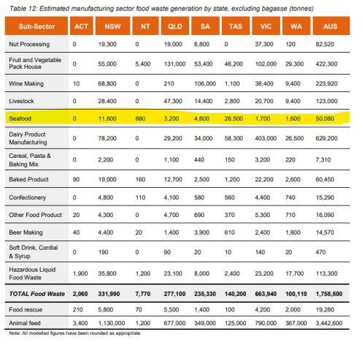
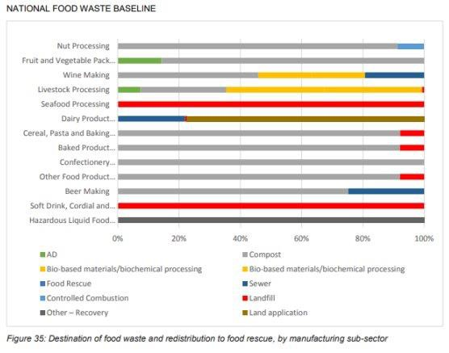
Why we do it

Slide 5
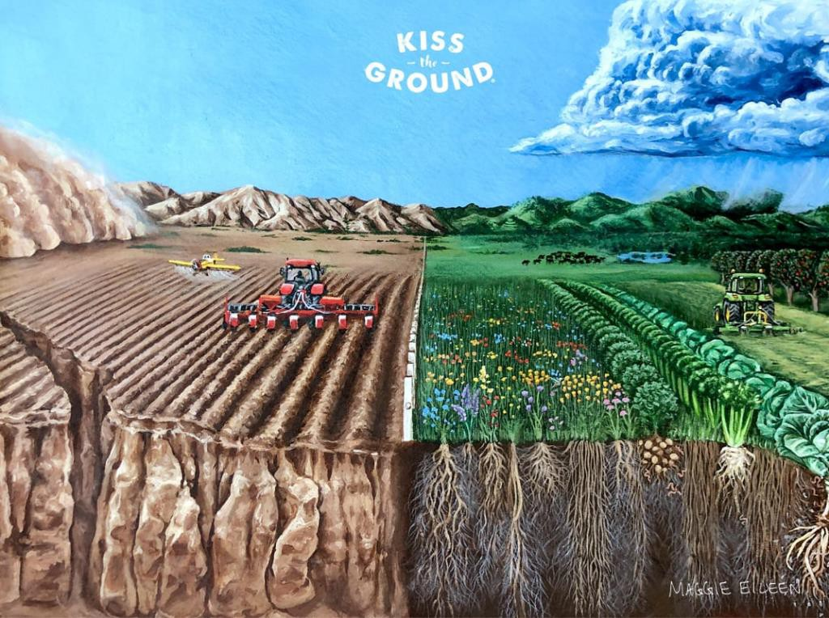
Why we do it cont.
Australia’s soils are deficient in the nutrients, minerals and biology that are in marine bioproducts.
Australia relies heavily on imported fertiliser (particularly urea), exposing agriculture to global supply shocks, price volitility and geopolitical risk. Domestic production is a strategic necessity.
With a global shift to regenerative agriculture, biological and natural products there are opportunities to improve traditional farming practices by adopting a circular economy principles.

Slide 6
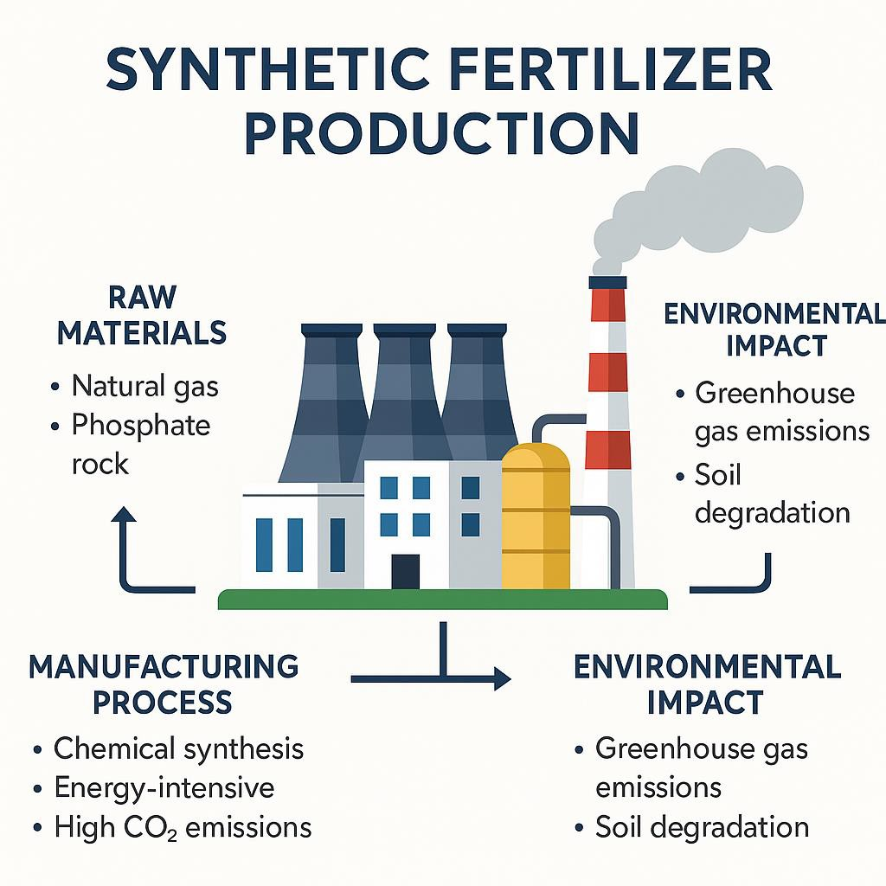
Synthetic fertilisers - NPK
Made using the Haber-Bosch process, which combines nitrogen from the air with hydrogen from natural gas at very high heat and pressure to create ammonia.
It’s one of the most energy-intensive industrial processes on Earth, relying heavily on fossil fuels and producing large amounts of CO₂.
Producing just one tonne of ammonia uses as much energy as powering 60 Australian homes for a week.
Ammonia production accounts for about 2% of global energy use and 1-1.5% of global CO₂ emissions.
Phosphate and potash fertilisers are mined from finite mineral deposits and chemically processed.
These mineral reserves are declining, making supply more expensive and geopolitically risky.
Most synthetic fertilisers are imported, adding more embedded emissions and supply-chain risk.

Slide 7
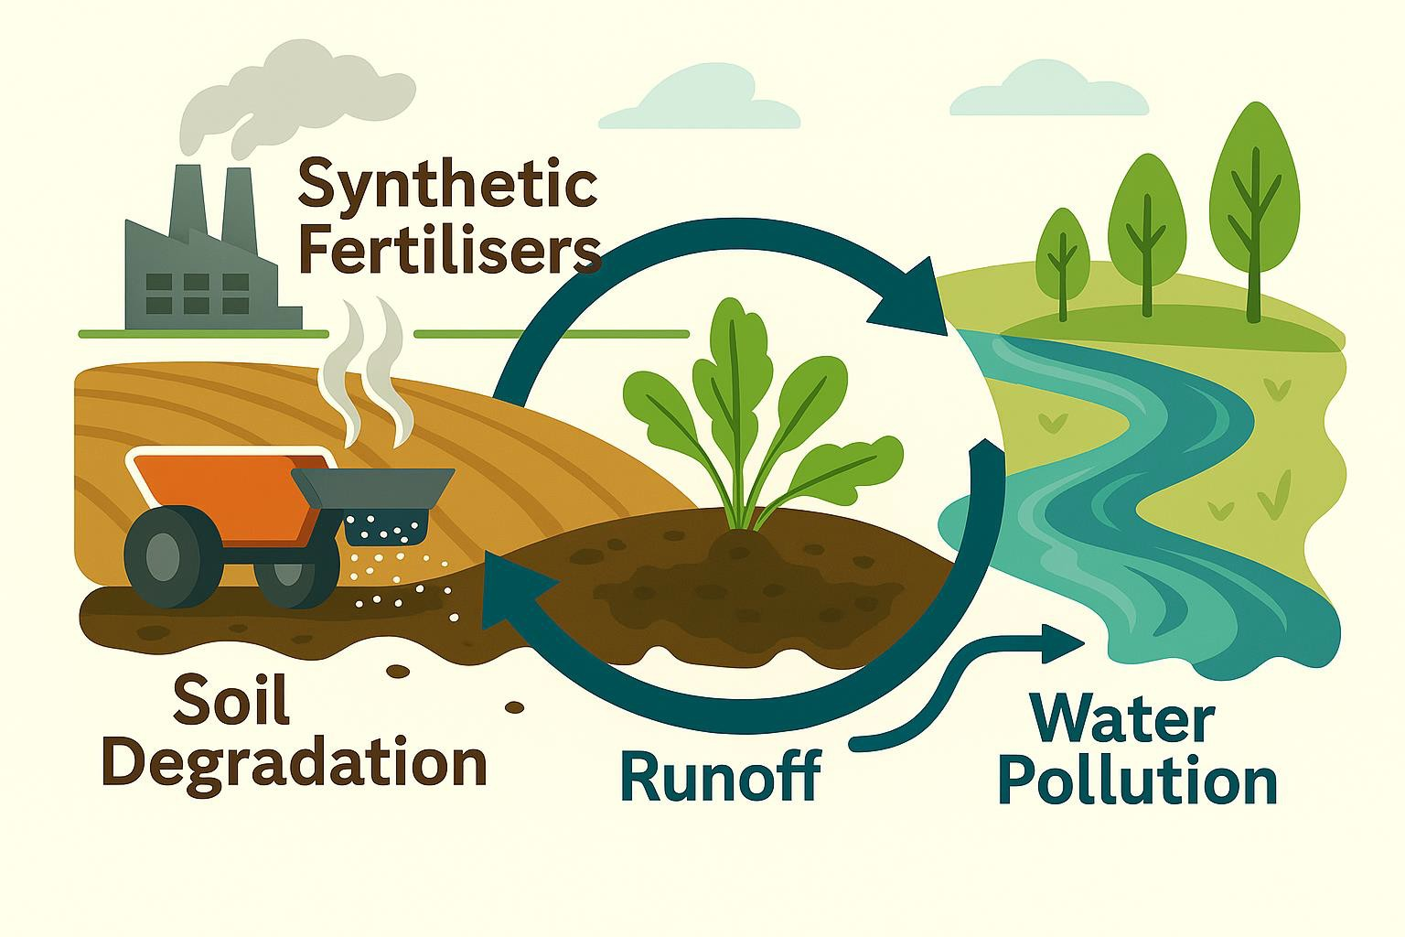
Issues with Synthetic Fertilisers
Only 30–50 % of applied synthetic nitrogen is taken up by plants - the rest is lost as runoff, leaching, or gas.
Nitrous oxide (N₂O), released from synthetic
nitrogen, is ~300× more potent as a
greenhouse gas than CO₂.
Causes eutrophication and algal blooms in waterways due to nutrient runoff (SA algal bloom)
Leads to soil acidification, declining microbial life, and reduced carbon sequestration capacity.
Long-term use increases dependence - soils become biologically inert, requiring more chemical input for the same yield.
Heavy reliance on imports exposes Australian agriculture to volatile global fertiliser prices and supply shocks.

Slide 8
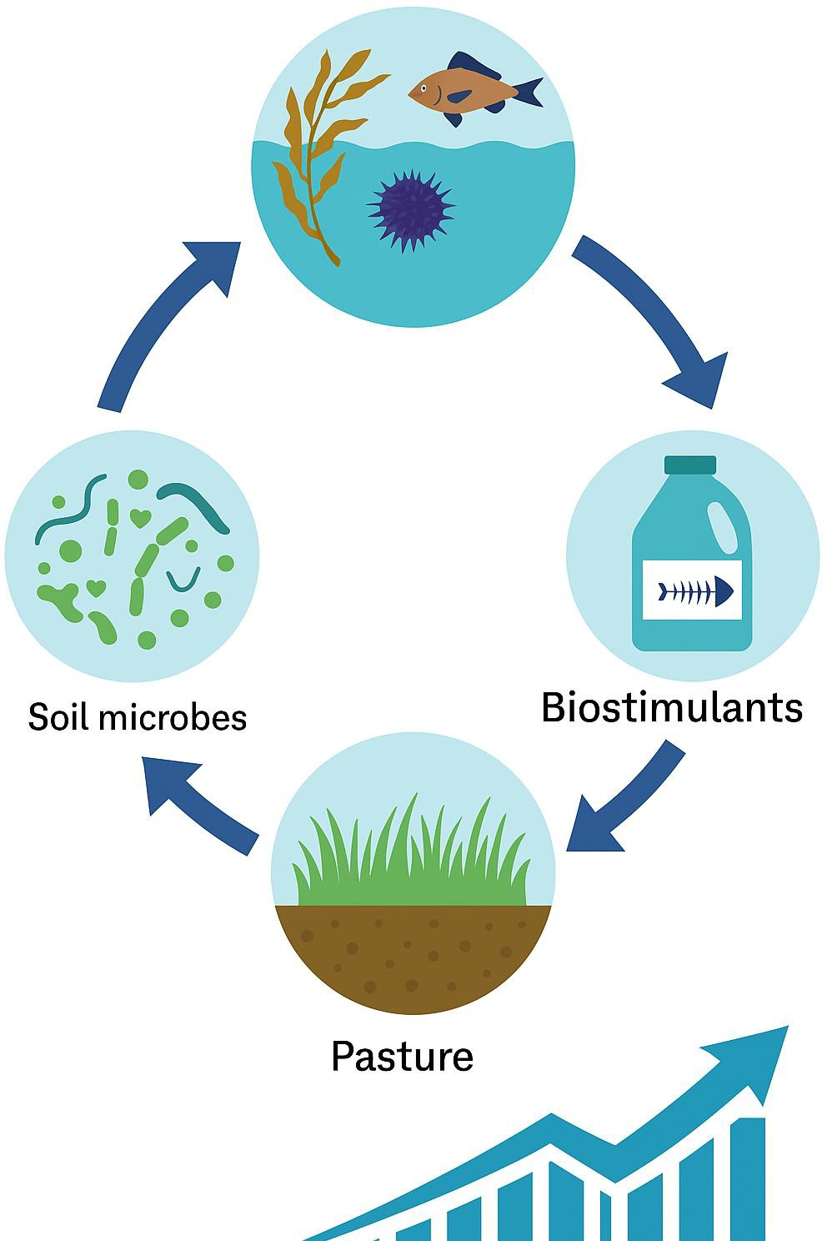
Why Biostimulants?
Made from natural, renewable biomass (marine bioproducts) - not fossil gas or mined resources.
Circular nutrient loop: repurposes marine and organic residues that would otherwise be waste.
In the case of kelp we are growing a carbon positive biomass.
Low energy, low emission manufacturing (fermentation using microbial processes).
Enhances microbial life, improves nutrient uptake, builds soil carbon and enhances natural capital.
Promotes plant resilience (to heat, drought, salinity).
Compatible with organic certification and supports net-zero agriculture.

Slide 9
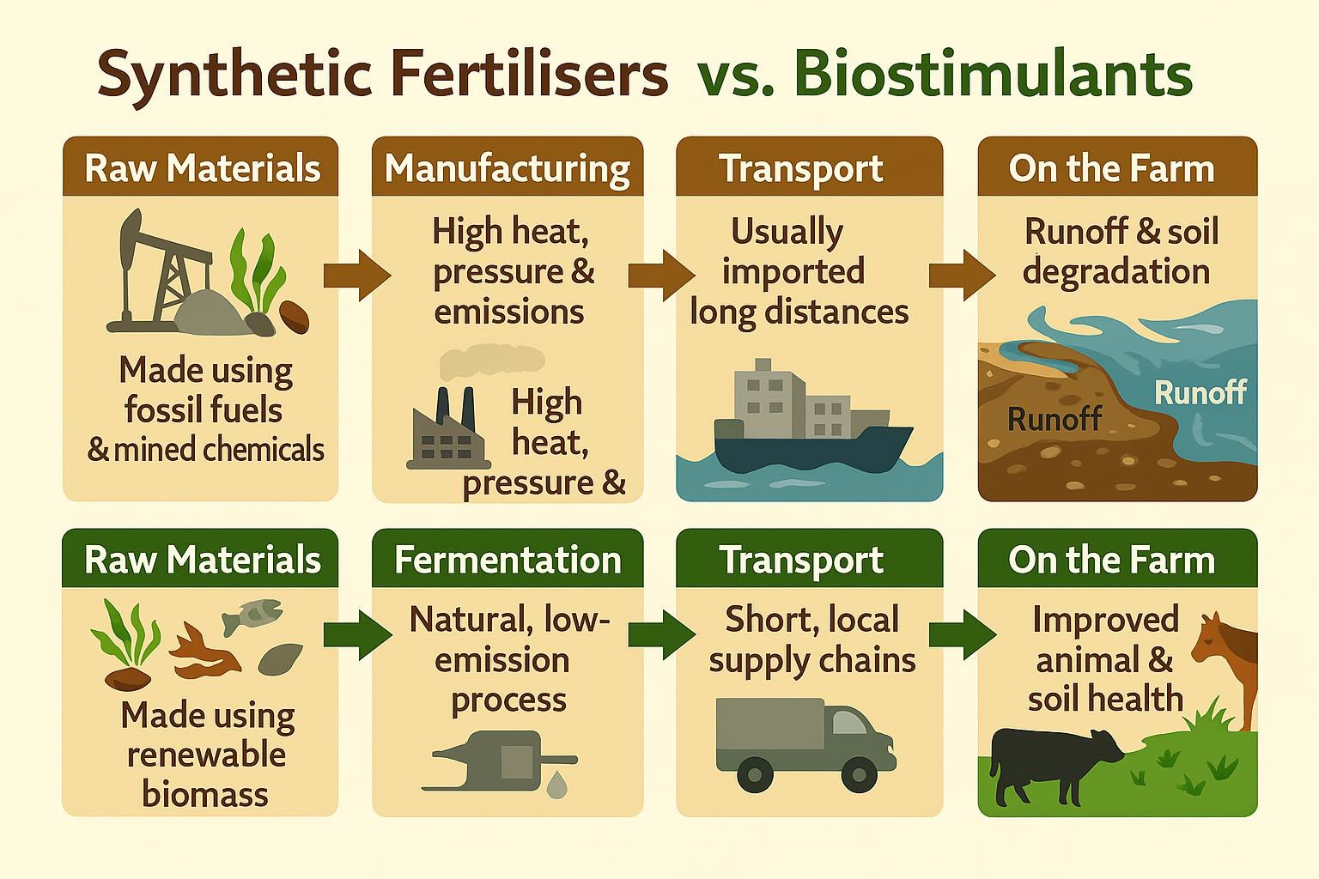

Slide 10
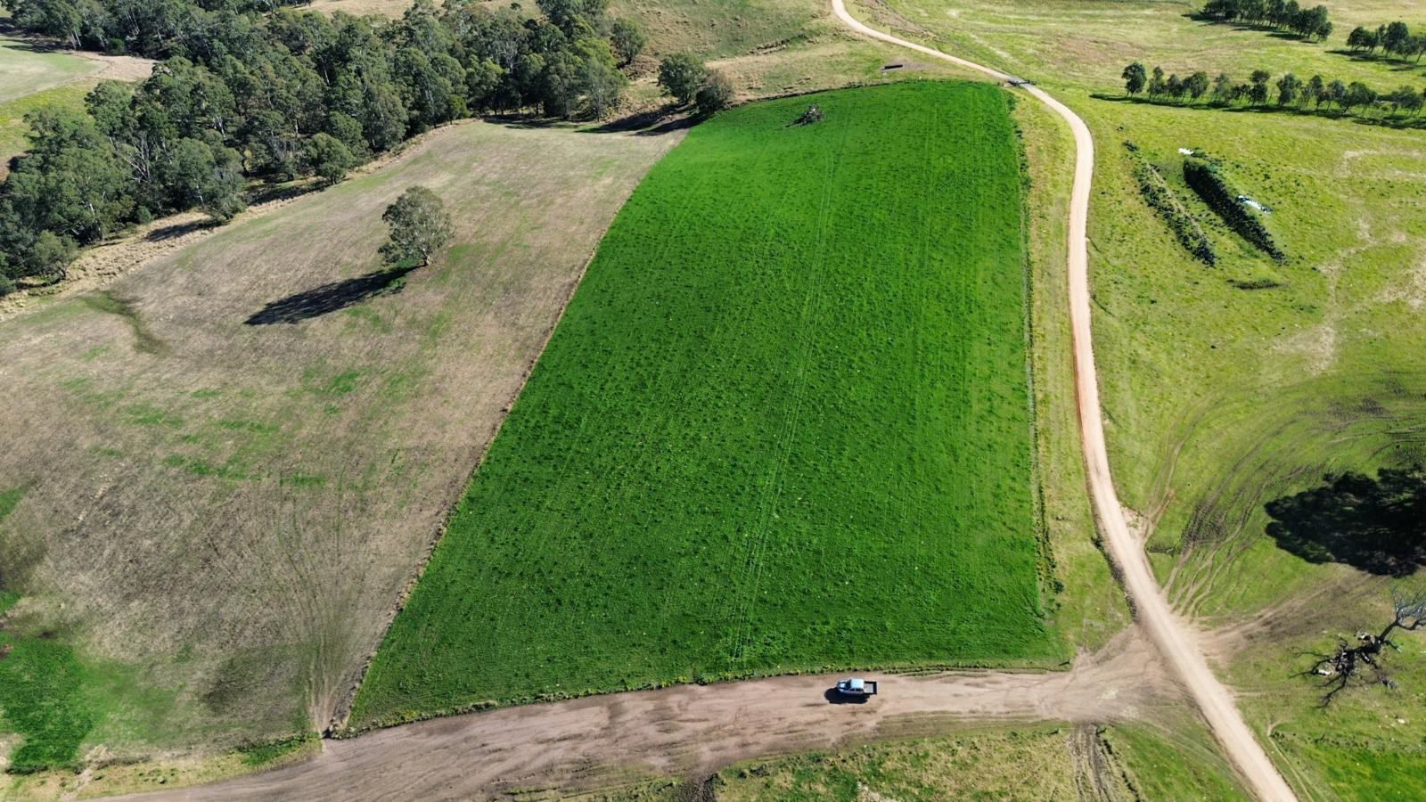
Commercial Adoption & Real-World Results
Commercial Momentum
Products used as standalone inputs in regenerative systems or integrated within conventional fertiliser programs
Strong repeat purchasing and expanding application use cases
Adoption across dairy, beef and horticulture systems,
with expansion into cropping
Observed On-Farm Outcomes
Improved soil and pasture health under variable and extreme seasonal conditions
Greater seasonal carry-through in transition periods
Improved nutrient-use efficiency within existing
fertiliser programs
Positive livestock health indicators (reduced mastitis etc.)
Significant reduction in the use of synthetic fertilisers

Slide 11
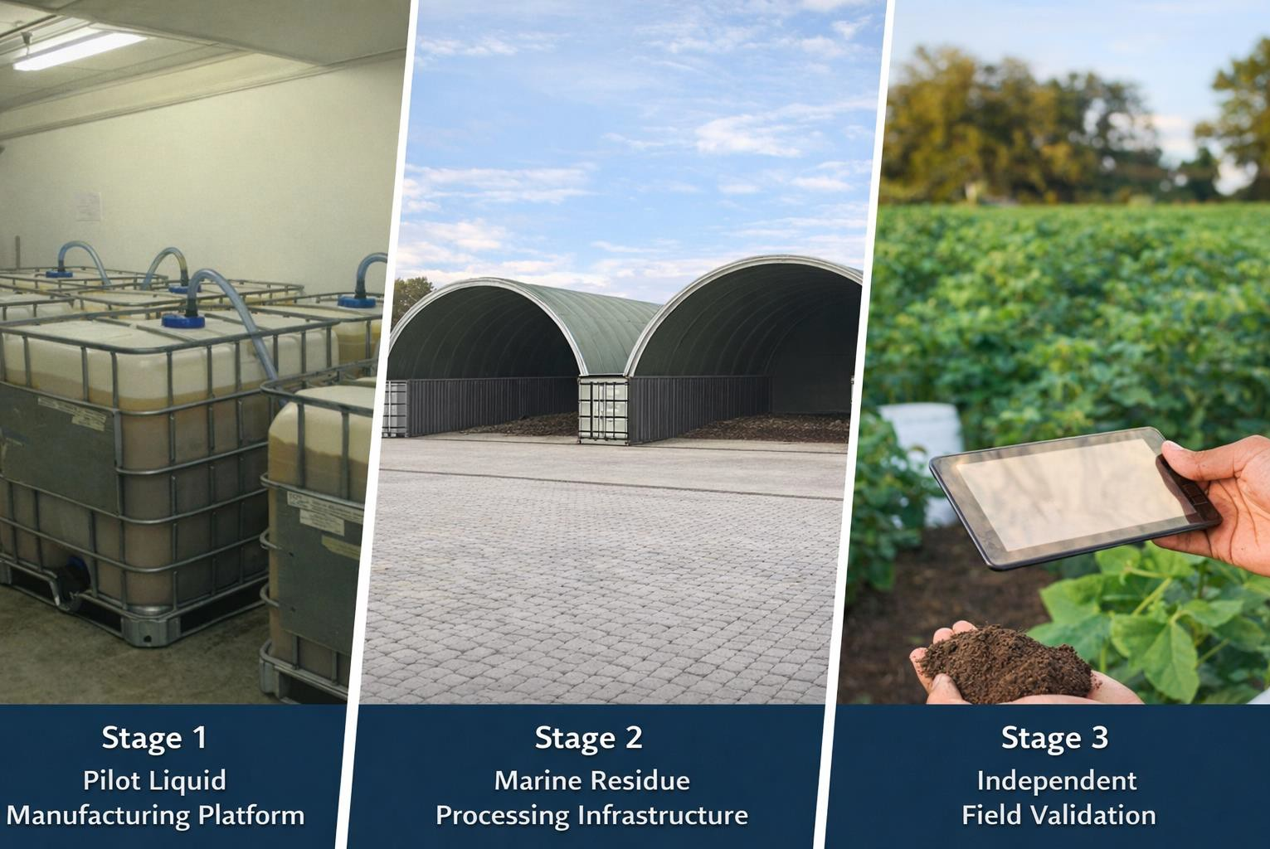
Research Program - Structured Validation
Purpose of the Program (supported by the Marine Bioproducts CRC)
To generate independent, repeatable validation that supports regulatory confidence, scalable manufacturing and accelerated commercial adoption.
Stage 1 – Pilot Liquid Manufacturing Platform
Controlled fermentation and processing capability
Stability and reproducibility datasets
Scalable manufacturing protocols
Stage 2 – Biosecure Marine Residue Composting
Biosecurity-compliant composting systems
Pathogen reduction validation
Nutrient recovery optimisation
Stage 3 - Independent Field Validation
Multi-site trials across representative production
systems
Soil, crop and livestock indicators
Nutrient-use efficiency and emissions metrics

Slide 12
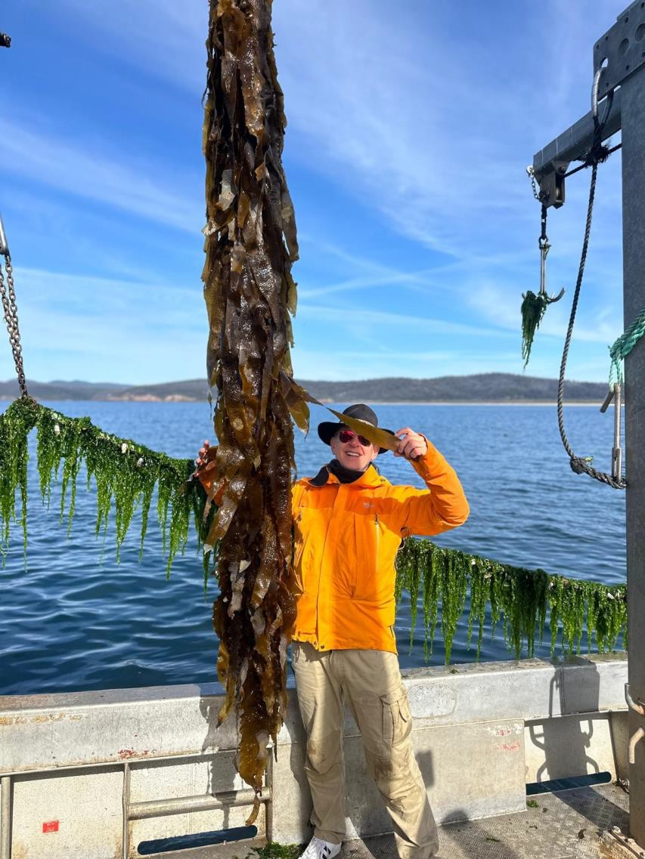

Strategic Partnerships Enabling Scale
AusKelp – Biomass Expansion & Security
Producing high quality biostimulants from fouled kelp
Strengthening long-term marine biomass supply and feedstock resilience
Deakin University – Scientific Integrity & Validation
Independent experimental design and analytical rigour
Laboratory and multi-site field validation underpinning regulatory and commercial confidence
Bega Regional Circularity Co-Op / Bega Group – Commercial Trial Integration
Access to active dairy and beef farming systems
Embedding trials within real supply chains
MBCRC – Research Governance & Industry Alignment
Structured program oversight and coordination
Alignment across industry, research and commercial deployment

Slide 13
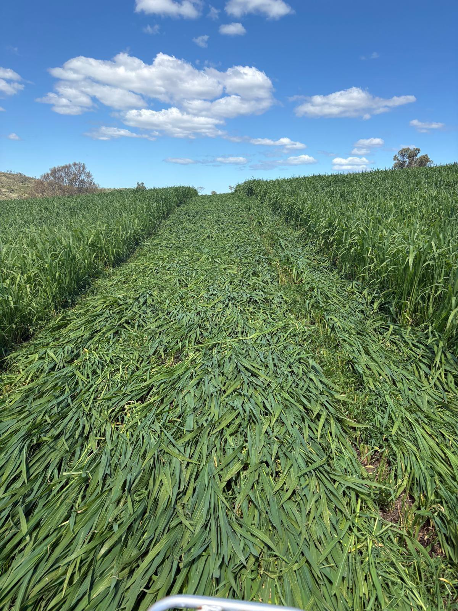
Measuring Success
Validation → Certainty
  Independent data on performance, soil and animal health and emissions reduction
Deployment → Scale up
  Pilot platforms transitioned to commercial production
  Expansion of regional processing hubs
  Broad adoption across regenerative and conventional farming systems
3. Scale → Measurable Impact
Thousands tonnes seafood waste diverted annually
1M+ litres marine-based fertiliser produced per year
Significant area of agricultural land serviced annually
Material CO₂-e reduction through reduced synthetic fertiliser intensity
12+ direct regional jobs created in Eden
10+ seafood producers serviced through free waste collection

Slide 14


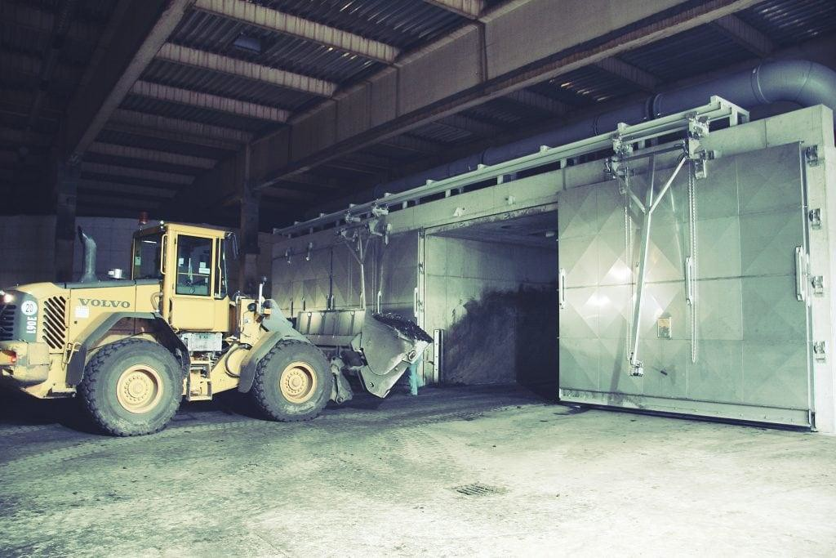
Tasmania Project – Scalable Waste-to-Value Platform
Developing a large-scale organic processing facility in the Hobart region to address growing salmon industry waste challenges.
Purpose built facility to provide reliable, biosecure waste disposal alternatives and value add into high quality soil health products.
Establishing a JV with an established Tasmanian landscaping and waste management operator to leverage infrastructure, logistics and market access at scale.
Overlaying O2E IP (composting and biological fertiliser products) onto the existing landscaping platform base to produce high value regenerative inputs at scale.
Creating a scalable model for marine waste recovery and bio-fertiliser production across Tasmania and beyond.

Slide 15
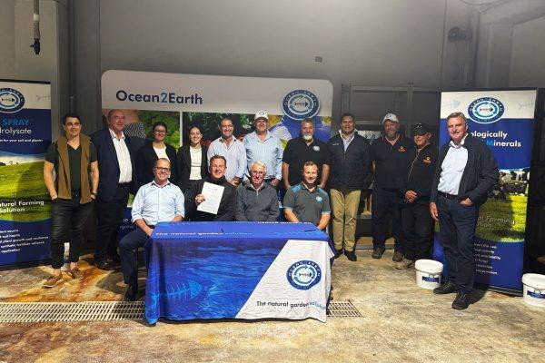
Questions?
9

