Slide 1

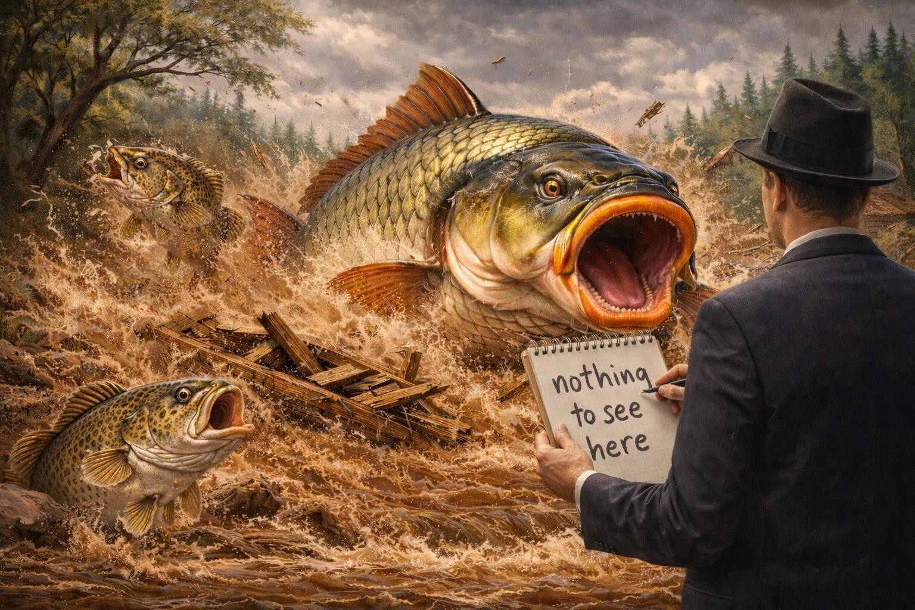
The elephant in the river
UNOFFICIAL
‘Awareness to action’
Anthony Forster,
Senior Fishery Manager, Victorian Fisheries Authority
Date
UNOFFICIAL

Slide 2
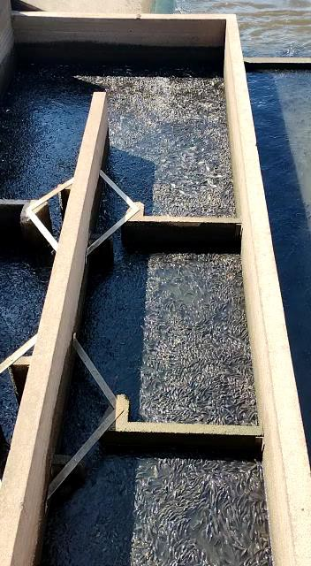
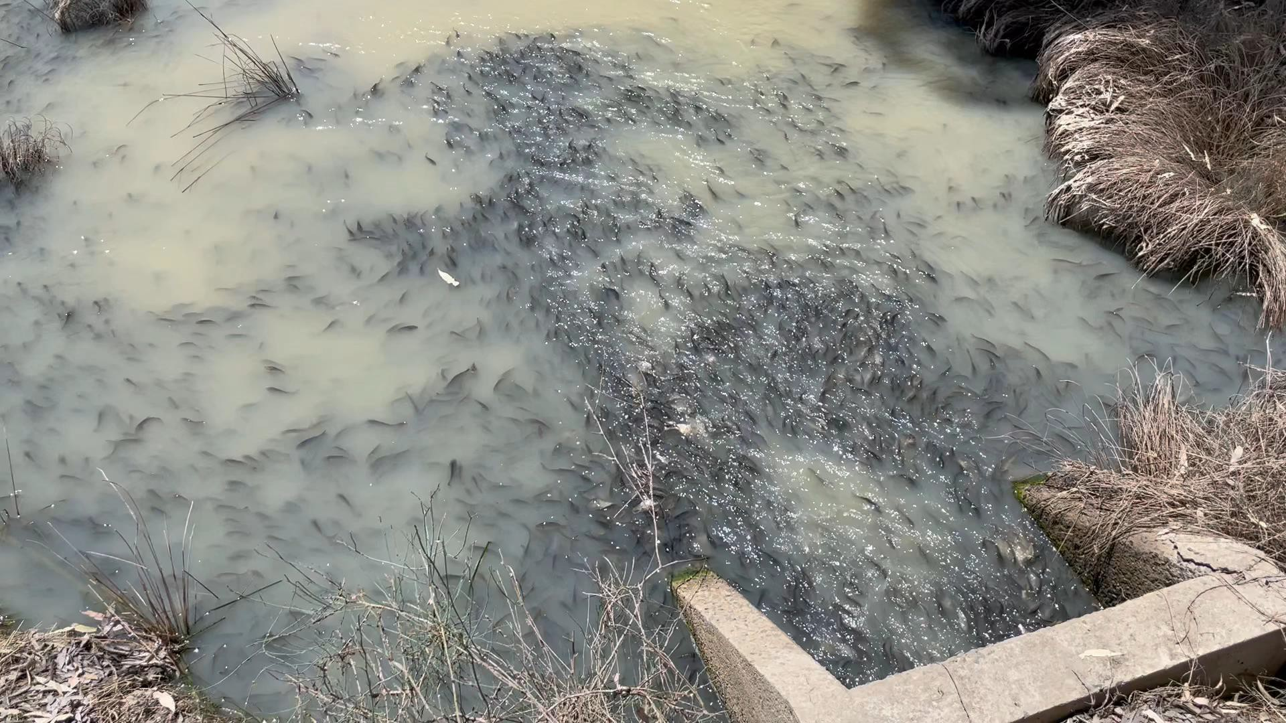
Exploding carp populations
UNOFFICIAL
Date

Slide 3
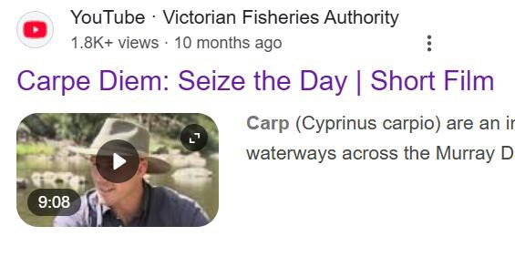
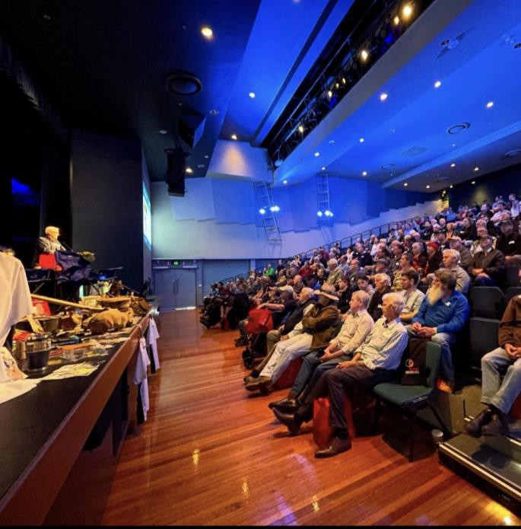
Raising awareness
UNOFFICIAL
Carpe Diem – Video documentary
Regional Fishing Forums
Angling club presentations Murray Codference
Talk Wild Trout Conference Carp harvest events
Date

Slide 4

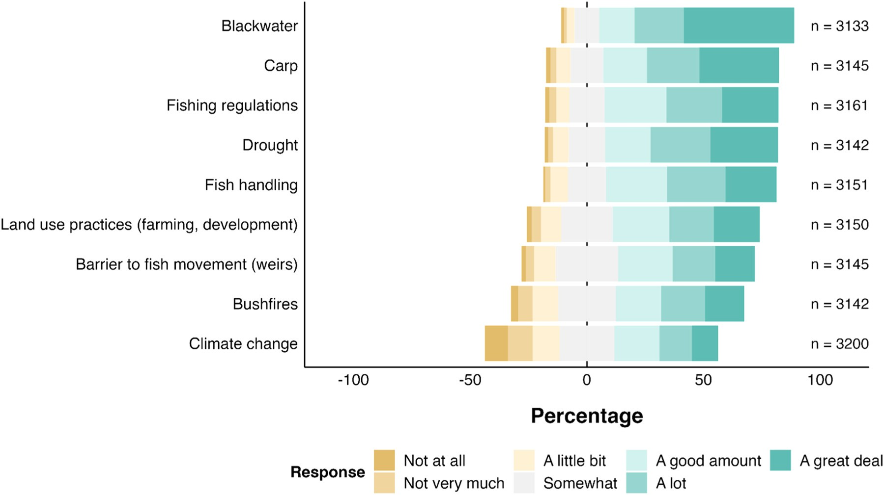
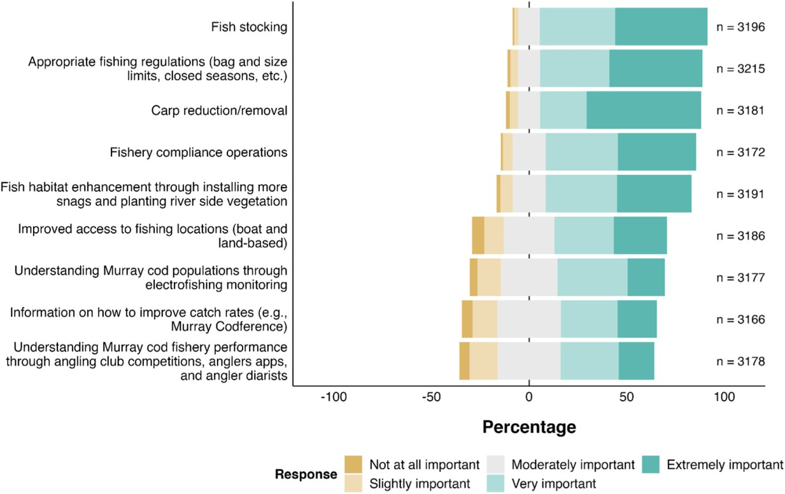
Strong support for more action on carp
UNOFFICIAL
Survey of 3,000+ Murray Cod fishers
Key concerns
Most important actions
Date
UNOFFICI
A
L

Slide 5
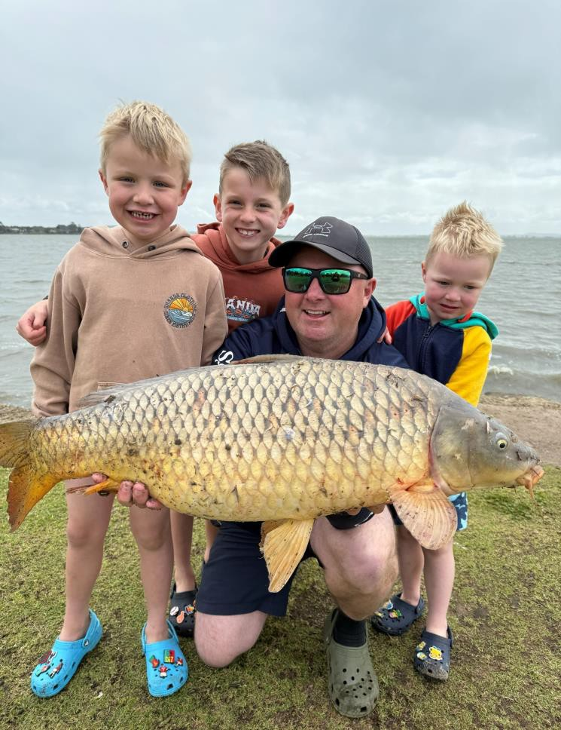

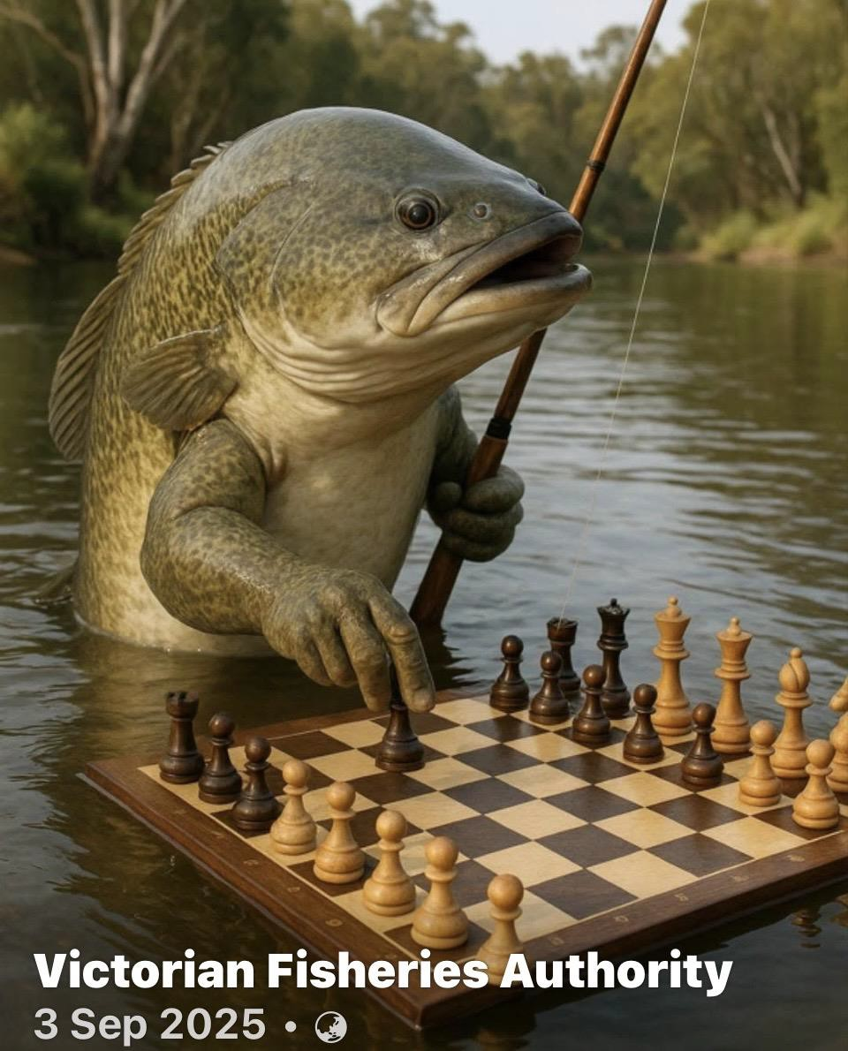
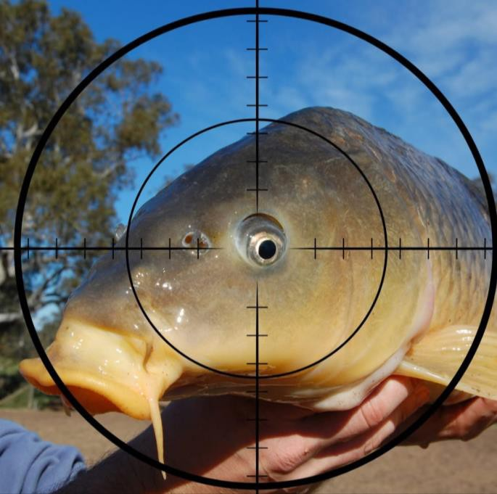

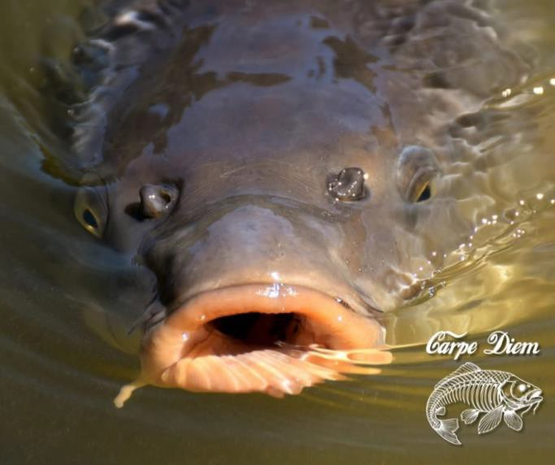
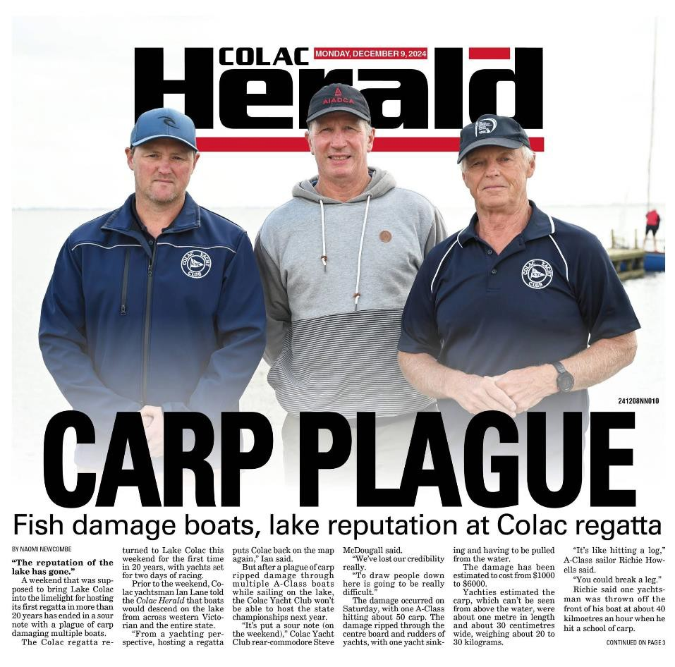

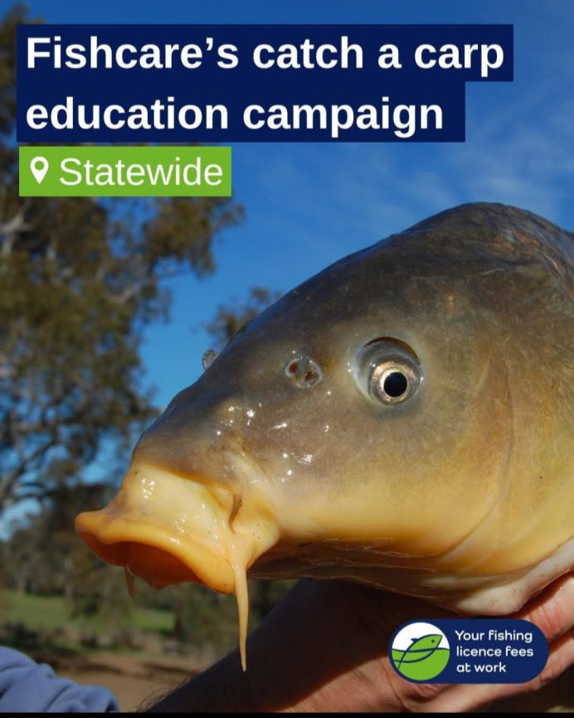

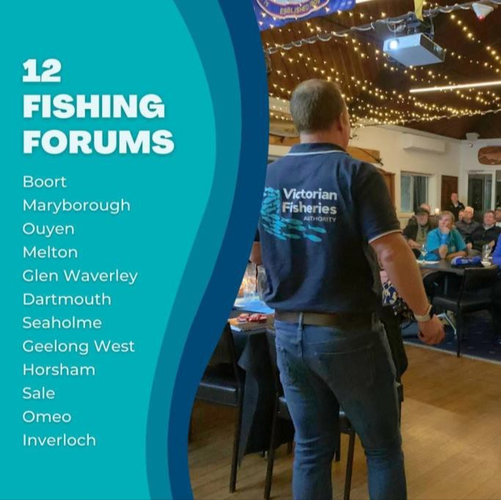
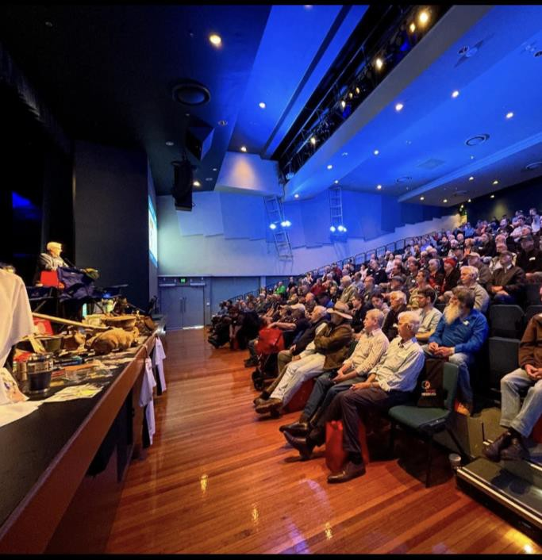
Social media
UNOFFICIAL
VFA
142,000 Facebook followers
35,000 Instagram
2000 - Linkedin
Carp Diem
50 posts - 3 million reach You tube - 12,000 views
Date
UN
OFFICIAL

Slide 6


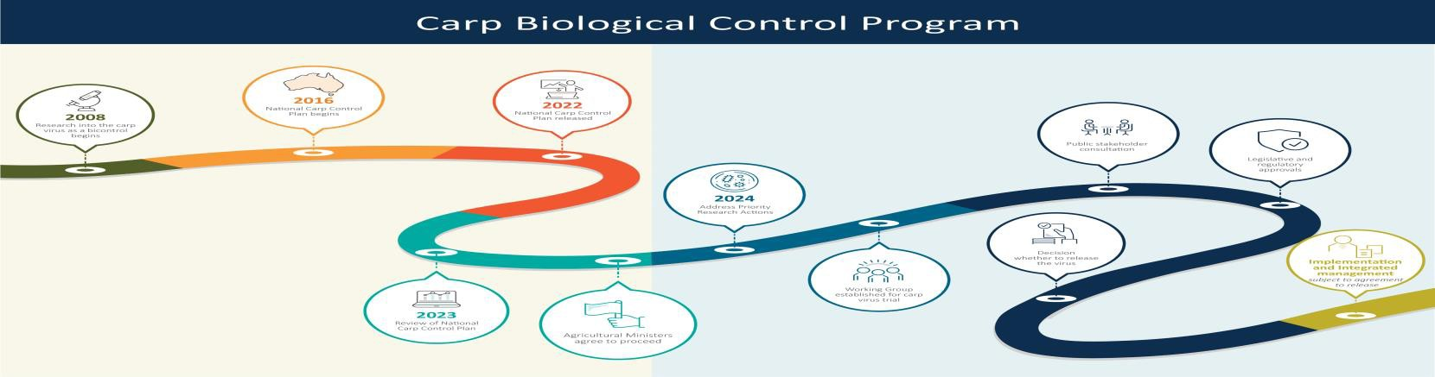

Help from Australian Government?
UNOFFICIAL
Dept. of Agriculture, Fisheries and Forestry - DAFF
(Carp Virus Trial Working Group & field trial proposal) Not progressed
Dept. Climate Change, Energy, the Environment and Water - DCCEEW
(Submission for National Threat Abatement Plan) Not progressed
Murray Darling Basin Authority (Submission to MDBA review) TBA
Date

Slide 7
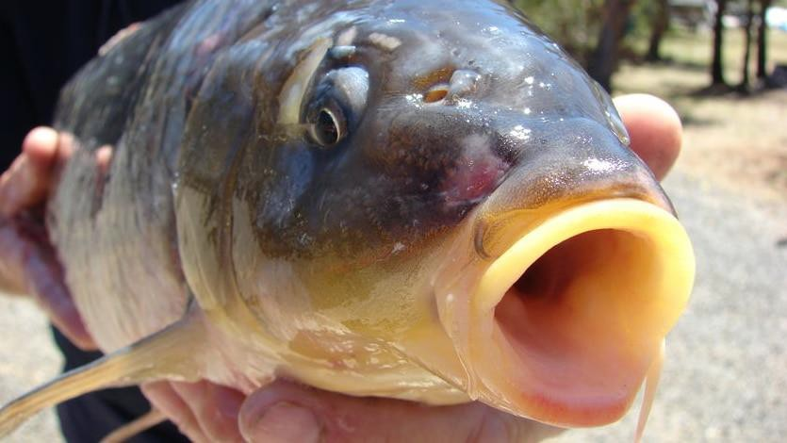
What does success look like?
UNOFFICIAL
Clear Government leadership on carp management
Urgent decision on the release of the carp herpes virus
A National Threat Abatement Plan Integrated control programs to manage carp
Date
Reduced carp numbers, improved river health, native fish recovery and better fishing

Slide 8
Carp control strategy
UNOFFICIAL
Targeted carp virus use (if available)
Carp harvesting and processing (if needed)
+ Native fish stocking
+ Fish habitat restoration
+ Environmental flows
+ Wetland drying / exclusion devices
Strong community involvement
Show it works and expand the carp control program.
Date
This requires a coordinated, cross-sector approach

Slide 9
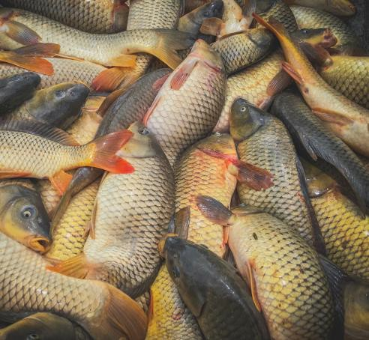
Murray Darling Carp Action Alliance?
UNOFFICIAL
See draft ‘Statement of Intent’
The case for coordinated action
Purpose of alliance
Shared commitment to work together
Be part of progressing this work beyond the summit
Date
Can we build on today’s interest and move
from Awareness to Action?

Slide 10
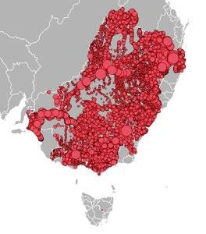
Workshop
UNOFFICIAL
Test the role and value of a Carp Action Alliance
Identify gaps or priorities
Are you willing to support this effort?
Date
Your views will shape a credible (and powerful) position

Slide 11








































Starting with a stron^{U}g^{NO}f^{FF}o^{ICI}u^{AL}ndation!
Date

