Slide 1

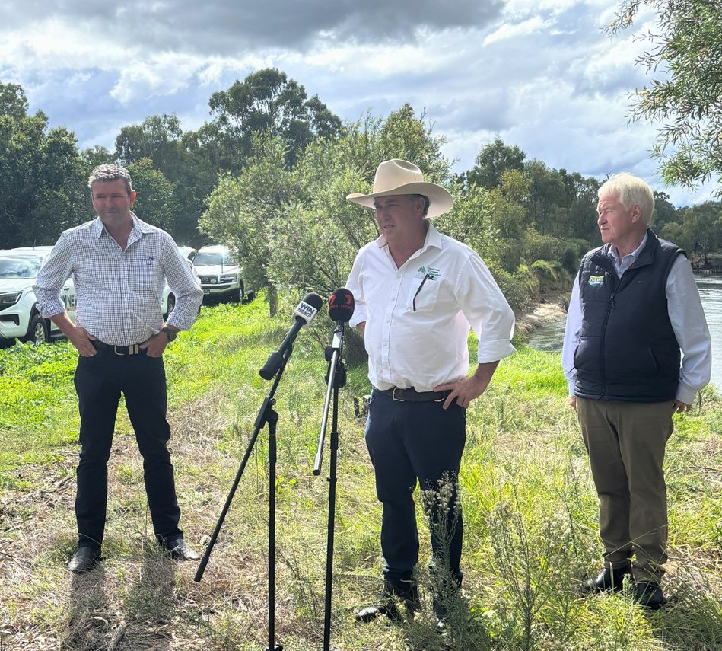

The Fifty-Year Carp River Health Catastrophe We Must Deal With
Mr. Warwick Ragg
General Manager, NRM

Slide 2
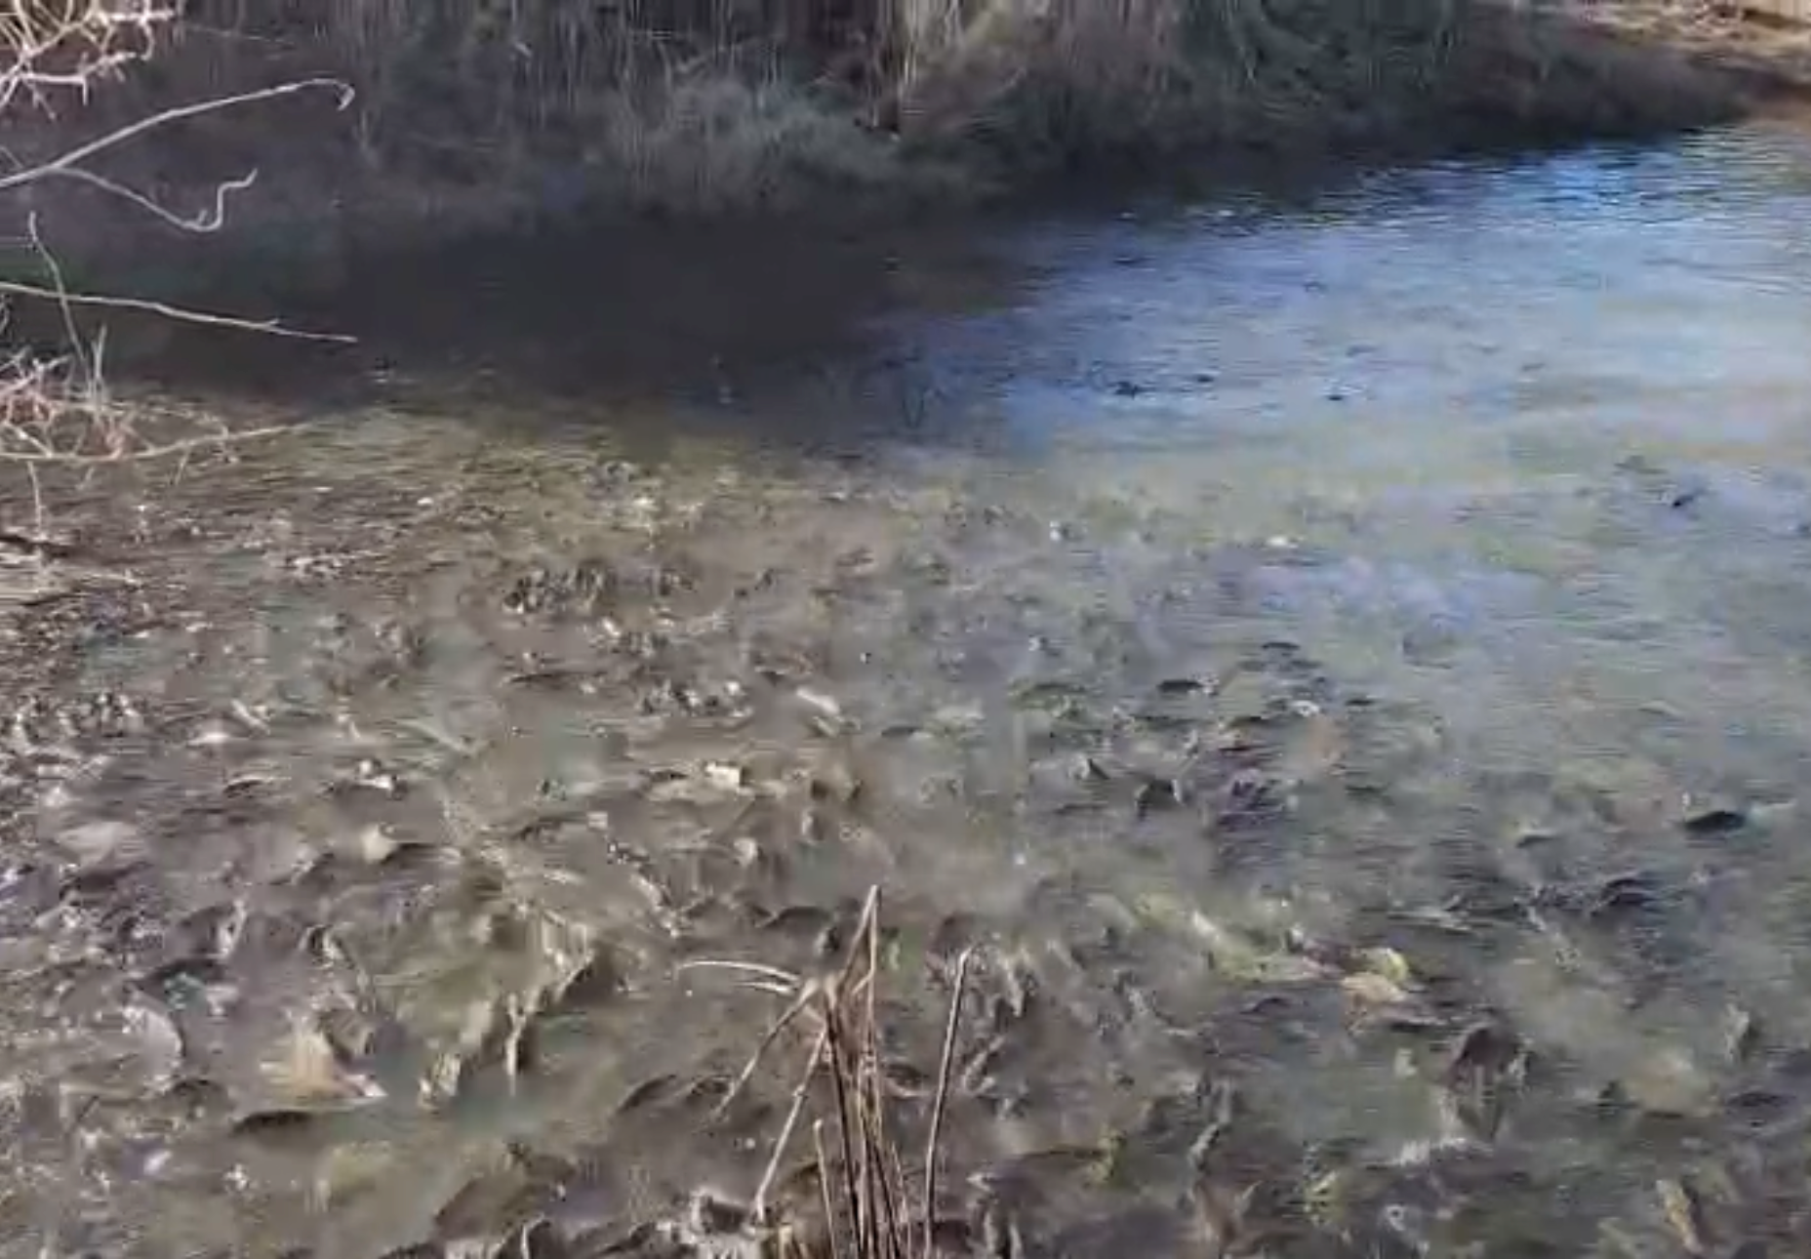
Impacts to River Health
A Persistent and Increasing Degradation Driver:
Carp feeding behaviour increases turbidity and destroys aquatic vegetation.
Bank destabilisation and sediment disturbance degrades habitat.
Outcompete native fish and contribute to declining biodiversity and water quality.
Carp account for 70-90% of total fish biomass in many Basin areas.

Slide 3
EPBC Gap: Driver Vs. Outcomes
Lower River Murray (Critically Endangered) and Macquarie Marshes (Endangered) listed early 2026 under National Environmental Law following Threatened Species and Scientific Committee assessment.
Draft Conservation Advice recognised European carp as either a “major” or “extreme” ongoing and increasing threat to both ecological communities … but not formally prioritised as a Key Threatening Process (KTP) under the EPBC Act!
KTP listing a logical and appropriate management pathway. Avoids regulatory overlap and complexity while attacking key degradation drivers (i.e., carp) head-on.

Slide 4
Rationale for Nomination Not Prioritised
‘Degradation and loss of inland aquatic ecosystems, habitats and associated biota caused by Common carp (Cyprinus carpio)’
“The Threatened Species Scientific Committee considers that actions to address the threat from common carp can continue to be undertaken through established abatement arrangements and thorough adoption of emerging technologies and biocontrol approaches”.
“Does not recommend that this nomination is prioritised for inclusion on the 2025 FPAL but notes that it is automatically eligible for reconsideration for the 2026 PPAL”.

Slide 5
Established Key Threatening Processes RE: Basin
Over 22 Key Threatening Processes Listed Under EPBC (Ranging 2001-2022), Including:
Predation by exotic rats on Australian offshore islands of less than 1,000 sq.km.
Predation by feral cats.
Predation by the European red fox.
Predation, habitat degradation, competition and disease transmission by feral pigs.
The reduction in the biodiversity of Australian native fauna and flora due to the Red Imported Fire Ant.
Competition and land degradation by feral goats.
Competition and land degradation by feral rabbits.

Slide 6
