Slide 1

Invasive species management in Australia
Lessons for carp control and advocacy
Reece Pianta
Advocacy Director
0422 935 665
reecep@invasives.org.au
I acknowledge the traditional custodians of the land on which we meet and pay respect to their elders past and present.
invasives.org.au

Slide 2
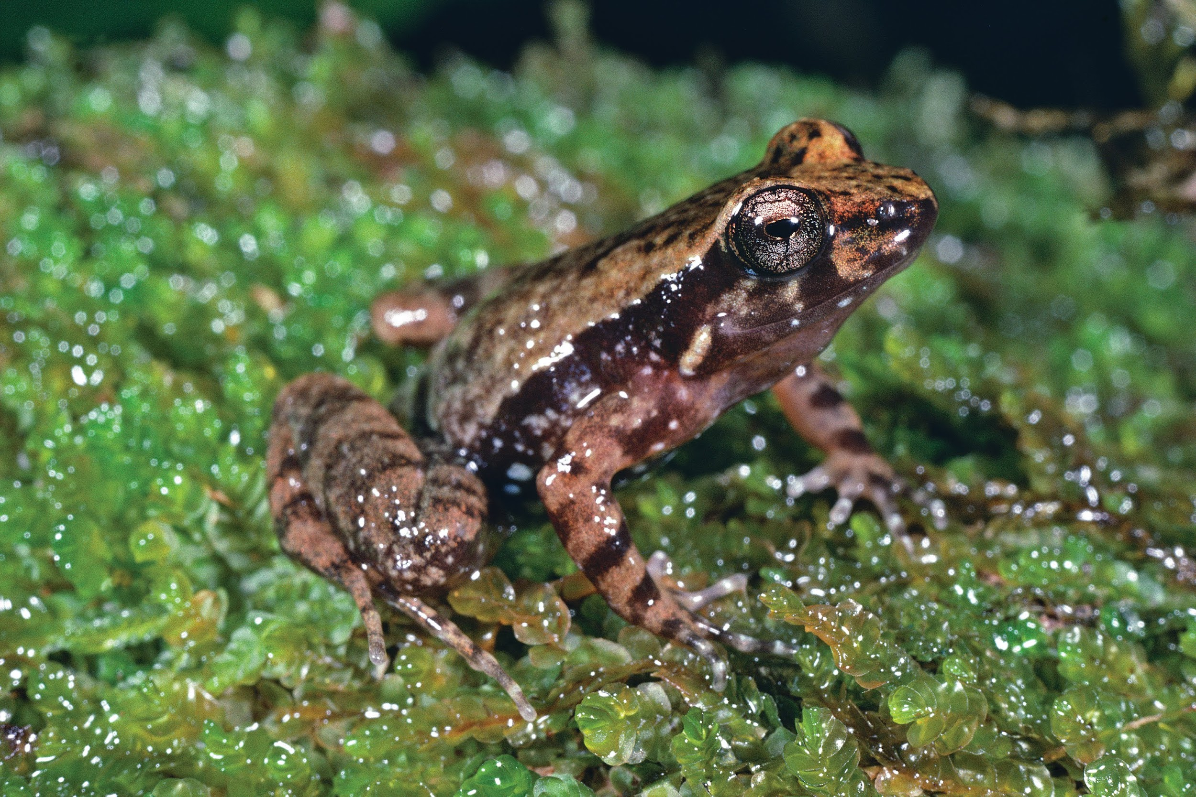
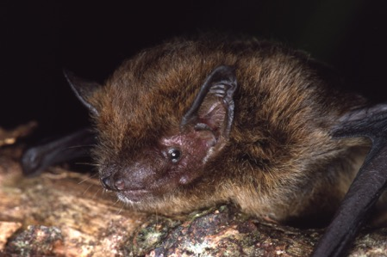
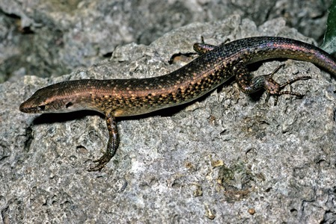
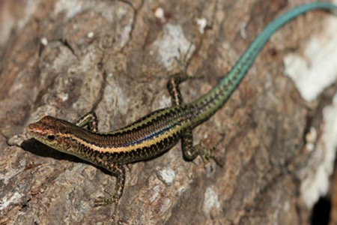
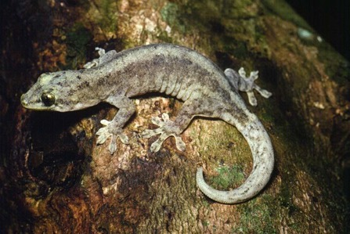
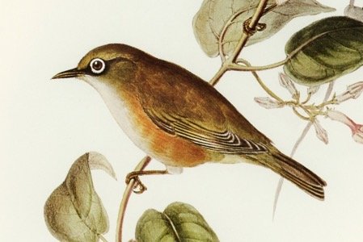
Animal extinctions since 2000 where invasive species was the primary cause
Northern tinker frog
Christmas Island pipistrelle
Christmas Island forest skink
Blue-tailed skink (extinct in the wild)
Lister’s gecko (extinct in the wild)
White-chested white-eye
Notes:
Recent extinctions
Invasive species issue has caused the majority of extinctions over the past 235 years
This is a contemporary issues – just in the past two decades since 2000, we have seen 6 animal extinctions where invasives have been a primary driver

Slide 3
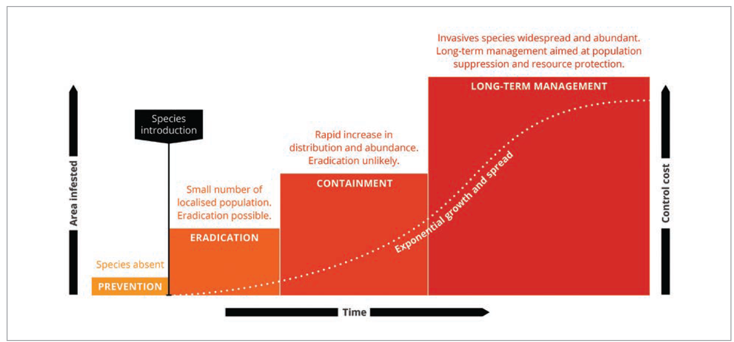
invasives.org.au
Notes:
This i am sure is familiar to most of you - the invasion curve guide the policy response on invasives when governments are considering policies and funding.
It describes the most cost effective interventions.
For a policy to be adopted that requires new regulations or funding for an invasive species in long term management or containment it usually requires an innovation - a biocontrol, new chemical, treatment tactic or other circumstantial change.
What has been that change with carp?
It could be a biocontrol release - even if it does not have high efficacy that population reduction could be an opportunity but it would require careful planning to make the most of the initial viral impacts to benefit restocking, habitat restoration or some other as yet unknown to me intervention that works with the virus.
This is a question for science - if the solution is proved the ISC can help with the advocacy

Slide 4
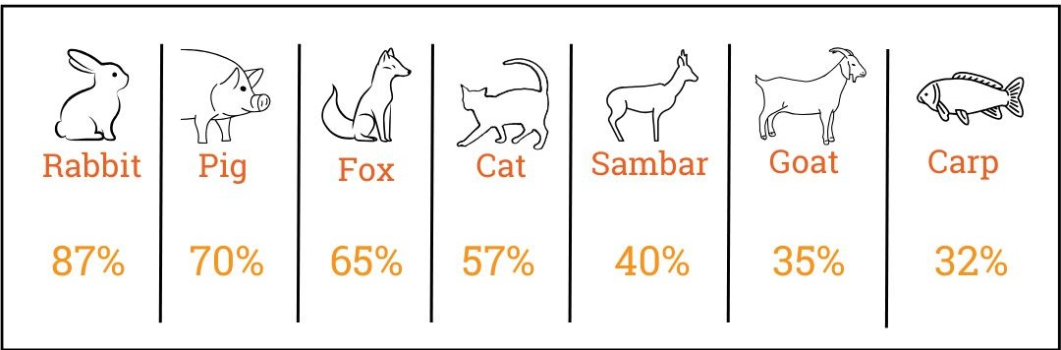
Effective invasive species action is about impact.
Notes:
What do I mean by proving the solution?
Any solution that does not reduce an invasive by its replacement rate is not invasive species control - it’s harvesting.
Population reductions also have to occur over multiple breeding seasons to avoid replacement accumulating over time.
The point of initial viral release is the crucial moment - but also consider how translocation or population spread between river sections might impact replacement too. Reproduction is one part but another part of replacement is spread and proliferation from nearby established invasive populations. I have a case study later on this point form another invader in another freshwater system.

Slide 5
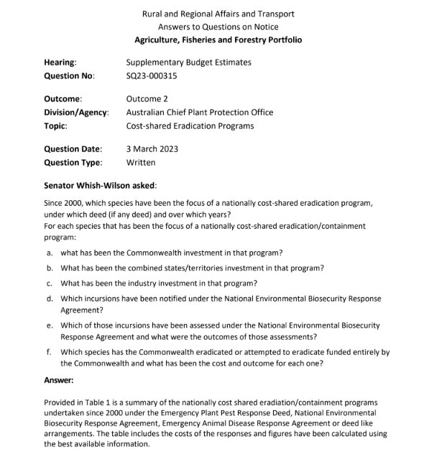
$2 billion+ spend on nationally cost shared eradication programs since 2023
Notes:
Initial Funding (2016): The initial $15.2 million was allocated to the Fisheries Research and Development Corporation (FRDC) to lead the feasibility study, with $10.4 million dedicated specifically to the National Carp Control Plan (2016-2022).
Additional Research Funding (2024): In 2024, the Federal government announced a further $3 million in research funding to address information gaps identified in the original NCCP findings. < this is funded under the established Pest Animals and Weeds Program which might not be continuing so delivery of the virus could be called into question

Slide 6
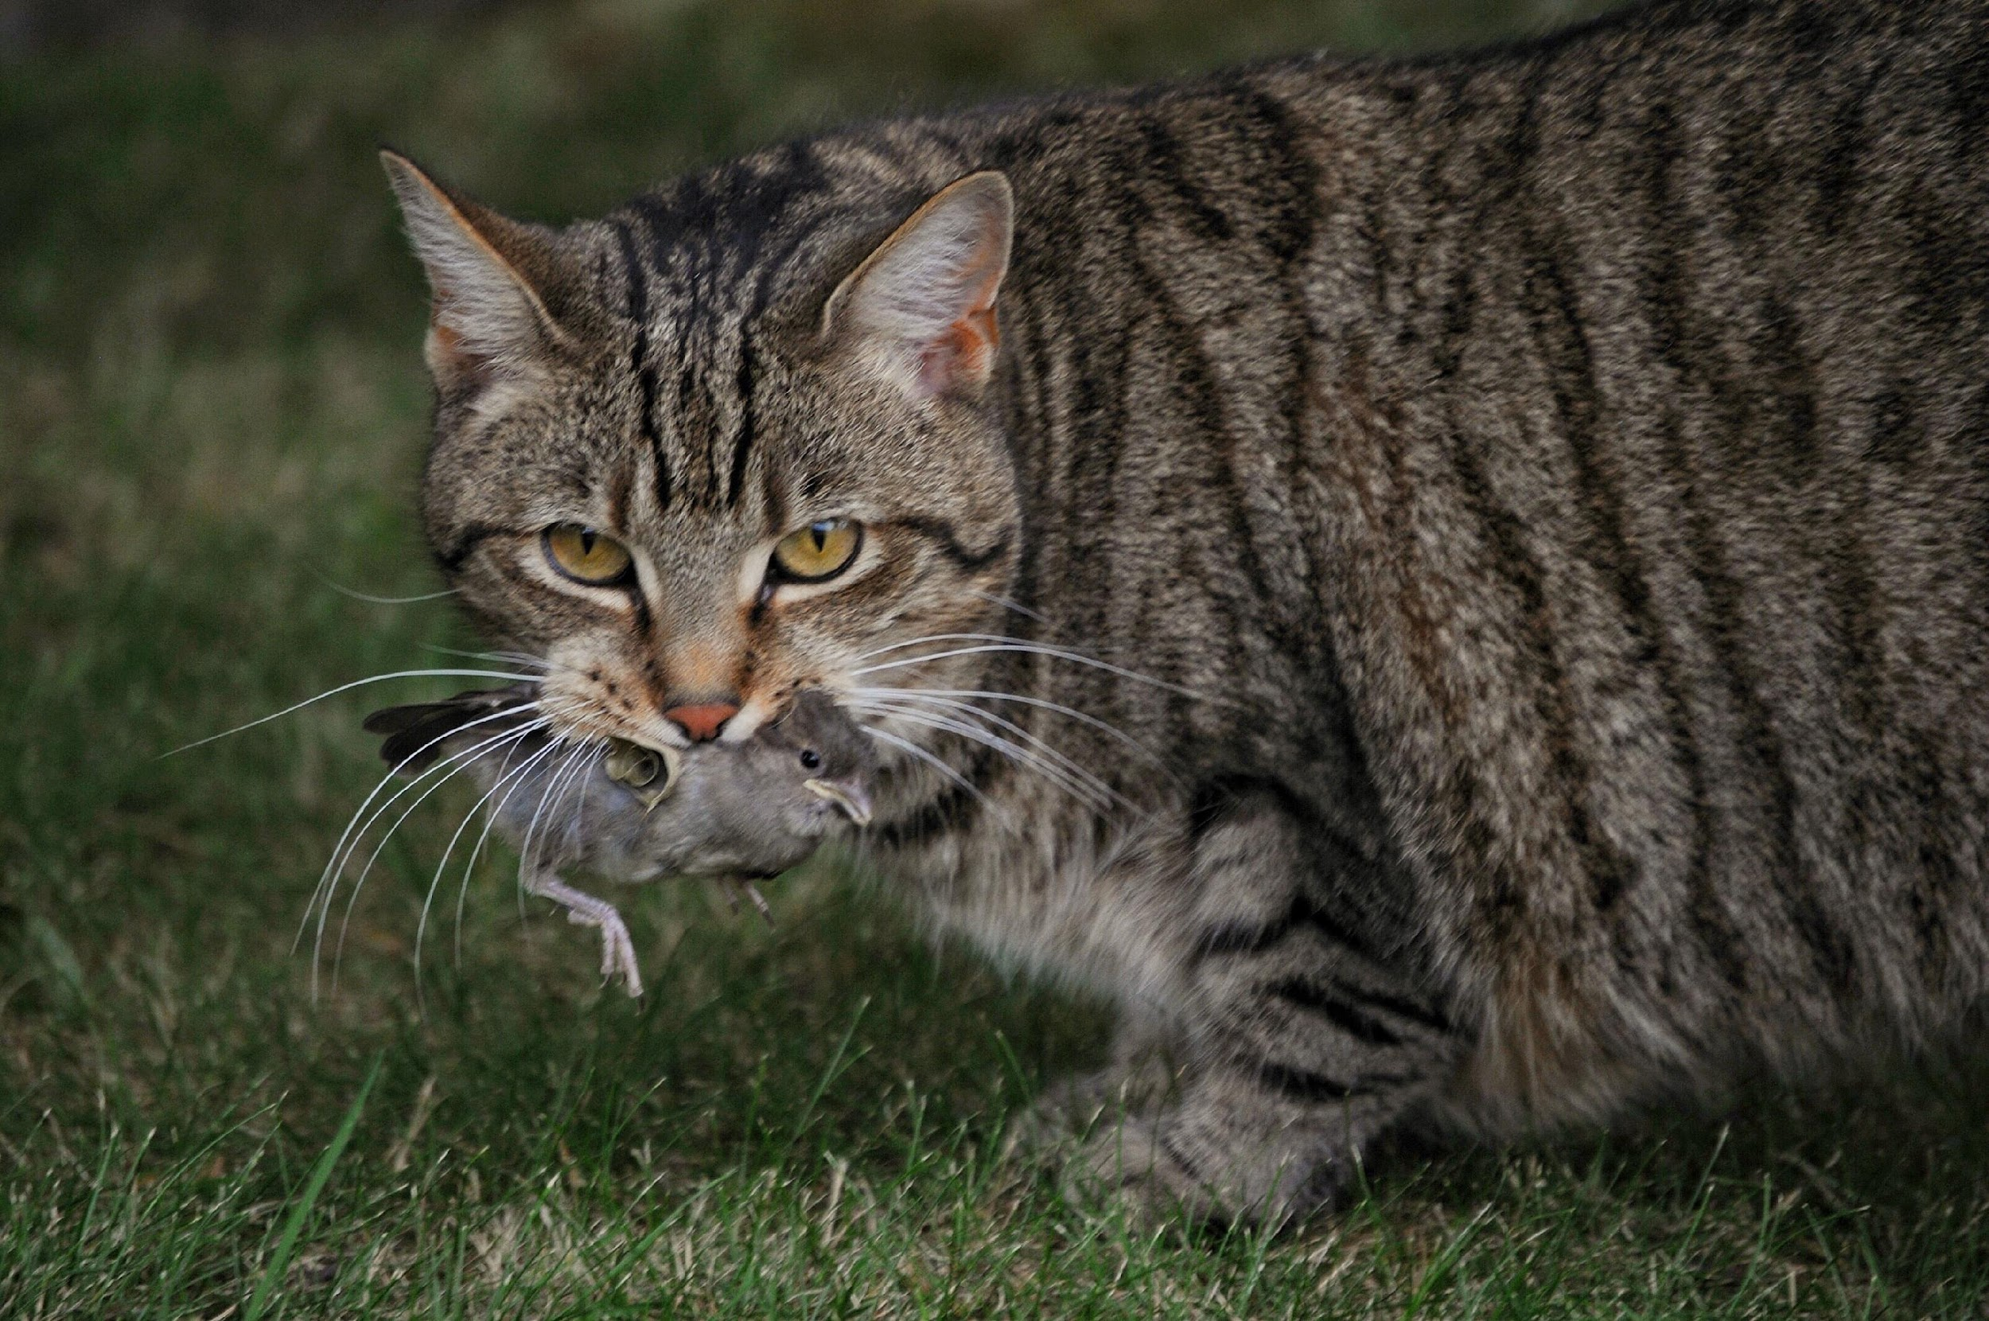
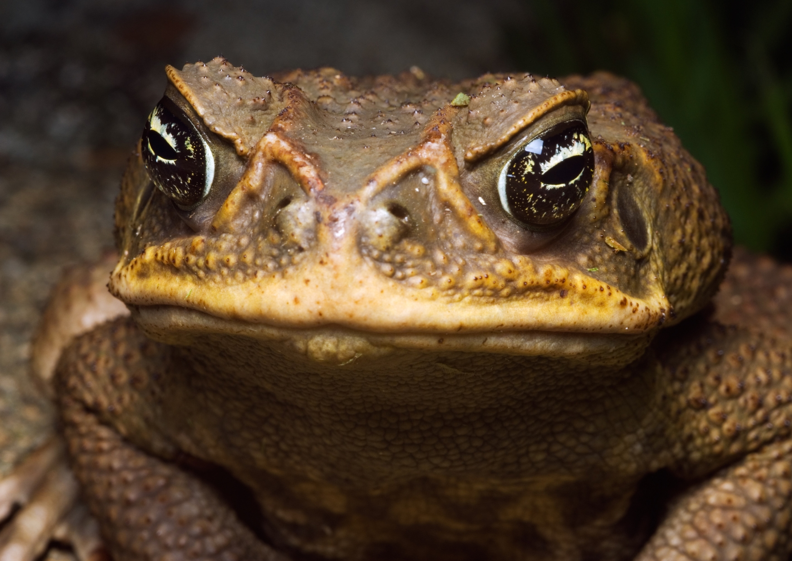
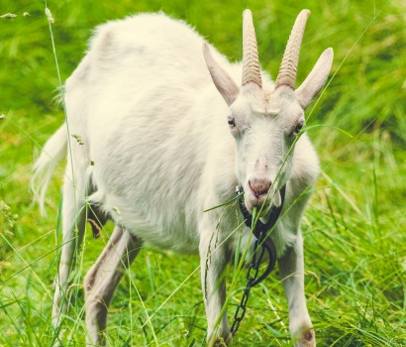
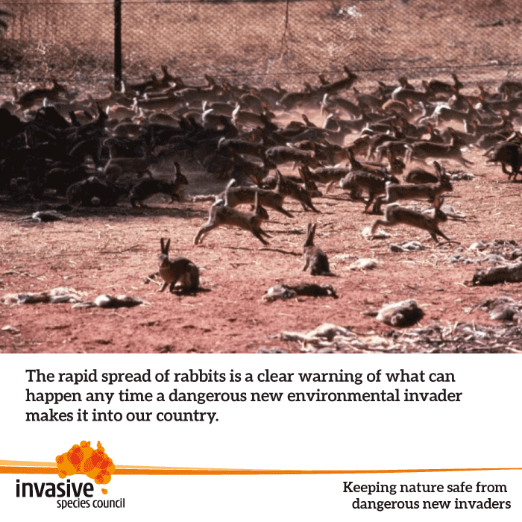
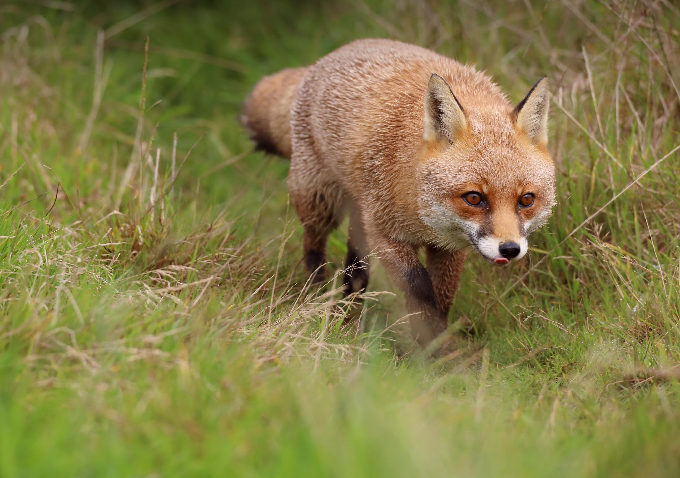
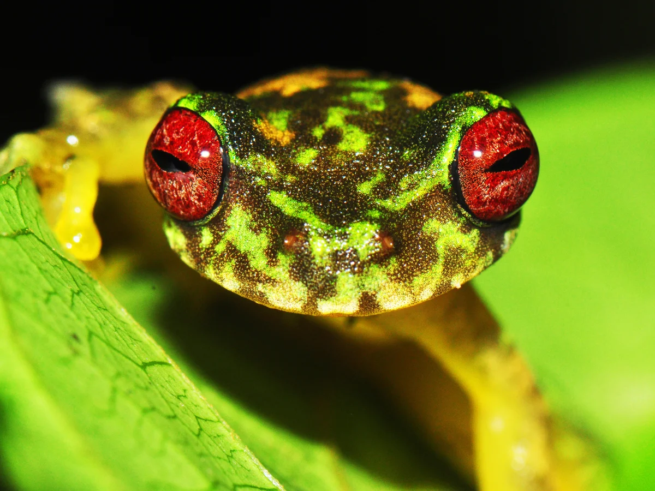
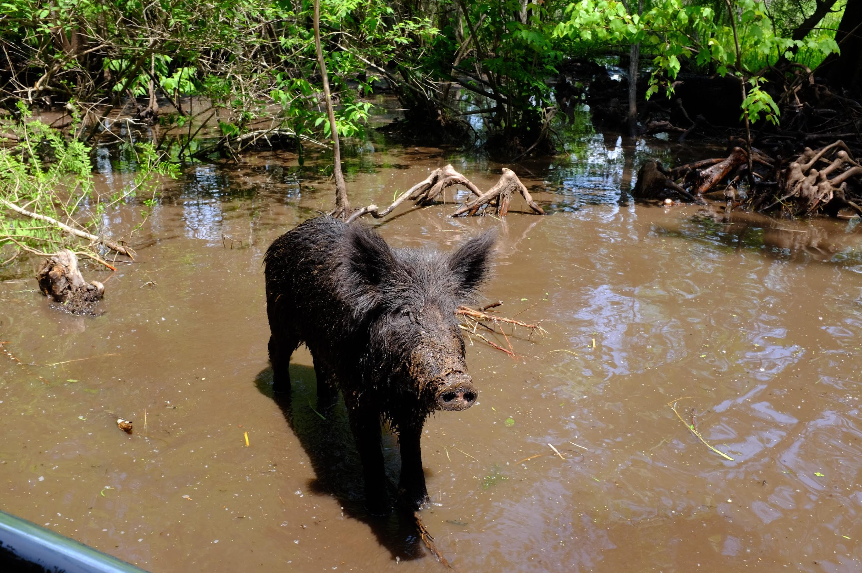
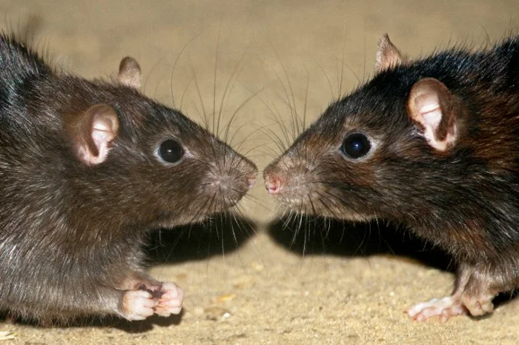
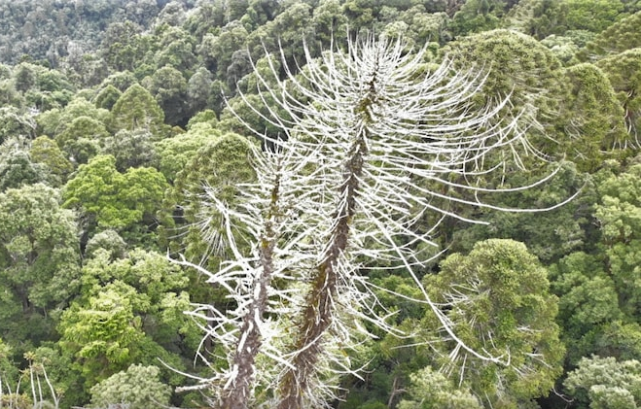
Approved Threat Abatement Plans (TAPs)
$60 million over four years
$24 million over five years
(2 funds)
$34 million across three funds
$11 million Pest animals and weeds fund
Notes:
European red fox (Vulpes vulpes)
Feral cats (Felis catus) - $60 million over four years
European rabbits (Oryctolagus cuniculus) - $23 million over five years also part of pest animals and weeds program (+ $11 million)
Unmanaged goats (Capra hircus) – no specific fund
Feral pigs (Sus scrofa) - $11 million pest animals and weeds
Cane toads (Bufo marinus) - $24 million over five years
Exotic rodents on Australian offshore islands (<100,000 hectares) – no specific fund
Infection of amphibians with chytrid fungus (chytridiomycosis) – no specific fund
Disease in natural ecosystems caused by Phytophthora cinnamomi (Root-rot fungus)
Limited capacity for new TAP’s - advocacy goal

Slide 7
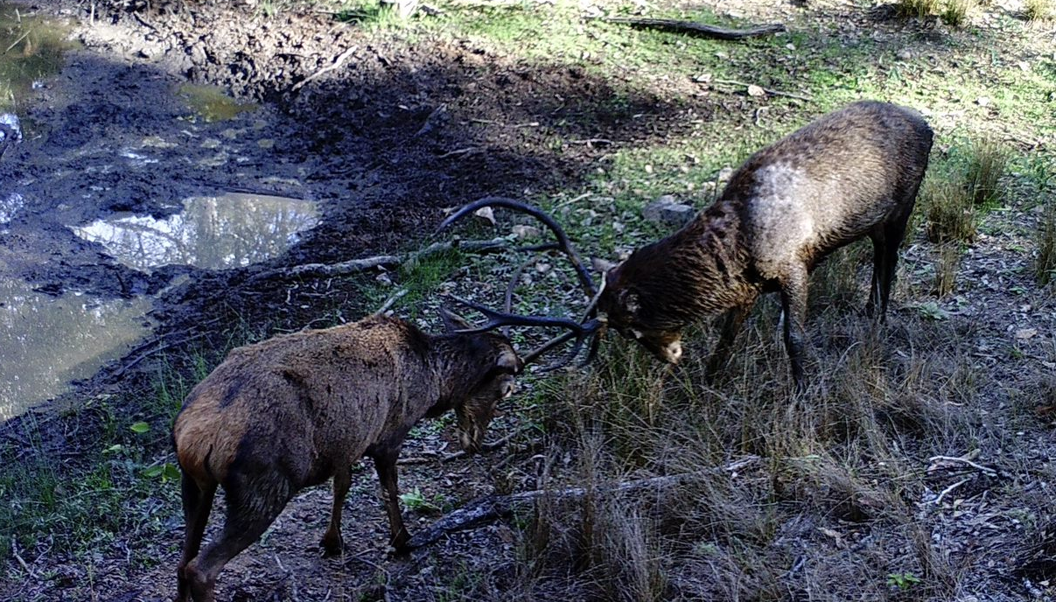
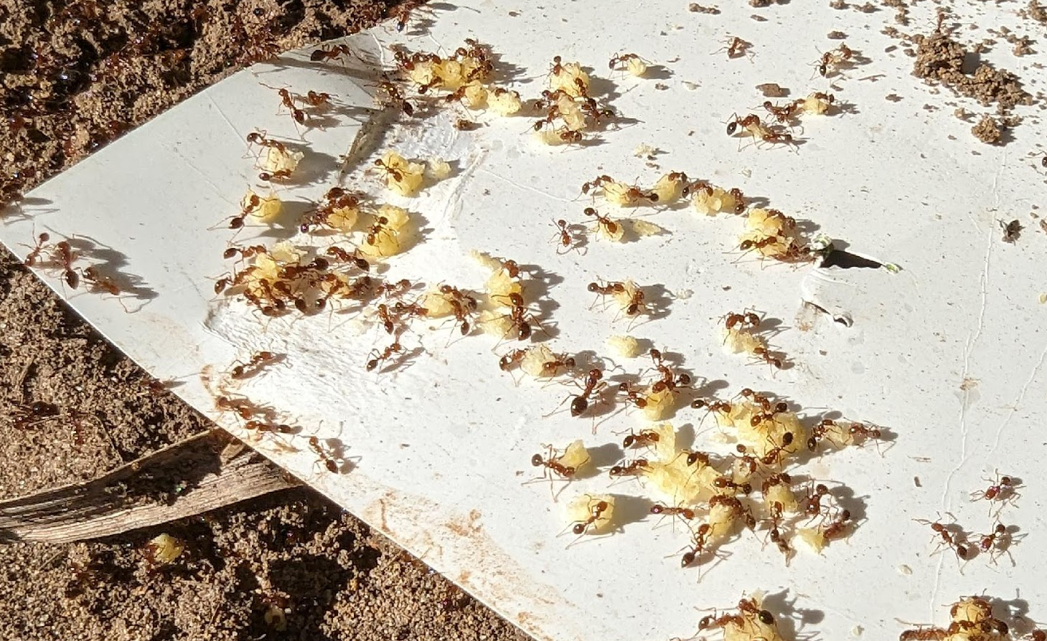
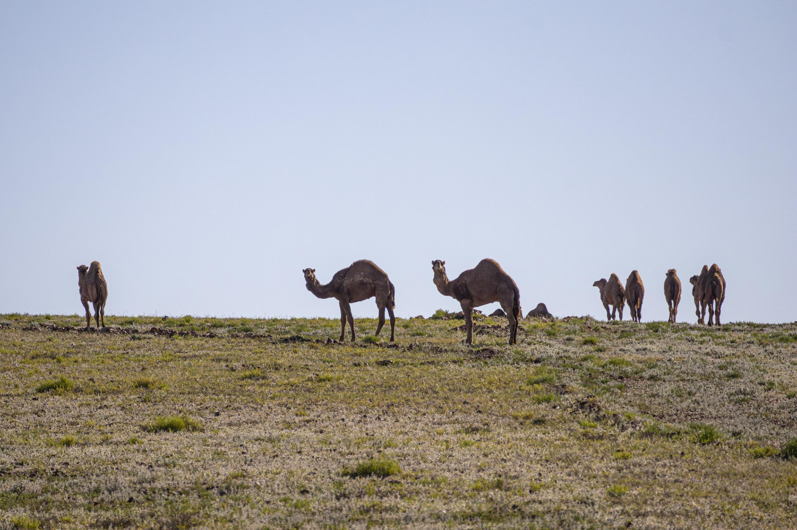
National Action Plans
$40 million between 2023 - 28
National cost share
Pest Animals and Weeds Program
Pest animals and weeds program is $49.1 million between 2021 and 2025.
$2.418 billion since 2000 across 47 programs
Notes:
National Feral Deer Action Plan - $40 million between 2023 - 28
National Invasive Ant Biosecurity Plan – part of cost share
National Feral Camel Action Plan – in Pest Animals and Weeds Program
Pest animals and weeds program is $49.1 million between 2021 and 2025.
93 million per year across 47 programs – 2 million per program per year
Tiny portion of federal and state budget allocations but we are actively arguing to grow this investment across invasive species priorities

Slide 8
Summary of Biocontrol Performance (1970–Present)
Invasive Species | Primary Agent(s) | Established? | Initial effectiveness | Est. Cost to Develop
European Rabbit | RHDV1 / K5 Virus | Yes | High | $15M+ (multiple strains)
Giant Salvinia | Salvinia Weevil | Yes | Extreme | Moderate (CSIRO led)
Paterson's Curse | Root/Leaf Insects | Yes | High | ~$23M (inflation adj.)
Prickly Acacia | Gall Thrips | Newly | Low to Moderate (Historical failure; new agent pending) | ~$12M+ (ongoing)
Notes:
Biocontrol's take many years to develop and can be effective interventions at managing established invasive populations but in most cases will decline in efficacy over time as invasive populations adjust
This does not mean they are not worth doing but if effectiveness at introduction is low it should be considered as part of a suite of ongoing tools
While RHDV dramatically changed the landscape of rabbit management, its success depended on continued coordination, monitoring and adaptation – and those requirements remain just as relevant today. (Rabbit Free Australia)
Thirty years on, rabbit management remains complex and requires sustained, long-term investment. But the groundwork laid by those early trailblazers has made today’s work possible– and reminds us of what can be achieved when science, policy and on-ground action are aligned. (CISS)
Current research aims to help the virus stay ahead in the co-evolutionary arms race with its rabbit host, to protect the gains made by the past successful biocontrol initiatives and to keep rabbit numbers below the damage threshold. ... It highlights the need to never solely rely on biological control to manage pest rabbits, but to always combine it with conventional control methods. (CSIRO)
In each release of rabbit biocontrol there were surprises, highlighting the limitations of our ability to predict the behaviour of invading organisms placed in ecologically different environments
Many years away from a deployable carp biocontrol and given the urgency of the growing carp population problem other immediate control interventions should be considered particularly for those areas where density is approaching 200 kg per hectare
How is it similar to rabbit biocontrol and how is it different? Efficacy, follow up from deployment, land rehabilitation.
Longer term commitment to research and funding and development - no silver bullets
Ongoing research to improve efficacy and develop variants and also consider and develop control tools
From the event briefing note:
The virus is not a silver bullet - it will not eradicate carp entirely however, it is the most
scalable, basin-wide solution available. Models show it could reduce carp populations
by 40 to 60 percent, particularly in areas where density exceeds 200 kilograms per
hectare - the threshold where ecological collapse often begins. The federal government
must decide on release by 2027.

Slide 9
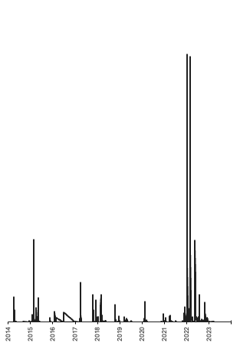
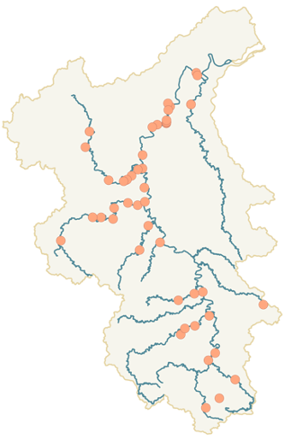
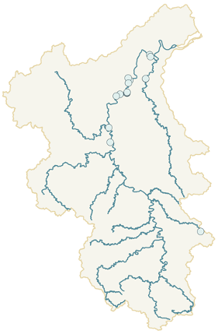
Pre 2022 Tilapia Distribution
Post 2022 Tilapia Distribution
Major Flooding (Mary River)
Case Study:
Mary River floods and invasive freshwater fish
Pre 2022 Tilapia Distribution Post 2022 Tilapia Distribution
Source: BMRG eDNA and fish trap monitoring
Notes:
Why is this is a good comparison? A smaller river system and a different fish.
From a relatively small population and distribution in 2022 a flood event has created a population increase and spread. Something to be wary of in your context if you are doing a focussed section by section approach.
It’s a good study in trying to control a freshwater invasive where biocontrol is not an option. It’s an example of water flow impacting spread and proliferation. In some sections of this river local population reduction has been effective when combined with native restocking and habitat rehabilitation..
For river systems that have had years of bank clearing, dredging or runoff events removal of vital habitat and the bulwark against erosion has created a degradation cycle. Flood events exacerbate this decline cycle by polluting water, displacing native flora and fauna and providing the opportunity for existing tilapia to proliferate in this system to spread upstream and increase their range – displacing native species like endangered cod and turtle populations.
These waterways become dominated by invasive fish that pollute the water degrading its quality and destroying the habitat that supports bank sustaining plant life and native fish that could compete with invasives.
You can see here how the flood event led to spread of invasive fish through the river system into areas previously dominated by cod and shows the interplay of events with population ecology.

Slide 10
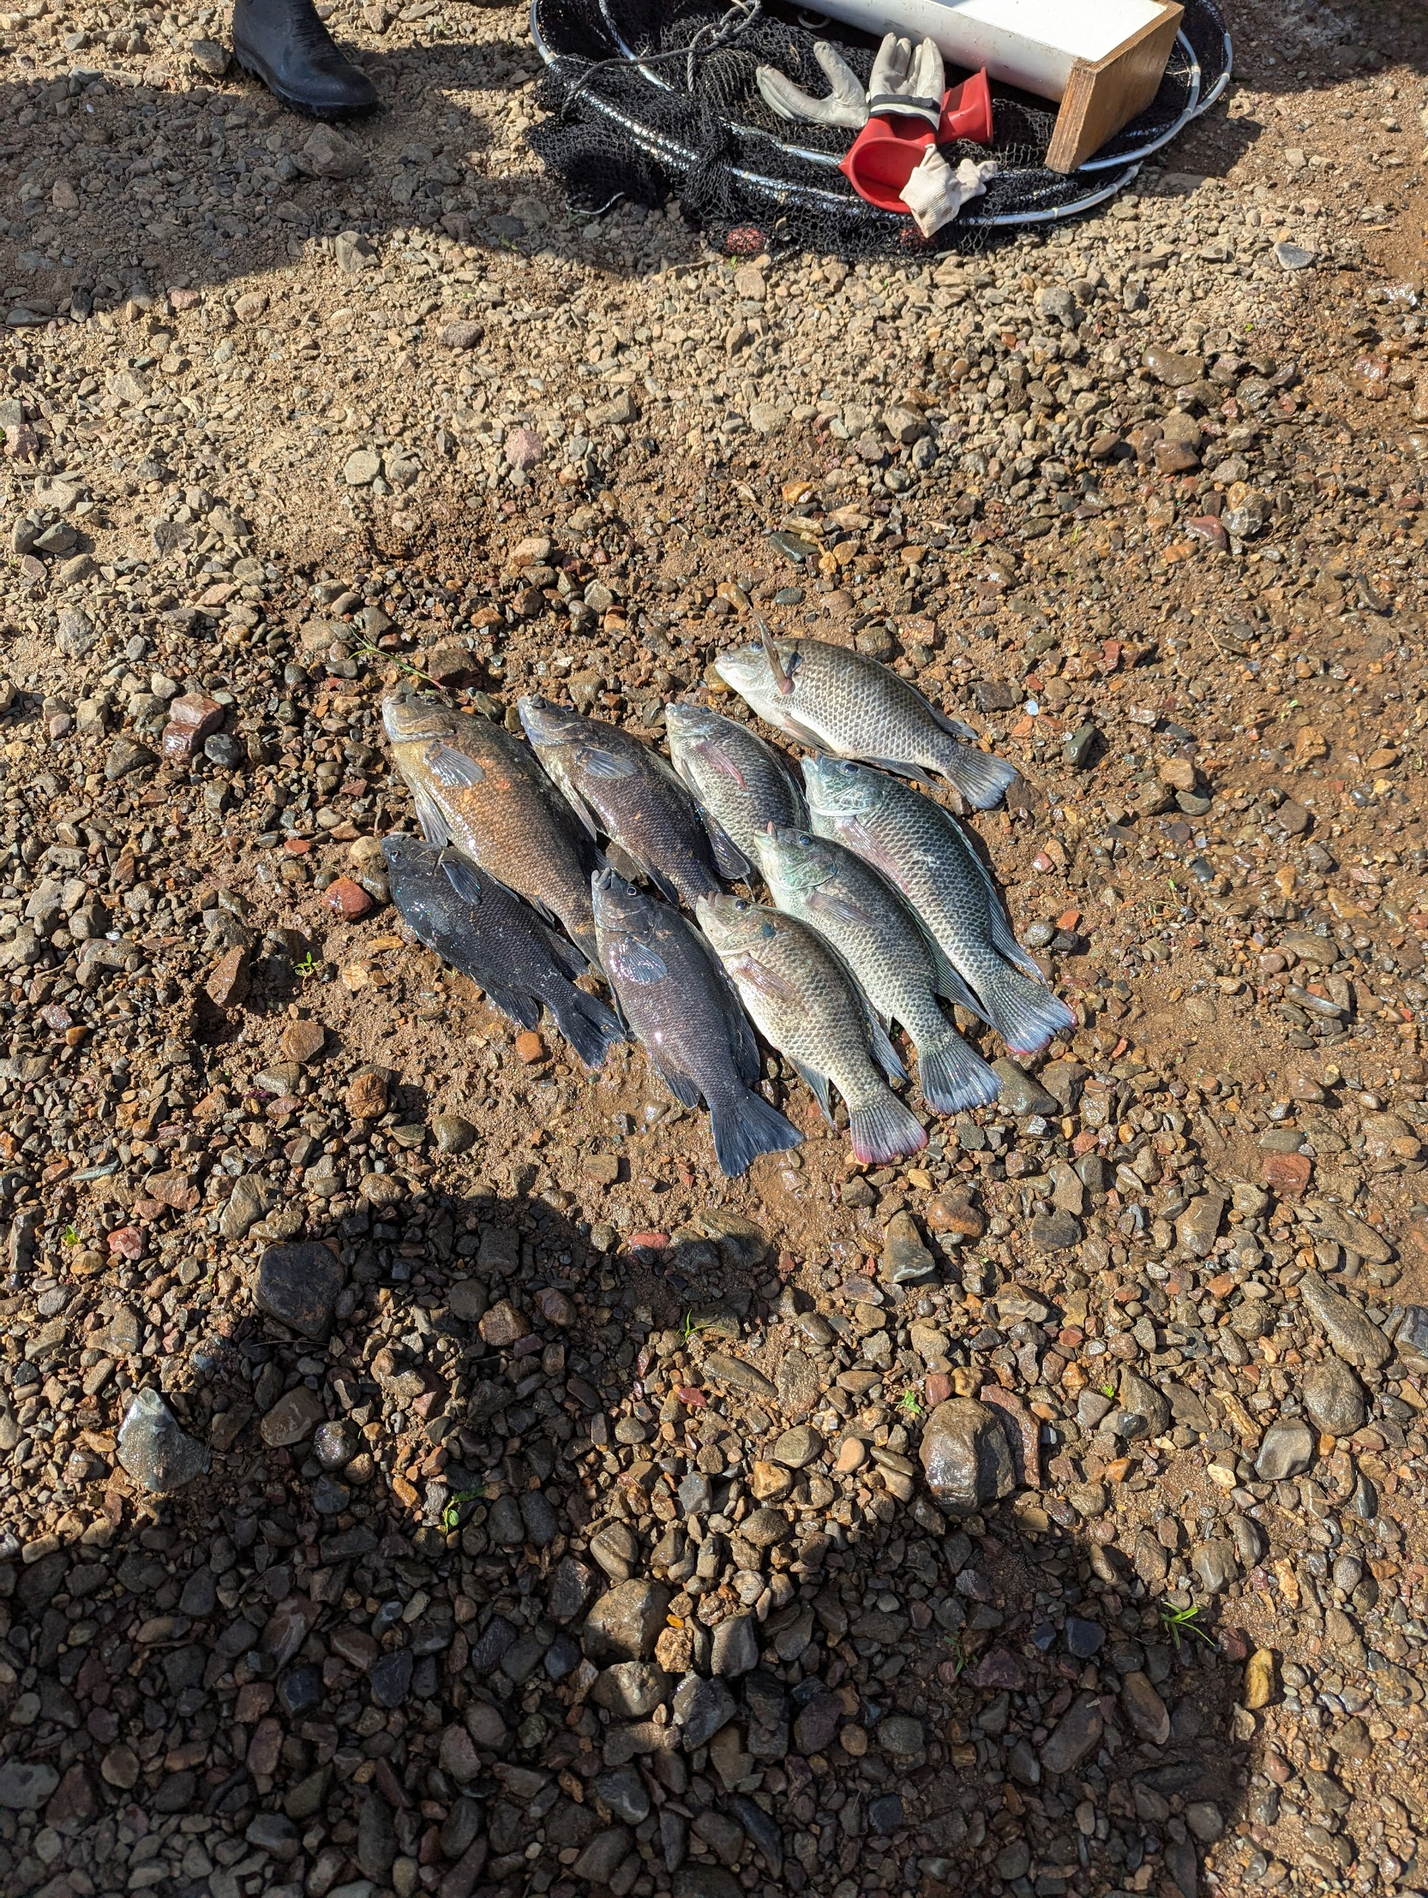
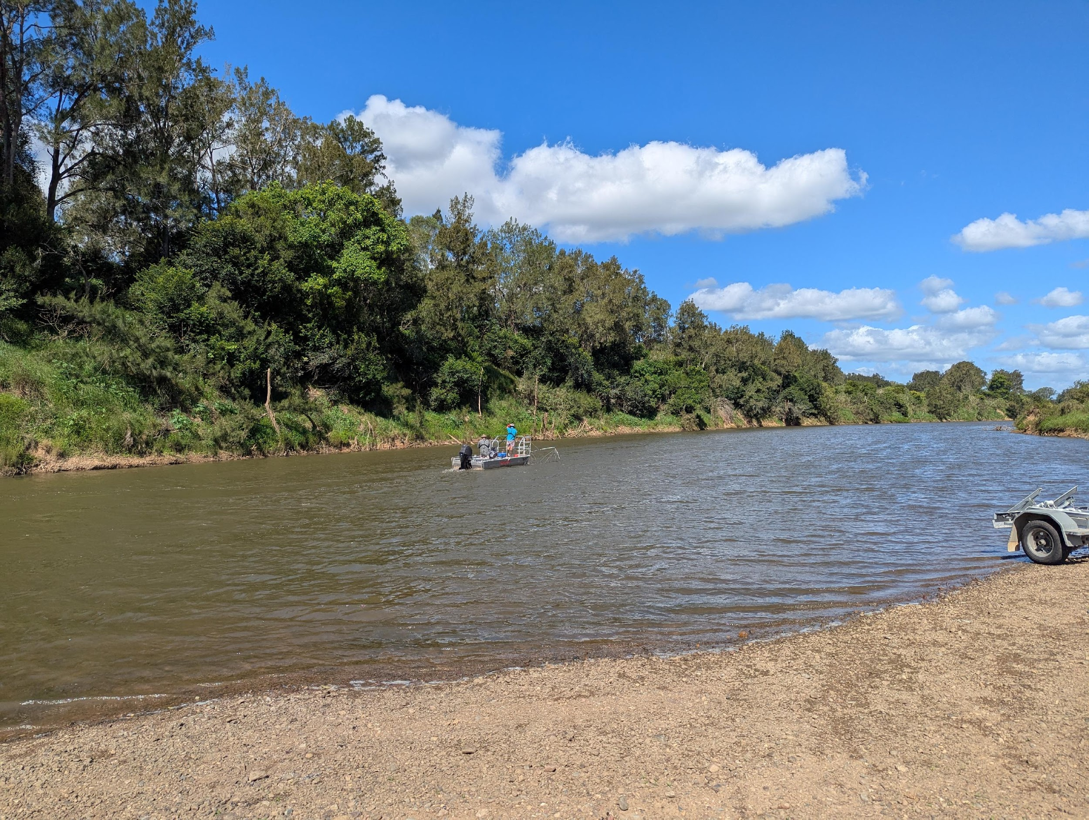
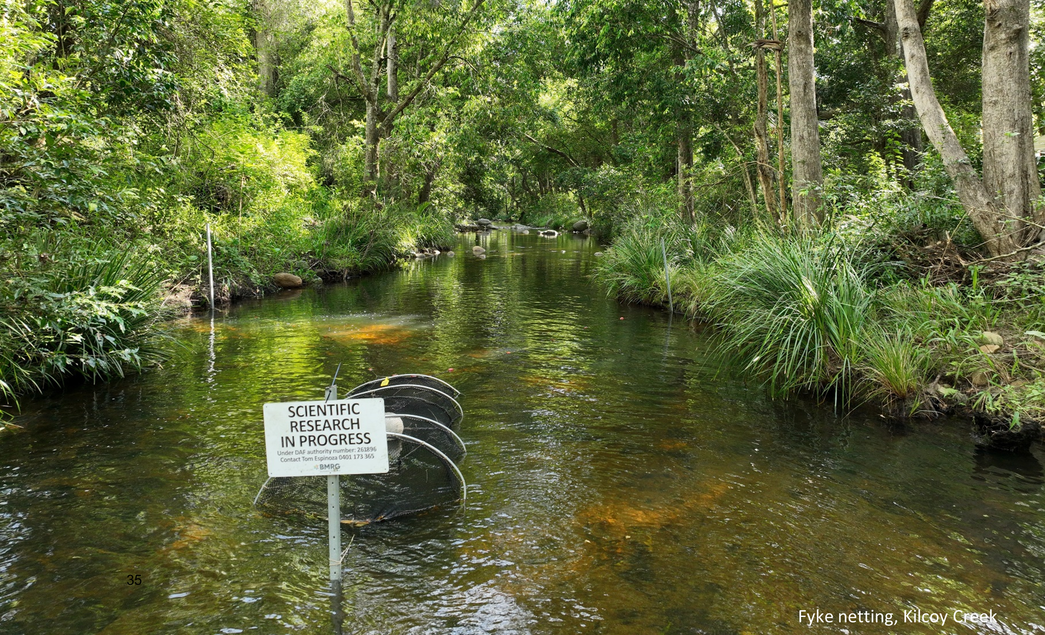
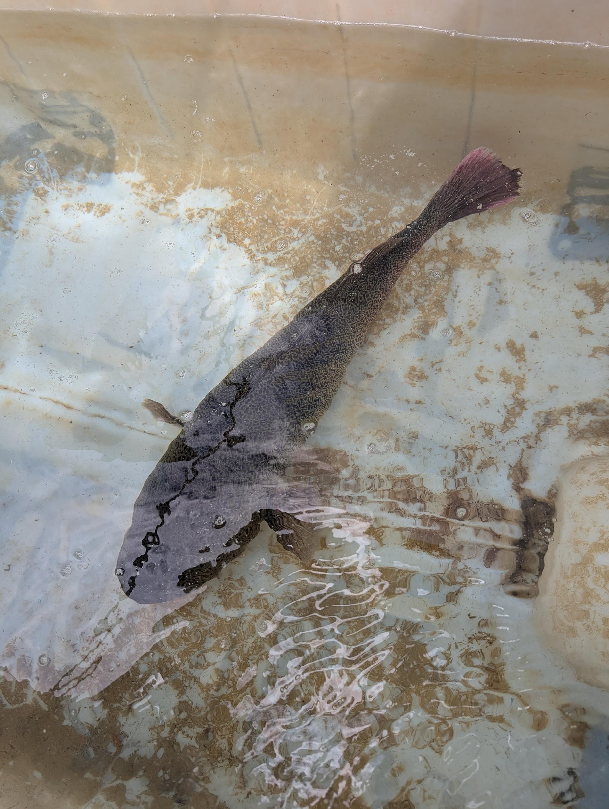
Notes:
Tilapia are not the only invasive fish species in this river - here is an example with sooty grunter, rainbow perch.
Trials are underway using electrofishing and fyke nets to measure populations and develop a response and management plan.
The intention is to build on trials that show how the reintroduction of mature mary cod from nearby restocking facilties can help keep native populations down once they are reduced over several breeding seasons.
To ensure the objectives do not become captured by the need to maintain an ongoing commercial interest arrangement the project being led by traditional owners corporation with horizon and portability of the equipment and facilities is being built into the plan.

Slide 11
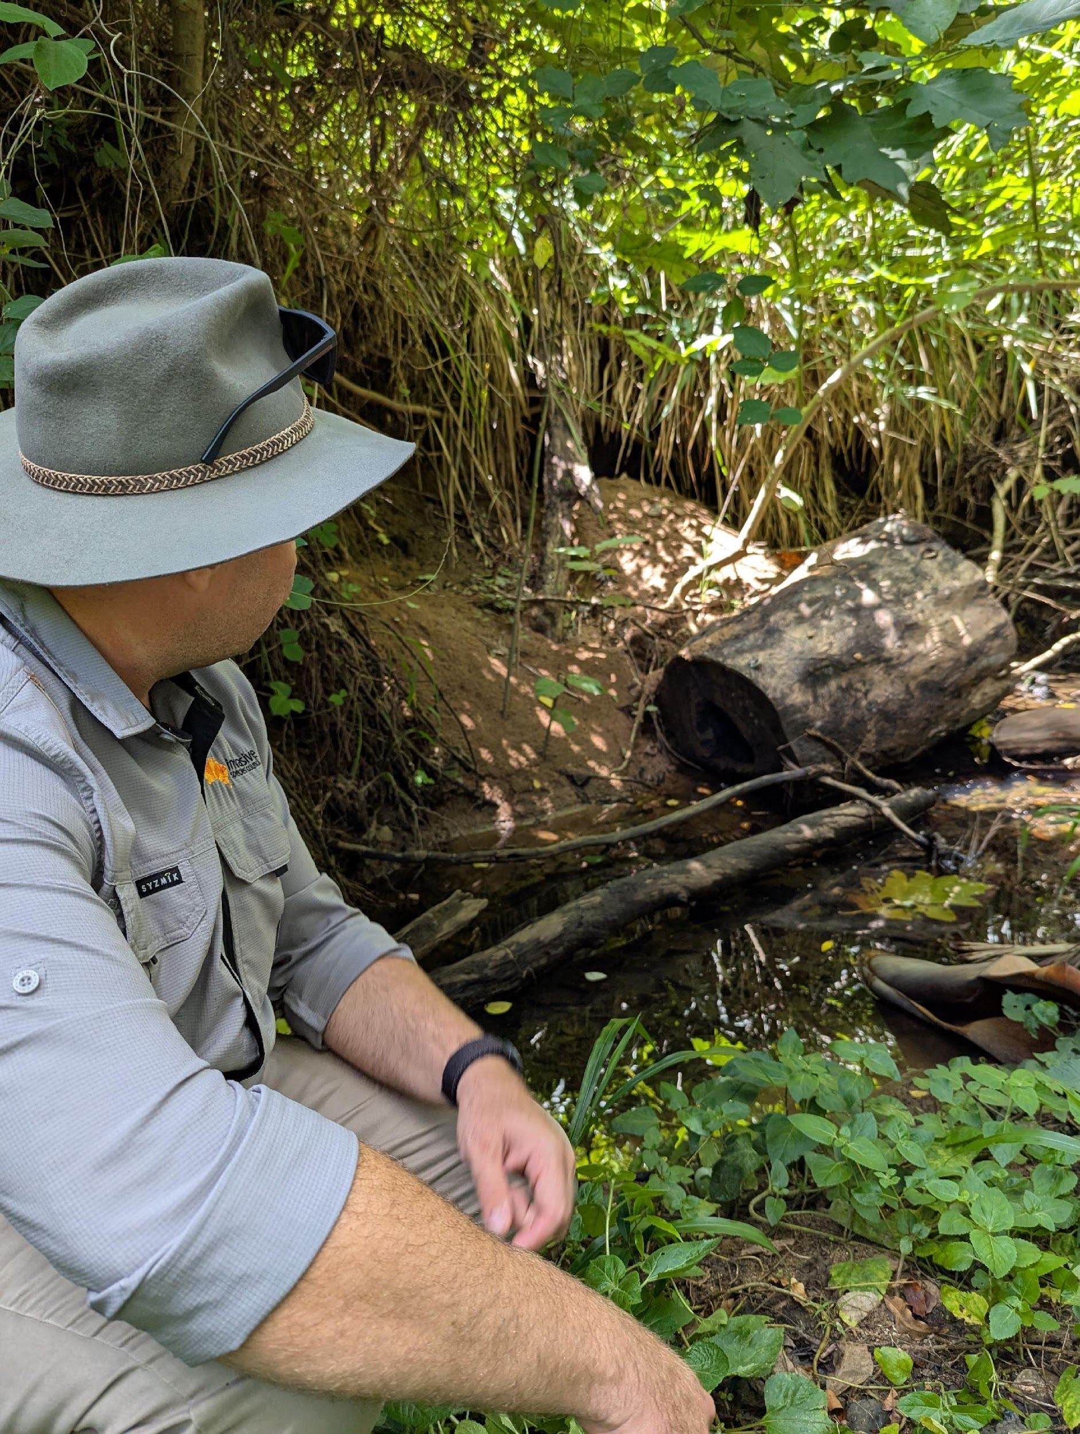
Flood proliferates invasive fish
Increase flood and erosion risk
Native species displaced by flood and invasives
Impact on riparian health
Decline in water quality
Notes:
Invasives drive landscape level degradation cycles so we need landscape scale responses. In this system by aggressively fishing invasives to create space and improve water quality, restoring habitat and undertaking riverbank restoration and then restocking with mature native fish it will be possible to change course and create a more resistant river system.
If we can isolate and reduce invasive populations we can trial and prove management concepts and tools - but the containment is crucial and humans are the x factor here.
This is the kind of landscape level custodianship should be understood as more than just removing an invasive species individually but as the fundamental groundwork for creating resilient landscapes.

Slide 12
Recommendations and priorities:
Consider interventions that break degradation cycles
Avoid commercialisation cul-de-sacs in carp biomass management
Establish demonstration reaches to prove and promote intervention tools
Consider ecological interactions and regulations for other invasive risks
Prioritise ongoing funding for research and funding a deployment and recovery plan - restoration
Reece Pianta
Advocacy Director
0422 935 665
reecep@invasives.org.au
Notes:
So Where is carp control in Australia’s invasive species management landscape? Carp are an established late stage invader in a sea of established new and emerging invasives threats. But what happens next is up to us here. If we can look past silver bullets and super weapons any invasive species control really is about hard work, boots on the ground and eyes in the field.
I leave you with some thoughts and suggestions for some principals to consider
Any approach to managing carp should not do so in isolation. If we take the model of a degradation cycle, we should look for interventions that break that cycle at several points. Habitat restoration and restocking would work hand in glove with tactics that reduce and remove carp biomass – biocontrol could be one of those tools but we don’t need to wait for that
The temptation to find a market solution to invasive species like carp makes common sense but ultimately could lead to a perverse policy outcome where carp populations are protected for their commercial value. Circular economy approaches should prioritise destocking and rehabilitation to create the greatest overall benefit – a NFP or government led model here is probably the only way to quarantine commercial incentives
While I am wary of small virus trial releases and would need convincing that this can be done in a contained way. However – demonstration reaches for an ecological systems restoration approach would be valuable to build confidence and capability and to prepare sections for biocontrol interventions and restocking. Restocking is an essential component here as removal of invasive species can leave a blank slate for the next invader if rehabilitation is not also prioritized in implementation planning
Finally – looking at systems as a whole is probably the only way to deliver meaningful carp control in the long term if we accept that biocontrol won’t be a silver bullet solution. We could remove carp only to find that they repopulation successfully or that another invader takes their place. For example before the advent of carp redfin were implicated in the demise of native fish populations such as Murray cod, silver & golden perch and trout cod. Redfin lay their eggs in sheets that are easily and readily eaten up by foraging carp and carp have been strongly implicated in the reduction of redfin population. Carp removal should also consider management for other invasive fish like redfin.

