Slide 1

A SPEECH BY HELEN DALTON MP
CARPe DIEM
IT'S TIME TO SEIZE THE CARP
350 million carp are ripping the guts out of the Murray-Darling.
The science is done. The solution is ready. It's time to act.

Slide 2
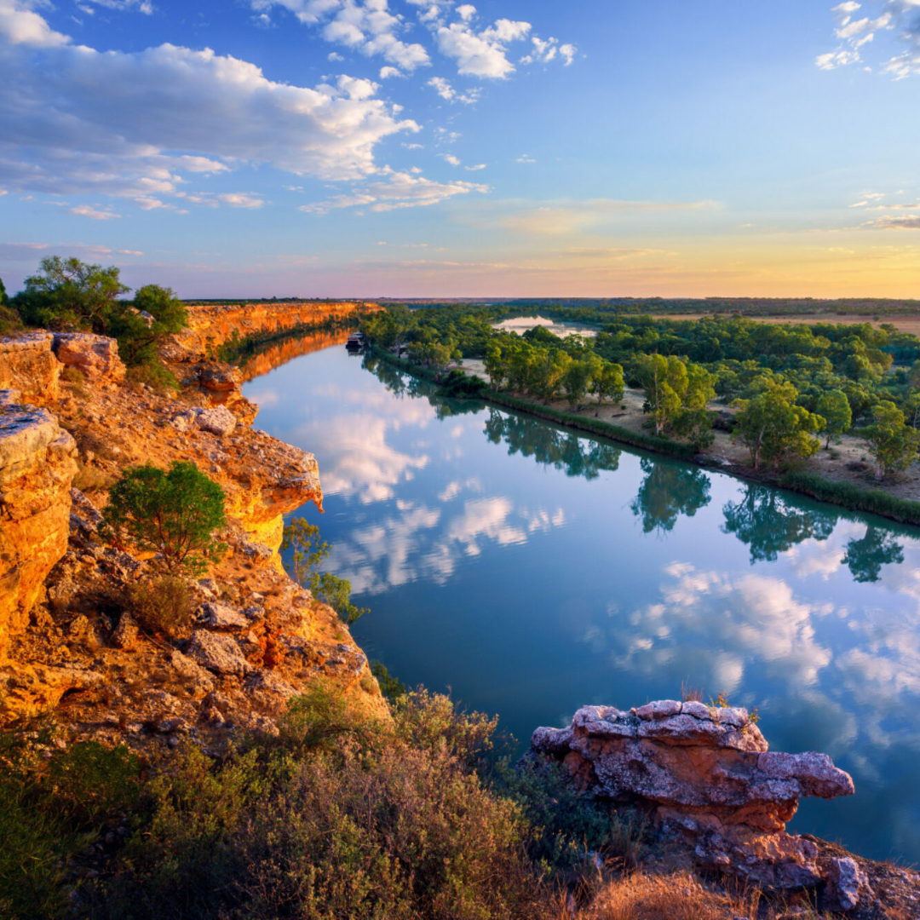
DO THE MATHS
145 CARP
PER PERSON
2.4 million Australians live in the Murray-Darling Basin.
For every one of us, there are 145 carp.
"I want my 145 carp dead, immediately. I am sure you do too."
HELEN DALTON MP | INDEPENDENT MEMBER FOR MURRAY
2 / 12

Slide 3
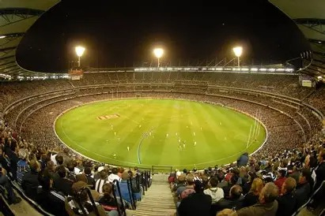
THE SCALE
350 MILLION CARP
3.5 x MCG
Enough carp to fill the MCG three and a half times over.
Packed in. Floor to rafters. Wall to wall with fish.
HELEN DALTON MP | INDEPENDENT MEMBER FOR MURRAY
3 / 12

Slide 4
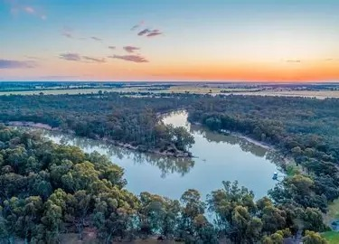
THE DAMAGE
60-90%
OF ALL FISH IN PARTS OF THE MURRAY ARE CARP
"Like teenagers who break into your house, trash the place, and refuse to leave."
DR JOHN CONALLIN, CHARLES STURT UNIVERSITY
HELEN DALTON MP | INDEPENDENT MEMBER FOR MURRAY
4 / 12

Slide 5
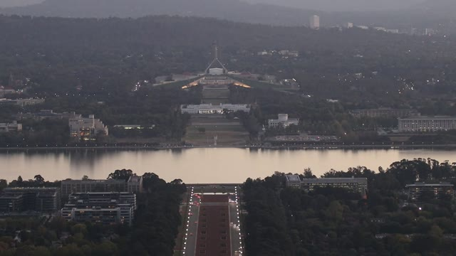
THE BLOCKAGE
POLITICS
IS PROTECTING THE CARP
If 90% of Sydney Harbour were littered with carp,
it would be declared a national crisis.
Timid politicians would rather watch rural Australia die
than do what is needed to make our regions flourish.
HELEN DALTON MP | INDEPENDENT MEMBER FOR MURRAY
5 / 12

Slide 6
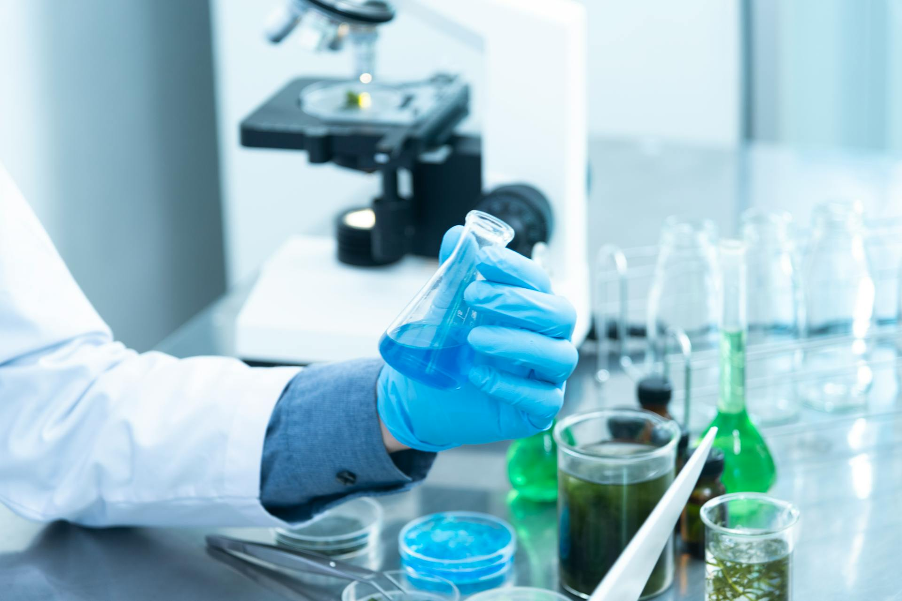
THE SOLUTION
CyHV-3
40-60% knockdown of carp populations. Science done. Safety done.
CARP ONLY
NATIVES SAFE
HUMAN SAFE
Targets common carp. Nothing else.
Native fish and freshwater species unaffected.
Cannot infect people. Cannot affect livestock.
HELEN DALTON MP | INDEPENDENT MEMBER FOR MURRAY
6 / 12

Slide 7
SPEND A LITTLE TO SAVE A LOT
THE FIX
THE FAILURE
$800M - $2B
$6-7B
ONE-OFF
OVER A DECADE
Science-led virus release
+ cleanup
+ coordinated strategy
$500M a year buying water to flush carp.
It is not working.
HELEN DALTON MP | INDEPENDENT MEMBER FOR MURRAY
7 / 12

Slide 8
BROKEN PRIORITIES
$20 BILLION
FOR SNOWY HYDRO 2.0
$2B
$10B
$5B
Original budget
Blowout to date
Still needed
Government found $20 billion for a hydro scheme years behind schedule.
It cannot find the money to save our rivers.
HELEN DALTON MP | INDEPENDENT MEMBER FOR MURRAY
8 / 12

Slide 9
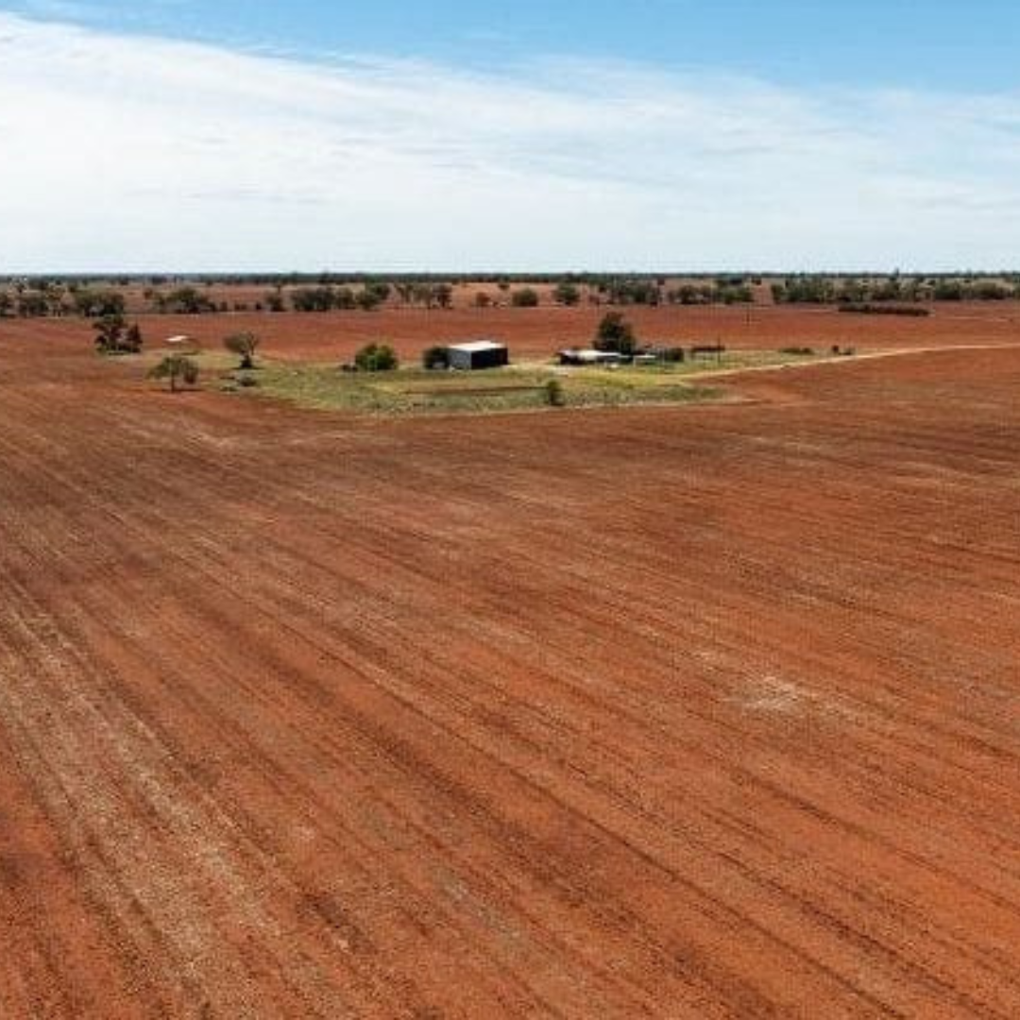
THE HUMAN COST
IT'S NOT JUST FISH
Carp destroy food, jobs, and our health.
FOOD SECURITY
ALGAE BLOOMS
OUR HEALTH
Hundreds of billions in lost food production, processing, and jobs.
Blue-green algae makes rivers and lakes unusable every summer.
Rising motor neurone disease risk. Mental toll of a dying environment.
HELEN DALTON MP | INDEPENDENT MEMBER FOR MURRAY
9 / 12

Slide 10
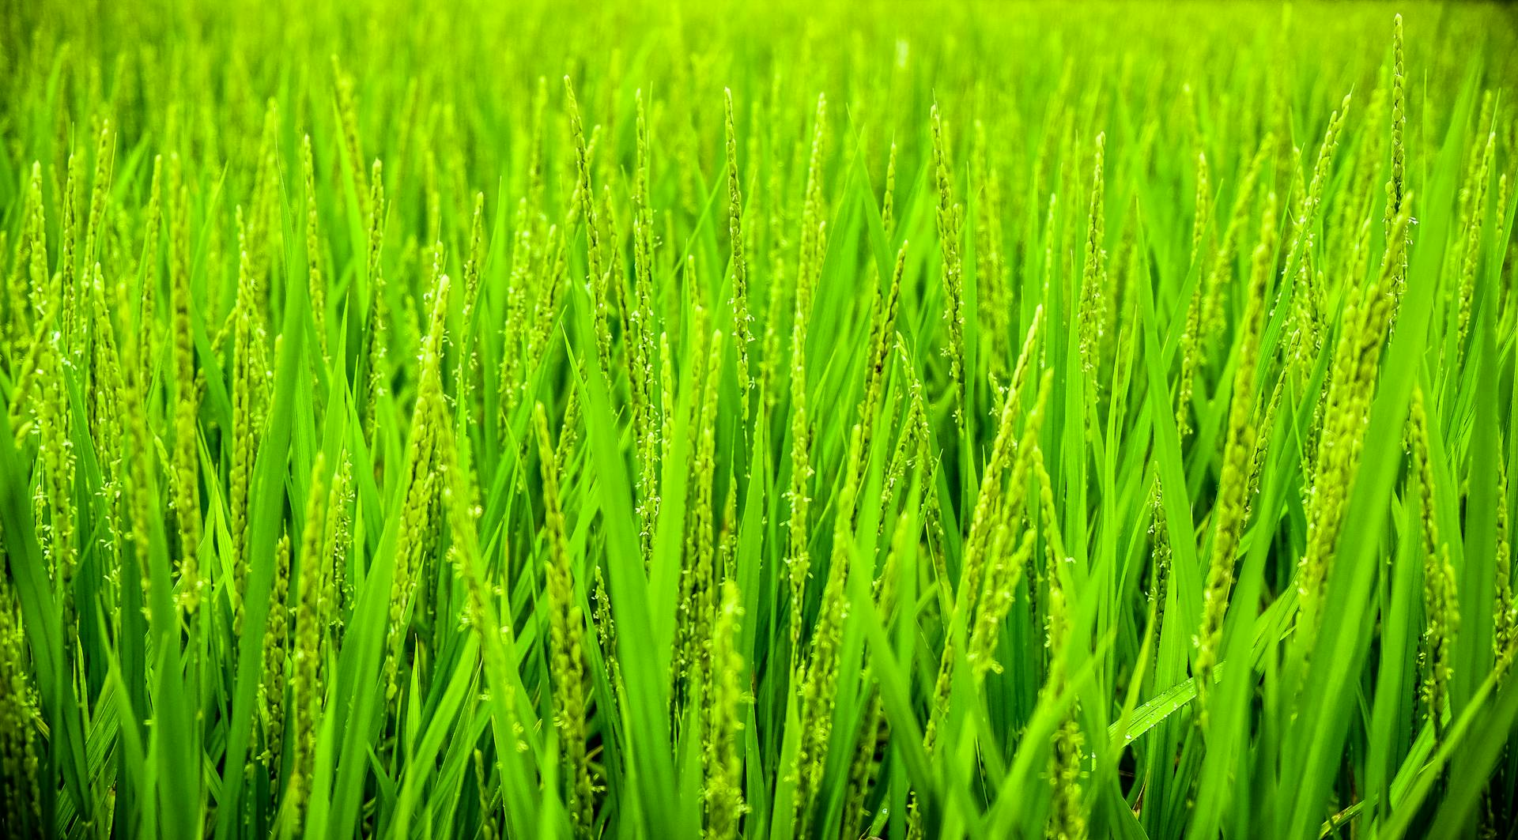
FEDERAL FAILURE
PLIBERSEK. WATT. MINNS.
Same failed policies. Same wasted billions. Same broken river.
The Lower Murray is now classified critically endangered.
Their policies are not working. Our money is funding complete failure.
WE NEED A FEDERAL ROYAL COMMISSION INTO WATER
NSW Parliament voted for one. Premier Minns still has not acted.
HELEN DALTON MP | INDEPENDENT MEMBER FOR MURRAY
10 / 12

Slide 11
WHAT WE NEED FROM CANBERRA
THREE THINGS
01
02
03
APPROVE CyHV-3
COORDINATED STRATEGY
ROYAL COMMISSION
The carp virus. Science, safety, modelling all done. No legitimate reason to delay.
Commercial harvesting, barriers, genetic tech, and community carp musters alongside the virus.
Federal Royal Commission into Australian water management. Full truth under oath.
No single tool fixes this. A coordinated effort can.
HELEN DALTON MP | INDEPENDENT MEMBER FOR MURRAY
11 / 12

Slide 12
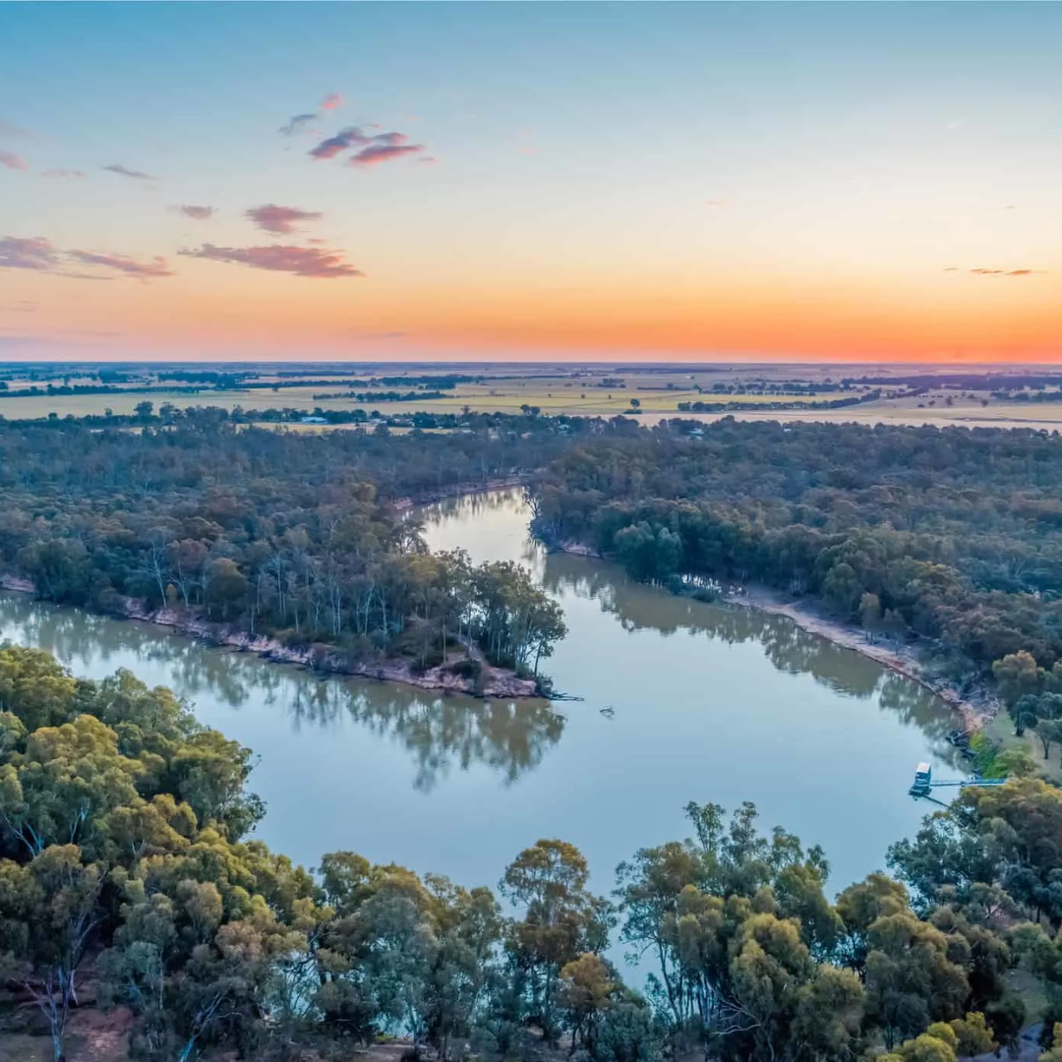
TAKE BACK OUR RIVERS
ACT NOW.
The future of rural Australia,
and therefore all of Australia, is at stake.
HELEN DALTON MP | INDEPENDENT MEMBER FOR MURRAY
12 / 12

